Slide 1
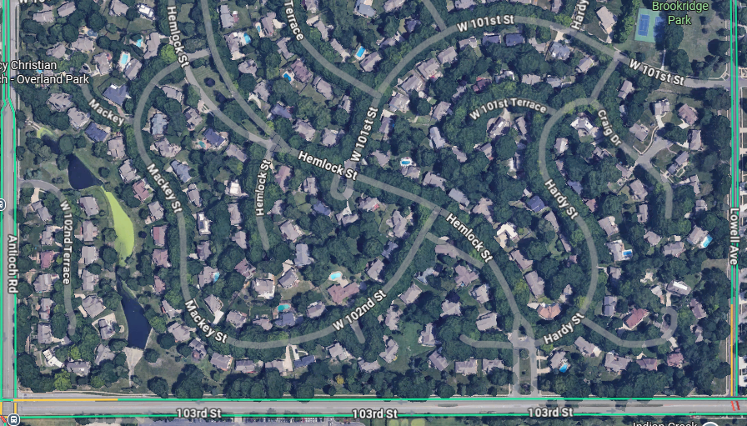
Mishloakh Manot
Notes:
Great blessing and success

Slide 2
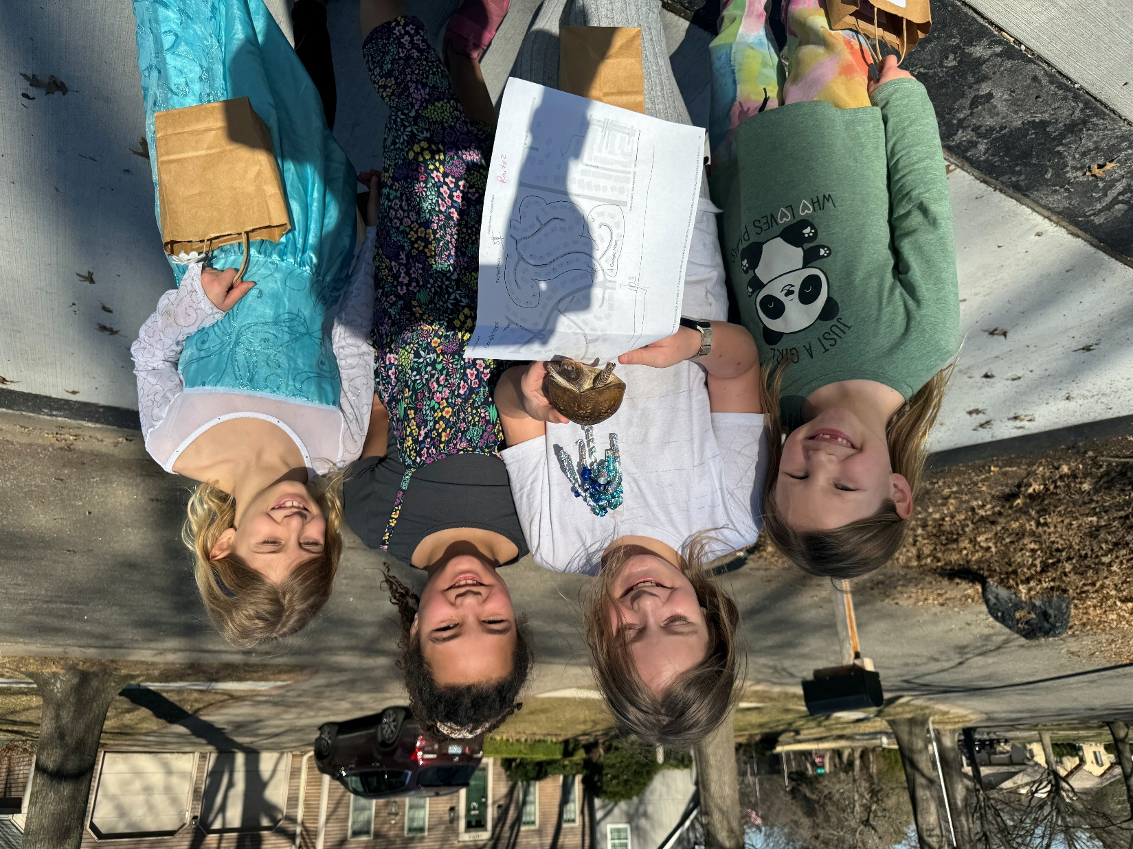
Our Mishloakh Manot Ingathering/
Outreach and a neighborhood girl and pet turtle
Notes:
3 mishloakh manot bags. Please stand if you helped pack or distribute. Especially Amy.

Slide 3


Slide 4
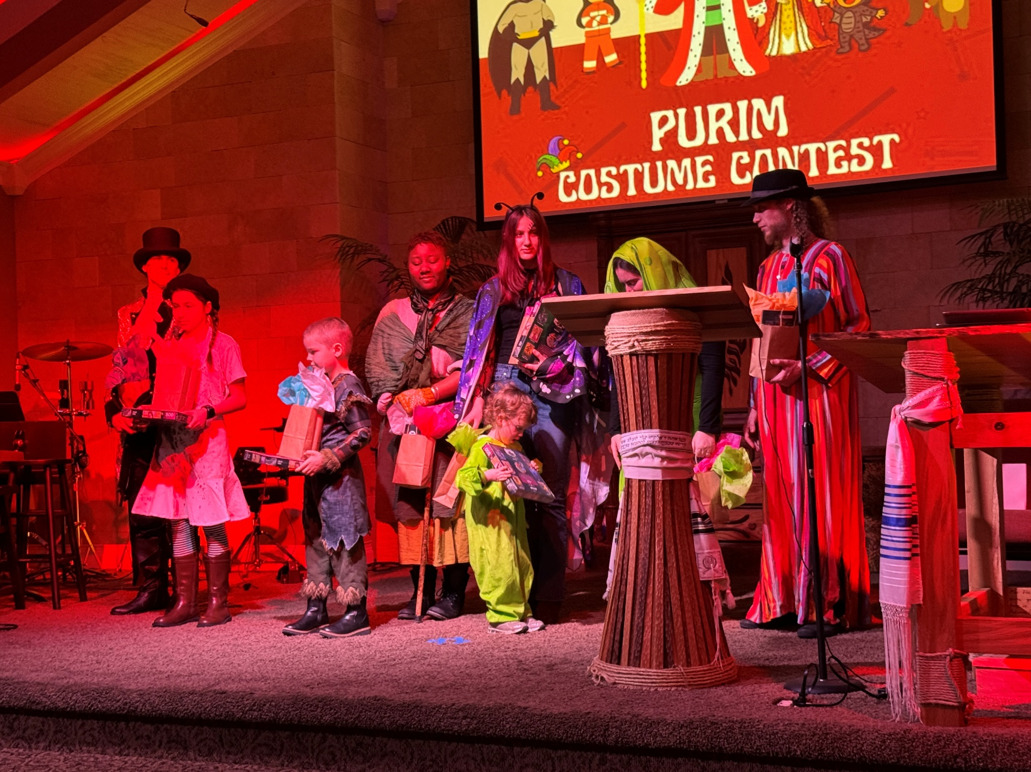
Purim costume winners
Notes:
Marcos, Sadie, Ben, Genesis, Addi, ??, Y’hoshua
If you helped set up or worked on Purim, please stand. Especially Angela.

Slide 5


Slide 6

The Fullness of all that G-d is
Timeless Revelation of His Glory
Medieval Revelation of His Glory
Application of Revelation of
His Glory
4. Outworking of the Revelation of
His Glory

Slide 7
The Fullness of all that G-d is
Timeless Revelation of His Glory
Medieval Revelation of His Glory
Application of Revelation of
His Glory
4. Outworking of the Revelation of
His Glory

Slide 8
^{Col. 2.8-10} Watch out, so that no one will take you captive by means of philosophy and empty deceit, following human tradition which accords with the elemental spirits of the world but does not accord with the Messiah.
Notes:
So many ways to get sidetracked.

Slide 9
^{Col. 2.8-10} For in him, bodily, lives the fullness of all that God is. And it is in union with him that you have been made full — he is the head of every rule and authority.
Notes:
It’s all about Messiah.
Even the ancient rabbis wrote…

Slide 10
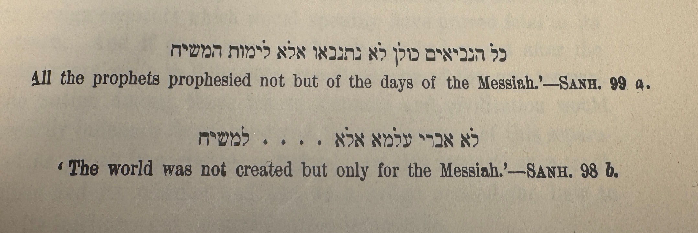
Alfred Edersheim, Life and Times of Jesus the Messiah
Notes:
It’s all about Messiah.

Slide 11
^{Phil 2.10-11} At the name of Yeshua every knee should bow, in heaven and on the earth and under the earth, and every tongue profess that Yeshua the Messiah is Lord— to the glory of God the Father.
Notes:
This is what I am consumed with, when I work out at the gym, visit family, consider the world.

Slide 12
^{Yeshayahu/Is 45.21b- 25} There is no other God besides me, a just God and a Savior; there is none besides me. Look to me, and be saved, all the ends of the earth! For I am God; there is no other. In the name of myself I have sworn, from my mouth has rightly gone out, a word that will not return —

Slide 13
^{Yeshayahu/Is 45.21b- 25} that to me every knee will bow and every tongue will swear about me that only in Adoni are justice and strength.” All who rage against him will come to him ashamed, but all the descendants of Isra’el will find justice and glory in Adoni.
Notes:
And those grafted in

Slide 14
^{Mtt 17.1-2} Six days later, Yeshua took Kefa, Ya‘akov and his brother Yochanan and led them up a high mountain privately. As they watched, he began to change form — his face shone like the sun, and his clothing became as white as light.

Slide 15
^{Mtt 17.5-8} While he was still speaking, a bright cloud enveloped them; and a voice from the cloud said, “This is my Son, whom I love, with whom I am well pleased. Listen to him!” When the talmidim heard this, they were so frightened that they fell face down on the ground.

Slide 16
^{Mtt 17.5-8} But Yeshua came and touched them. “Get up!” he said, “Don’t be afraid.” So they opened their eyes, looked up and saw only Yeshua by himself.
Notes:
How some groups get “Yeshua only” from this is amazing. Yeshua just heard from a separate Person, “This is my Son.”

Slide 17
^{Yn 17.1-3} After Yeshua had said these things, he looked up toward heaven and said, “Father, the time has come. Glorify your Son, so that the Son may glorify you — just as you gave him authority over all mankind,
Notes:
His basic purpose!

Slide 18
^{Yn 17.1-3} so that he might give eternal life to all those whom you have given him. And eternal life is this: to know you, the one true God, and him whom you sent, Yeshua the Messiah.
Notes:
In your spirit, close your eyes, or not, and talk to Him!!

Slide 19
^{Yn 17.13} Now, I am coming to you; and I say these things while I am still in the world so that they may have my joy made complete in themselves.

Slide 20
^{Yn 17.16-24} They do not belong to the world, just as I do not belong to the world. Set them apart for holiness by means of the truth — your word is truth. Just as you sent me into the world, I have sent them into the world. On their behalf I am setting myself apart for holiness,

Slide 21
^{Yn 17.16-24} so that they too may be set apart for holiness by means of the truth. “I pray not only for these, but also for those who will trust in me because of their word, that they may all be one. Just as you, Father, are united with me and I with you, I pray that they may be united with us, so that the world may believe that you sent me.
Notes:
Raleigh Washington, of Promise Keepers fame, who we have hosted at Or HaOlam at least twice, says “these and those” Jews and Gentiles.

Slide 22
^{Yn 17.16-24} The glory which you have given to me, I have given to them; so that they may be one, just as we are one — I united with them and you with me, so that they may be completely one, and the world thus realize that you sent me, and that you have loved them just as you have loved me.
Notes:
How has he given His glory to us??

Slide 23
^{Yn 17.16-24} “Father, I want those you have given me to be with me where I am; so that they may see my glory, which you have given me because you loved me before the creation of the world.
Notes:
Where He is, apparently in the spirit.

Slide 24
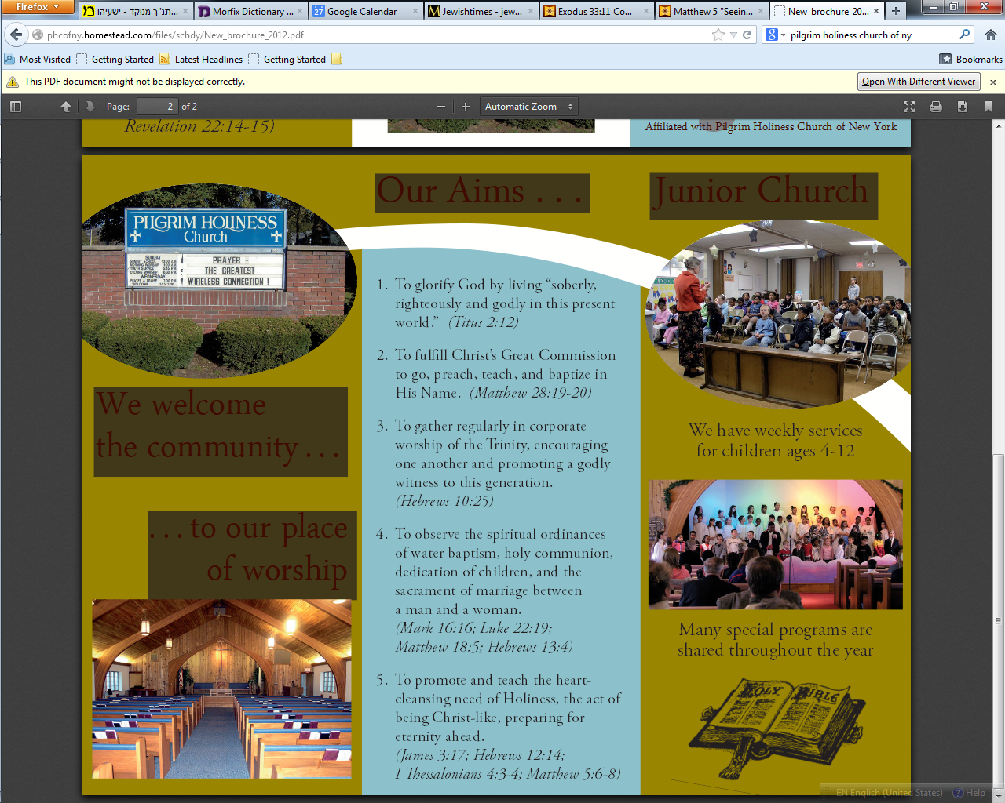
Pilgrim Holiness Church
Schenectady, NY
Notes:
Golden glow up in the laminated rafters. “Cloud of liquid love.” April 13, 1969 I experienced New Birth. Many young people similarly seeking. Yeshua Revolution.
Went home few weeks later. “Mom, Dad, I’ve found the answer to life’s problems. It’s not in drugs, or revolution, but in the love of Jesus Christ.”
Sent me to psychiatrist.
“You’re worse than Hitler. He destroyed our bodies. You are destroying our souls.”
But, what about Jewishness? “Put on altar” I’ll figure out the Jewish piece later. Need to get the salvation piece. Later, I learned…

Slide 26
The Fullness of all that G-d is
Timeless Revelation of His Glory
Medieval Revelation of His Glory
Application of Revelation of
His Glory
4. Outworking of the Revelation of
His Glory

Slide 27
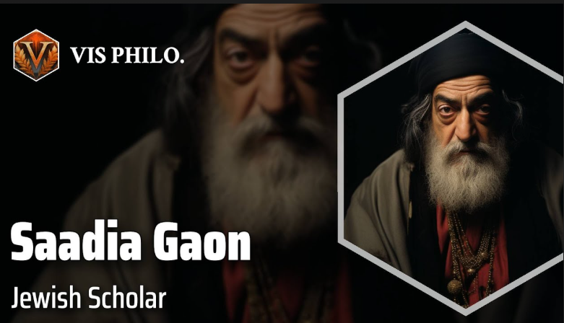
892-942, Egypt

Slide 28
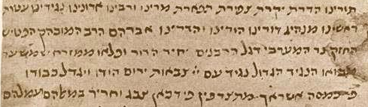
Saadia is the first important rabbinic figure to write extensively in Judeo-Arabic.
Notes:
Arabic in Hebrew letters.
~Yiddish is German in Hebrew letters.
~Judeo Farsi: Persian in Hebrew letters.

Slide 29
  ^{Mes. Jews/Heb. 1.1-3} The Son is the radiance of God's glory and the exact representation of his being,
Notes:
Owner of the universe
Designer Logos, Davar, equations.
Better than Moshe

Slide 30
^{Mes. Jews/Heb. 1.1-3} being the effulgence of his glory, and the very image of his substance, ^{ASV}
Solar flares

Slide 31
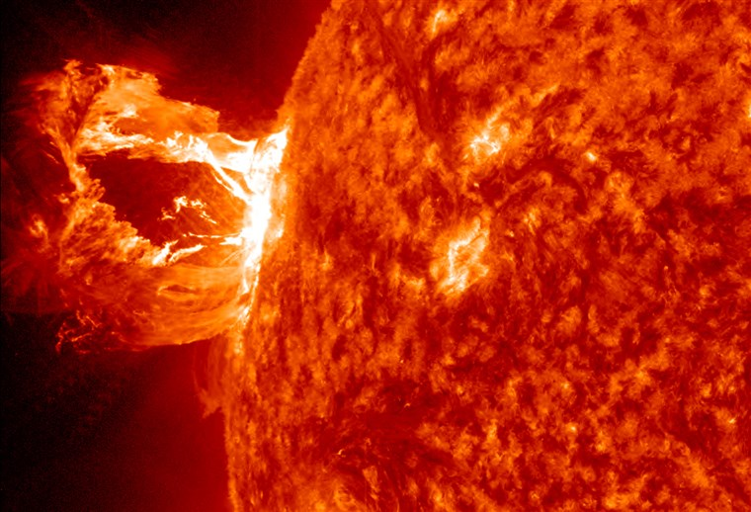
Notes:
Solar flares ARE the sun, same thermonuclear reaction happening. The texture you see on the sun’s surface are the edges of magnetic loops. Some break out in flares.

Slide 32
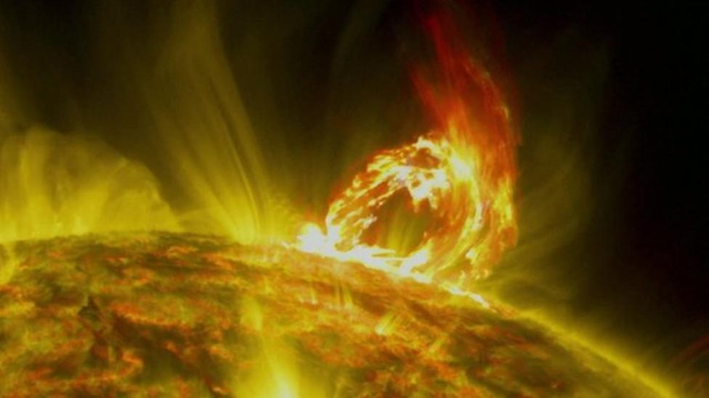
Notes:
Magnetic field and magnetic lines projecting out.
Jewish objection: a man can’t make himself G-d. Not the incarnation at all. G-d extending out.
Effulgence.

Slide 33

Aug. 21, 2017
Notes:
A bunch of us went to see the corona in the full eclipse of Aug. 2017. Prayed for clouds to dissipated, but only when blew shofars cleared up. Then torrential rain. Saw it.
Talking about seeing something MUCH more glorious.

Slide 34
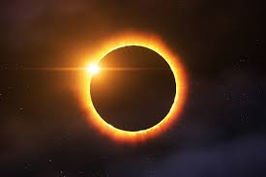

Slide 35
David Stern: This Son is the radiance of, literally, “the glory,” best rendered Jewishly as the Sh’khinah, which the Encyclopedia Judaica ^{(Volume 14, pp. 1349–1351)} defines as
Notes:
Solar flare consumes all
This effulgence
Enlightens all
Convicts all of sinfulness
Redeems all

Slide 36
“the Divine Presence, the numinous immanence of God in the world, … a revelation of the holy in the midst of the profane ….”
Notes:
Solar flare consumes all
This effulgence
Enlightens all
Convicts all of sinfulness
Redeems all

Slide 37
^{Encyclopedia Judaica} “One of the more prominent images associated with the Shekhinah is that of light. Thus, on the verse, ‘ … the earth did shine with His glory’ (Ezekiel 43:2), the rabbis remark, ‘This is the face of the Shekhinah’ (Avot diRabbi Natan [18b–19a]; see also Chullin 59b–60a).

Slide 38
^{Encyclopedia Judaica} Both the angels in heaven and the righteous in olam ha-ba (‘the world to come’) are sustained by the radiance of the Shekhinah (Exodus Rabbah 32:4, B’rakhot 17a; cf. Exodus 34:29–35) ….

Slide 39
“According to Saadiah Gaon [882–942 c.e.], the Shekhinah is identical with kevod Adoni
כבוד יי (‘the glory of God’), which served as an intermediary between God and man during the prophetic experience.

Slide 40
Saadia suggests that the ‘glory of God’ is the biblical term, and Shekhinah the talmudic term for the created splendor of light which acts as an intermediary between God and man, and which sometimes takes on human form.

Slide 41
Thus when Moses asked to see the glory of God, he was shown the Shekhinah, and when the prophets in their visions saw God in human likeness, what they actually saw was…the Shekhinah.
Notes:
(see Saadiah’s interpretation of Ezekiel 1:26, 1 Kings 22:19, and Daniel 7:9 in Book of Beliefs and Opinions 2:10).”
The Jewish New Testament Commentary, (Clarksville, MD: Jewish New Testament Publications) 1996.

Slide 42
Moshe prayed: Show me your glory.
Hareni et kvodekha
הַרְאֵנִי נָא אֶת-כְּבֹדֶךָ.

Slide 43
^{Col 1.15-17} He is the visible image of the invisible God. He is supreme over all creation, because in connection with him were created all things — in heaven and on earth, visible and invisible, whether thrones, lordships, rulers or authorities —

Slide 44
Perceiving His face is the basis of the Aharonic blessing:

Slide 45
יָאֵר יְיָ פָּנָיו אֵלֶיךָ וִיחֻנֶּךָּ. יִשָּׂא יְיָ פָּנָיו אֵלֶיךָ וְיָשֵׂם לְךָ שָׁלוֹם.
^{Bamidbar/Nu 6.24-26} Adoni bless you and keep you! Adoni make His face to shine on you and be gracious to you! Adoni turn His face toward you and grant you shalom!’

Slide 47
The Fullness of all that G-d is
Timeless Revelation of His Glory
Medieval Revelation of His Glory
Application of Revelation of
His Glory
4. Outworking of the Revelation of
His Glory

Slide 48
A pillar of a believer’s life is how he / she perceives the welcoming face of Messiah.
Notes:
Key to this message

Slide 49
^{T’hillim / Ps 27.4} One thing have I asked of Adoni, that will I seek: to dwell in the House of Adoni all the days of my life, to behold the beauty of Adoni, and to meditate in His Temple.

Slide 50
^{T’hillim / Ps 90.16-17} Let Your work appear to Your servants, and Your splendor הֲדָרְךָ hadarkha [glory, splendor, majesty] on their children. Let the נֹעַם noam beauty [loveliness,kindness, pleasantness, charm] of Adoni our G-d be upon us.
Notes:
This is the key to communicating Messiah to the next generation.
What do our children see in us, and our community?

Slide 51
^{2 Cor 4.6} For it is the God who once said, “Let light shine out of darkness,” who has made his light shine in our hearts, the light of the knowledge of God’s glory shining in the face of the Messiah Yeshua.

Slide 52
Seeing His face is the foundation of good.

Slide 53
^{2 Cor 3.18} So all of us, with faces unveiled, see as in a mirror the glory of the Lord; and we are being changed into his very image, from one degree of glory to the next, by Adoni the Spirit.

Slide 54
^{Phil 3.7-8} The things that used to be advantages for me, I have, because of the Messiah, come to consider a disadvantage. Not only that, but I consider everything a disadvantage in comparison with the supreme value of knowing the Messiah Yeshua as my Lord.

Slide 55
His Face is the source of joy.
Notes:
Affirmation from G-d, not people. Me “needy guy”. Some marriages are two vacuum cleaners.

Slide 56
^{T’hillim/Ps 4.7-9} Many ask, “Who can show us some good?” Adoni, lift the light of your face over us!
You have filled my heart with more joy than all their grain and new wine. I will lie down and sleep in peace; for, Adoni, you alone make me live securely.
Notes:
Formula for overcoming sleeplessness:
Memorizing as bedtime is a powerful tool. You just take three of four words and recite them till they are embedded in memory. Then add the next three or four the next night. Cumulatively, you'll have a passage in a week!
That has three effects:
it's tiring mental labor that makes you sleepy,
it's the Word of G-d, so as your focus on it, you have insights that give shalom,
if there is any demonic influence that is affecting you, the demon sees that he's driving you to the Word, and will go away.
Psalm 3 and psalm 4 both discuss sleeping, and are GREAT for this.

Slide 57
“Without having seen him, you love him. Without seeing him now, but trusting in him, you continue to be full of joy that is glorious beyond words

Slide 58
Seeing His Face is the source motivation to conflict resolution.

Slide 59
^{Yn 17.3, 22-24} Eternal life is this: to know you, the one true God, and him whom you sent, Yeshua the Messiah… The glory which you have given to me, I have given to them; so that they may be one, just as we are one —
Notes:
Think of someone you are at odds with. How will you relate to that person if Messiah was in the room with you!

Slide 60
^{Yn 17.3, 22-24} I united with them and you with me, so that they may be completely one, and the world thus realize that you sent me, and that you have loved them just as you have loved me. “Father, I want those you have given me to be with me where I am;

Slide 61
^{Yn 17.3, 22-24} so that they may see my glory, which you have given me because you loved me before the creation of the world.
Notes:
In the great revival of the 1700’s, John Wesley founder of Methodism [name of derision], urged that Messiah’s followers would love the children of the world with all their sensuality, and love the children of G-d with all their weaknesses.

Slide 62
His Face is the source motivation to GO, to reach out.

Slide 63
^{Yesh/Is 6} In the year of King ‘Uziyahu’s death I saw Adoni sitting on a high, lofty throne! … Seraphs [cried] “Holy, holy, holy, is Adoni-Tzva’ot! The whole earth is full of His glory…So I said, “Hineni. Send me.”

Slide 64
^{Rev. 20.11} Then I saw a great white throne and the one who is seated on it. Before his face both earth and heaven fled away, and no place was found for them…Anyone whose name was not found written in the Book of Life was hurled into the lake of fire.
Notes:
Knowing the terror of Adoni, we persuade men.

Slide 65
Seeing His face is the motivation to purity.

Slide 66
^{1 Yn 3.2-3} We shall be like Him, because we will see Him just as He is. Everyone who has this hope in Him purifies himself, just as He is pure.
^{Mtt 5.8} “How blessed are the pure in heart! for they will see God.
Notes:
So here I will mention purity of speech, especially from the bima, the pulpit. Words like c-r-a-p, gosh, golly, sissy swearing are really not appropriate.

Slide 67
Look within you’ll be depressed.
Look around you’ll be distressed.
Look to Yeshua and you’ll be at rest, and blessed!

Slide 69
The Fullness of all that G-d is
Timeless Revelation of His Glory
Medieval Revelation of His Glory
Application of Revelation of
His Glory
4. Outworking of the Revelation of
His Glory

Slide 70
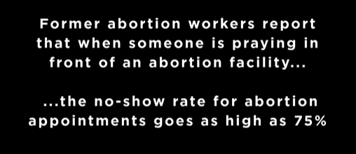
Notes:
https://vimeo.com/1154049529
Why? Unseen, but perceived GLORY

Slide 71
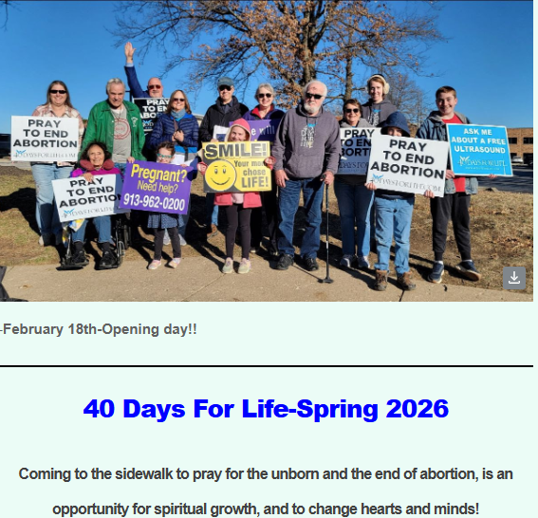
Tuesday,
Mar 10
Roe Ave &
College Blvd.

Slide 72
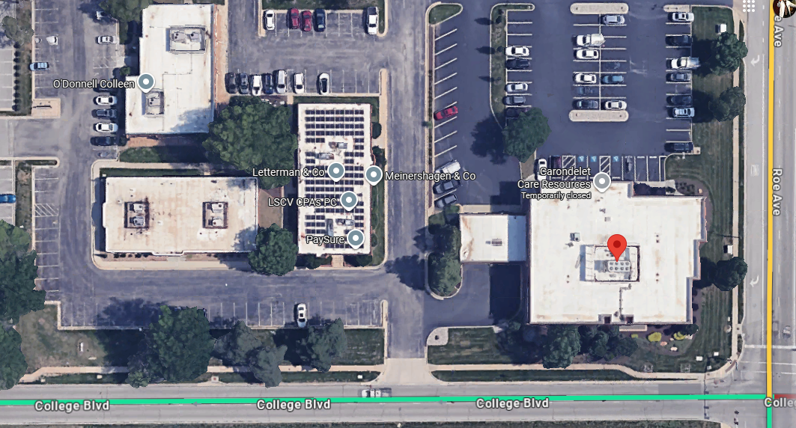
Tuesday, Mar 10

Slide 73

Tuesday, Mar 10
Notes:
Mar 10 So many churches represented on this day!!
Left to right: Rob Stickney - Holy Spirit Catholic Church. Ron/Cathy Anielak - St Robert Bellarmine Catholic. Allen McLain - Kingdom Living Messianic Congregation. Judy Newkirk - St. Robert Bellarmine, Linda Linder - St. Robert Bellarmine, Terri Bryant - St. Robert Bellarmine.
Annie Bang - St. John La Lande, Donna Harris - St. John La Lande

Slide 74
Israel is the place of His glory.

Slide 75
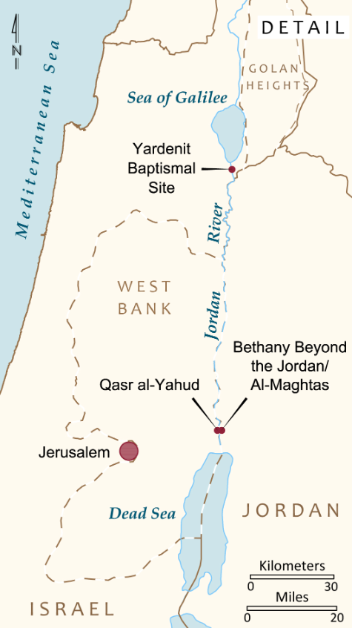
November 15 - Covenant and Renewal in the Jordan Valley
Today, we get an early start! After breakfast, visit Beit She'an, a major Roman city. Continue to Qasr al-Yahud, the traditional site of Yeshua's immersion by John

Slide 76
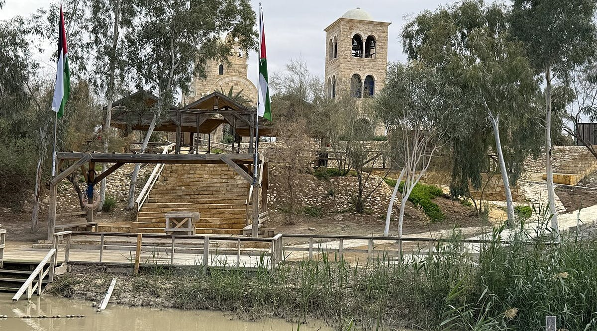
Qasr-al-Yahud immersion
site reopens after
nis 25 million facelift
Notes:
https://vfinews.com/news/us-evacuates-embassy-staff-from-lebanon-as-iran-tensions-intensify-hamas-refuses-to-disarm/qasr-al-yahud-baptismal-site-reopens-after-nis-25-million-facelift?utm_source=VFI+News+-+English&utm_campaign=f96c05737a-EMAIL_CAMPAIGN_2026_02_27_06_10&utm_medium=email&utm_term=0_c414809724-f96c05737a-148559991&mc_cid=f96c05737a&mc_eid=UNIQID

Slide 77
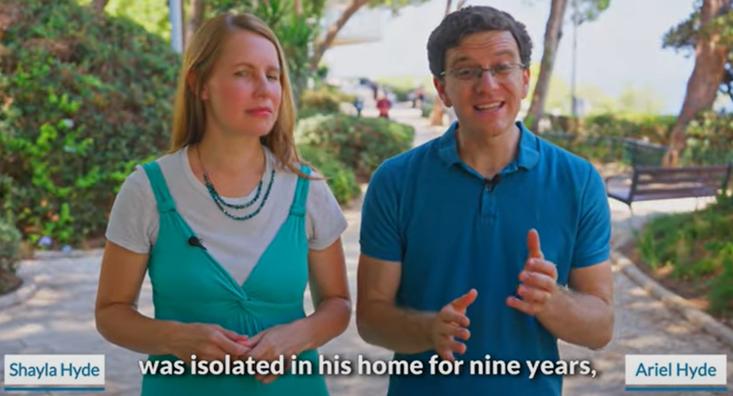
Notes:
We have hosted his mom, Carolyn Hyde, for a concert in our old building. We ALL ate in their home on a tour about 10 years ago.
https://youtu.be/hZAPuOThXpw
https://youtu.be/oIbGl5GwNvw

Slide 79
The Fullness of all that G-d is
Timeless Revelation of His Glory
Medieval Revelation of His Glory
Application of Revelation of
His Glory
4. Outworking of the Revelation of
His Glory

