Slide 1
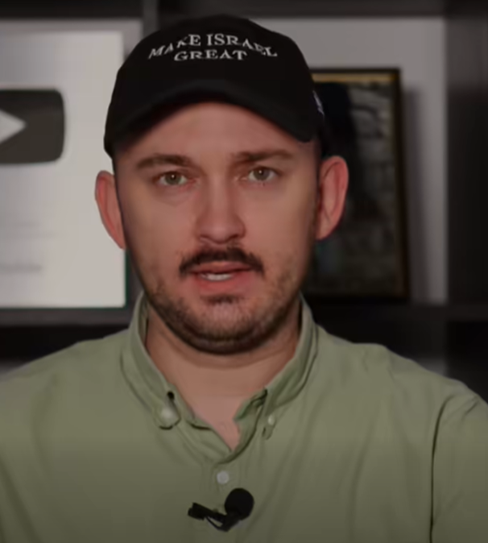
Hananya Naftali on Israel’s 78th Birthday
Notes:
https://www.facebook.com/reel/1271933457868378
4 minutes

Slide 2


Slide 7
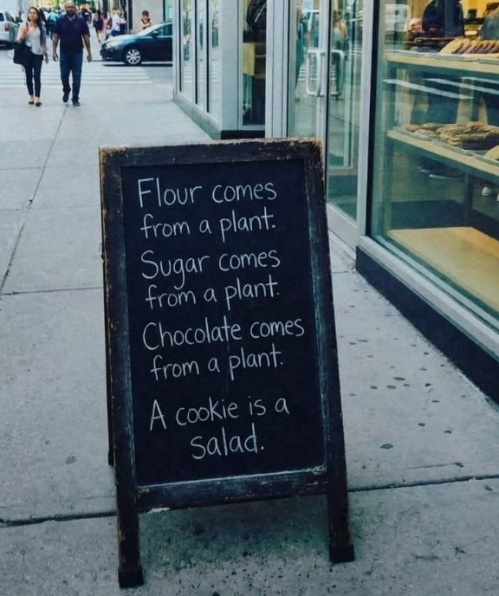
Healthy eating
Notes:
Ben Troyer

Slide 8
Healthy eating
Notes:
Ben Troyer

Slide 9


Slide 10
In contrast to Israel’s victory;
the lowest point
in her history.

Slide 11

Notes:
US Psychiatrist, Goering, US prosecutor, Am Jewish translator
About the trial of the second in command to Hitler, Reichsmarschall Herman Goering.

Slide 12

Notes:
The plot is essentially about the prosecutor preparing the case to condemn Goering, and with him Nazism, before the eyes of the world.

Slide 13
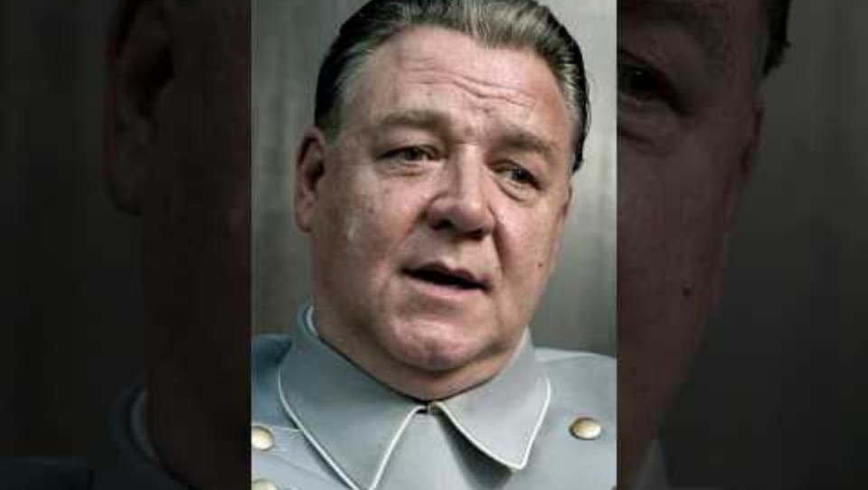
Notes:
https://youtu.be/y7OHVWu_Zlw?si=2-fN1MIxgfLJXQjx
The clip ends before the last line of the prosecutor….
In all this, would you have opposed Hitler?
I would not have opposed Hitler. Heil Hitler. That was the condemning line.
The goal was condemnation. He was sentenced to be hanged, but took a cyanide capsule suicide.

Slide 14
This was a trial to convict a monstrous criminal.
Notes:
Sometimes this spirit gets carried over into more simple relational issues.
Connection between the trial of Goering and our treatment of each other: not condemnation, restoration.

Slide 15
^{Kohelet / Eccles 3.1} For everything there is a season and a time for every activity under heaven
^{3b} a time to tear down and a time to build up;
^{7a} a time to tear apart and a time to mend.

Slide 16

SATAN’S SCHEMES

Slide 17
^{2 Cor. 2.11} We will not be taken advantage of by Satan the Adversary — for we are quite aware of his schemes!
Notes:
Time to pray!
The most complete description of Satan’s schemes and identities is Rev 12.9-10

Slide 18
^{Rev 12.9-10} The great dragon was thrown out, that ancient serpent, also known as the Devil and Satan [the Adversary], the deceiver of the whole world…the Accuser of our brothers, who accuses them day and night before God, has been thrown out!
Notes:
Here is the built in message outline. But we’ll consider in reverse order. Bc most intensive and extensive activity is accuser.

Slide 19

Satan’s schemes
Accuser
Deceiver
Adversary / Opposer / Satan
Devil
Dragon / Serpent
The solution: Affirmation

Slide 20
Satan’s schemes
Accuser
Deceiver
Adversary / Opposer / Satan
Devil
Dragon / Serpent
The solution: Affirmation

Slide 21
Κατήγορος
kategoros: Accuser
From kata and agora; against one in the assembly
In the Greco-Roman court system a public plaintiff initiated formal charges
Notes:
https://biblehub.com/greek/2725.htm

Slide 22
^{Rev 12.10} The accuser of our brothers and sisters—the one who accuses them before our God day and night.
Notes:
Before G-d. No hesitation to continue in immediate presence. G-d knows “the rest of the story.”
Never stops.
This is what we are dealing with. Maybe dealing out?
When we consider people,
are we looking for what is wrong,
or how we can bless them?
Or are we fearful of being accused of something/

Slide 23
Stinging, ringing, relentless, tormenting voice: you did wrong, you ARE wrong, you will be hated for your sin, for your mistake, you will be despised and rejected from your community, there is no mercy or grace, only shame.
Not a voice of redemption.
Notes:
Looking to hurt, bring down, diminish
Defending myself!!
With Goering, they were looking to destroy him to be sentenced to death by hanging, to rid the world of a vile corrupt individual and influence.
Satan’s scheme here is
that we can be accusers and hurtful, OR
we can be accused viciously, and hurt.

Slide 24
^{Rev 12.10} The accuser of our brothers and sisters—the one who accuses them before our God day and night.
Notes:
Continual, unrelenting

Slide 25
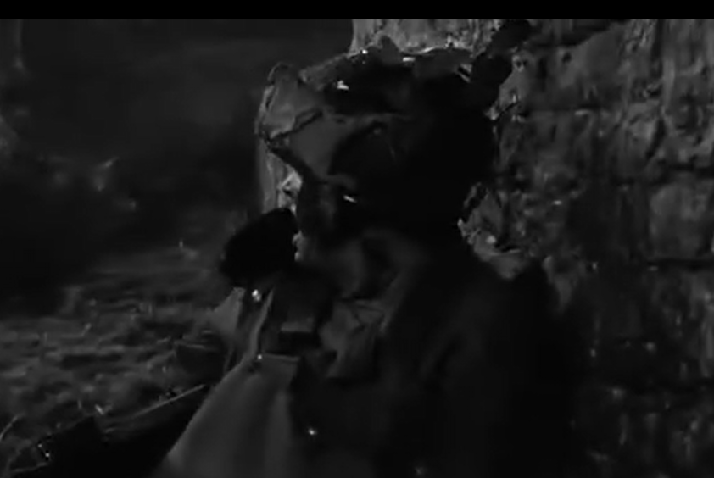
From “The Longest Day”
Notes:
https://ok.ru/video/89277860418?fromTime=5207

Slide 26
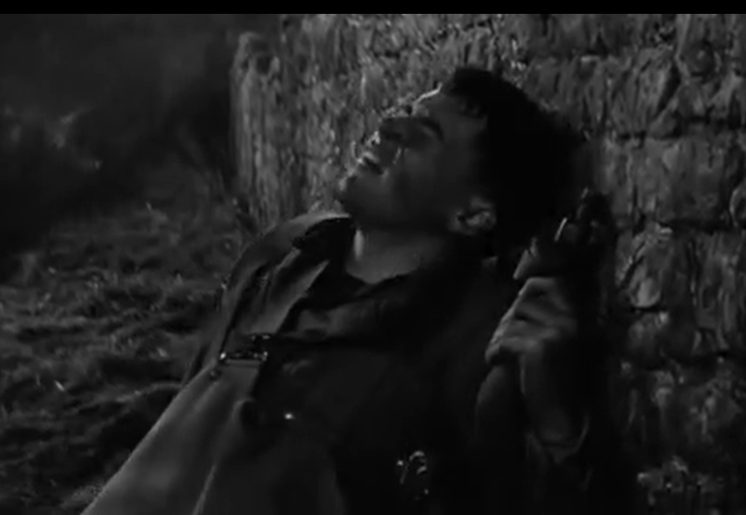
Notes:
In the movie, in a similar scene, the brief removal of the helmet is met with a deadly hail of machine gun bullets.

Slide 27
^{Eph 6.16} Above all, take up the shield of faith with which you will be able to extinguish all the flaming arrows of the evil one.
Notes:
Faith and thanksgiving and praise.

Slide 28
Characteristics of an Accusing Spirit [are we facing it, or projecting it?]
Suspicion
Analyzing other’s motives
Continued bitterness
Becoming bitter when exposed to another’s failures.

Slide 29
Characteristics of an Accusing Spirit [are we facing it, or projecting it.
Mistrust—everyone will hurt you.
Believing the worst. Gevaltism.
Offending or creating an offense
Being easily offended without much cause.

Slide 30
Characteristics of an Accusing Spirit [are we facing it, or projecting it.
Quickly judging others
Building a case to turn people against each other
Refusing fellowship even after repentance
Focusing on the evil excluding good.

Slide 31
^{Mtt 24.10} At that time many will be trapped into betraying and hating each other…and many people’s love will grow cold because of increased distance from scripture.

Slide 32
^{Gal 5.14-15} For the whole Torah can be summed up in a single saying: “Love your neighbor as yourself.”
וְאָהַבְתָּ לְרֵעֲךָ כָּמוֹךָ
ve’ahavta l’re’acha kamocha,
But if you bite and devour one another, watch out that you are not destroyed by one another.
Notes:
Satan’s scheme here is that we can be accusers and hurtful, OR we can be accused viciously, and hurt.

Slide 33
Accusations are usually half truths because we all always could do better.

Slide 34
Primarily personal accusations,
Also, national, ethnic, racial
accusations
We’ll focus on accusations against Jews

Slide 35
Some accusations the Jewish people in Israel and in the Diaspora frequently face:

Slide 36
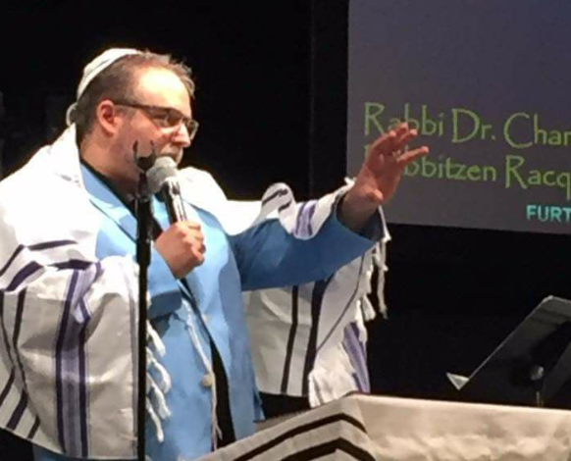
Rabbi Joe Bell https://forzionsake.org/ Bristol, VA
Compilation:

Slide 37
Bibi is the reason Trump went to war with Iran. Trump is his puppet.
The Israel of our world is not the Israel of the Bible
Israel has no greater significance than any other country.
Notes:
From Rabbi Joe Bell https://forzionsake.org/ Bristol, VA
If you like my teaching at Rav Joe Abelow on Facebook, you may share it. It encompasses what I have said, its 28 minutes long and also includes the 3 lies I mentioned:

Slide 38
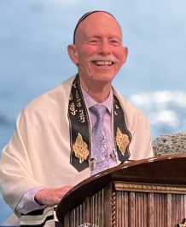
Rabbi Jim Appel
Messianic Synagogue
שמע ישראל
Shema Yisrael
Rochester NY
Notes:
I’ll be speaking in a few minutes about his book.

Slide 39
Other tropes:
Jews control the world through a secret society - The Protocol of the Elders of Zion
Jews were behind 9/11
Jews were behind COVID
Notes:
Story of a guy with friends on the subway reading the Al Jazeera Newsp
Why?
NYT Palest genocide, Jews bomb hospitals,
Al Jazeera Jews own the banks, own the media, all rich Much more cheerful news

Slide 40
Other tropes:
Israel is a colonial power oppressing the native Palestinians
Palestinians live in poverty because Israel oppresses them
The Holocaust never happened, it's just a ploy by Jews to gain sympathy
Notes:
Jim Appel

Slide 41
SATAN’S SCHEMES

Slide 42
Satan’s schemes
Accuser
Deceiver
Adversary / Opposer / Satan
Devil
Dragon / Serpent
The solution: Affirmation

Slide 43
planaó: πλανάω
To lead astray, to deceive, to cause to wander
1. (properly) to cause to stray from the straight path (i.e. to roam, wander)
2. (figuratively) to lead astray from safety, truth, or moral uprightness
3. (by implication) to deceive, mislead

Slide 44
Approximately 1 in 10 seniors fall victim to scams each year.
Financial losses for seniors due to scams can exceed $3 billion annually.
The scam that affected seniors the most by far was investment scams, then romance scams, tech support scams, and lottery scams.
Notes:
https://search.yahoo.com/yhs/search?p=how%20many%20seniors%20fall%20to%20scams&hspart=fc&hsimp=yhs-5918_1&type=fc_A2EFA035EF5_s69_g_e_d111225_n141297_c999&param1=7&param2=eJwtj81qwzAQhF9FxwRkZVeS7Sg6WSR9gNJTFx1cR3WEf7EdXPr0RaHMZWC%2BgZk23sn69ysC5LpUxP1I1qNGaUriPoWIKGVO3DdkvTGGuI8zWa9KgUZIAIGIxH0bJrL%2BuRL3z5qsH6bf2Pf1KRfADnsc79O%2BsnFjCAIs2%2BNYaMt%2BCn1k9Tz3YQ9fXdxOuSqFKtihe2xDz1kfu8Da0HTTkTWPZRrCCXUpIImt9Xe9xP9KmrW%2B3qQBa1he%2FnauVFU5yDRonSG%2BYVahw8y5a3F26qacgcQ3CZYgiwx0JvMPwIuECyoBaD7%2FABfBU1k%3D

Slide 45
Seniors are often targeted due to isolation and lack of familiarity with technology.
Awareness and education can significantly reduce the risk of scams among seniors.
Support networks and community programs can help protect vulnerable individuals.
Notes:
https://search.yahoo.com/yhs/search?p=how%20many%20seniors%20fall%20to%20scams&hspart=fc&hsimp=yhs-5918_1&type=fc_A2EFA035EF5_s69_g_e_d111225_n141297_c999&param1=7&param2=eJwtj81qwzAQhF9FxwRkZVeS7Sg6WSR9gNJTFx1cR3WEf7EdXPr0RaHMZWC%2BgZk23sn69ysC5LpUxP1I1qNGaUriPoWIKGVO3DdkvTGGuI8zWa9KgUZIAIGIxH0bJrL%2BuRL3z5qsH6bf2Pf1KRfADnsc79O%2BsnFjCAIs2%2BNYaMt%2BCn1k9Tz3YQ9fXdxOuSqFKtihe2xDz1kfu8Da0HTTkTWPZRrCCXUpIImt9Xe9xP9KmrW%2B3qQBa1he%2FnauVFU5yDRonSG%2BYVahw8y5a3F26qacgcQ3CZYgiwx0JvMPwIuECyoBaD7%2FABfBU1k%3D
https://www.forbes.com/sites/steveweisman/2025/12/16/ftc-report-seniors-lost-billions-to-scams-key-insights-and-prevention-tips/

Slide 46
Spiritual scams

Slide 47
^{Mtt 24.3-5} As He was sitting on the Mount of Olives, the disciples came to Him privately, saying, “Tell us, when will these things happen? What will be the sign of Your coming and of the end of the age?” Yeshua answered them, “Be careful that no one leads you astray! For many will come in My name, saying, ‘I am the Messiah,’ and will lead many astray.
Notes:
Check US out. Statement of faith on our website. Soon starting discipleship class.

Slide 48

Renewed talimdut / discipleship class
Tuesdays
6:30-7:30 class
7:30 -8:30 Teerosh
Live and Zoom
Notes:
It is written by Rabbi Jim Appel who has been teaching this course in ongoing Tuesday night sessions for more than two decades.
There are many astounding revelations and "Aha!" moments for the students. Your attitude toward your Savior and His Word will never be the same after studying this course! After all, He was born and lived as a Jew and all His disciples and apostles were Jewish.

Slide 49
SATAN’S SCHEMES

Slide 50
Satan’s schemes
Accuser
Deceiver
Adversary / Opposer / Satan
Devil
Dragon / Serpent
The solution: Affirmation

Slide 51
Satan Σατανᾶς
Satanas, designates a personal, supernatural adversary who opposes God, His purposes, and His people. The New Testament depicts Satan as a real being with intellect, will, emotion, and self-awareness, never as a mere impersonal force. His activity is consistently hostile, deceptive, and destructive.

Slide 52
שָׂטָן
Arch-enemy, adversary, foe, the Evil one, angel of death, evil inclination; hinderer, disturber, accuser, prosecutor
DON’T feel sorry for him.

Slide 53
^{Yeshayahu Is 14. 12-15} How you have fallen from heaven, O bright star, son of the dawn! How you are cut down to the earth, you who made the nations prostrate! You said in your heart: “I will ascend to heaven, I will exalt my throne above the stars of God.

Slide 54
^{Yeshayahu Is 14. 12-15} I will sit upon the mount of meeting, in the uttermost parts of the north. I will ascend above the high places of the clouds— I will make myself like Elyon.” Yet you will be brought down to Sheol, to the lowest parts of the Pit.
Notes:
Equal with G-d. Not above G-d.

Slide 55
^{Yekhezkek/ Ezek 28.14-17} You were an anointed guardian cheruv. I placed you on the holy mountain of God. You walked among stones of fire. You were perfect in your ways from the day that you were created, until unrighteousness was found in you…

Slide 56
^{Yekhezkek/ Ezek 28.14-17} I made you vanish, guardian cheruv, from among the stones of fire. Your heart was exalted because of your beauty. You corrupted your wisdom because of your splendor.
Notes:
One of the mysteries of the universe is the origin of evil. TW Commodol, 1969, G-d’s Bible School.

Slide 57
SATAN’S SCHEMES

Slide 58
Satan’s schemes
Accuser
Deceiver
Adversary / Opposer / Satan
Devil
Dragon / Serpent
The solution: Affirmation

Slide 59
diabolos: Devil, accuser, slanderer
διάβολος
to slander, accuse, defame unjustly criticizing to hurt (malign) and condemn to sever a relationship.

Slide 60
SATAN’S SCHEMES

Slide 61
Satan’s schemes
Accuser
Deceiver
Adversary / Opposer / Satan
Devil
Dragon / Serpent
The solution: Affirmation

Slide 62
The ancient Greeks classified a "dragon" as a type of serpent. drákōn ("a dragon") was believed to have incredible insight, able to spot prey in any hiding place.

Slide 63
Leviathanלִוְיָתָן is a giant sea serpent noted in theology.
A metaphor for a powerful enemy, notably Babylon. It is referred to in Psalms, the Book of Job, the Book of Isaiah, and the Book of Enoch.
Notes:
https://en.wikipedia.org/wiki/Leviathan

Slide 64
Included in God's lengthy description of his indomitable creation is Leviathan's fire-breathing ability, his impenetrable scales, and his overall indomitability in Job 41.
Notes:
https://en.wikipedia.org/wiki/Leviathan

Slide 65
In Psalm 104, God is praised for having made all things, including Leviathan, and in Isaiah 27:1, he is called the "tortuous serpent" who will be killed at the end of time.
There is a liturgical prayer and praise about Levyatan when the Sukkah is dismantled.
Notes:
https://en.wikipedia.org/wiki/Leviathan

Slide 66
SATAN’S SCHEMES

Slide 67
Satan’s schemes
Accuser
Deceiver
Adversary / Opposer / Satan
Devil
Dragon / Serpent
The solution: Affirmation

Slide 68
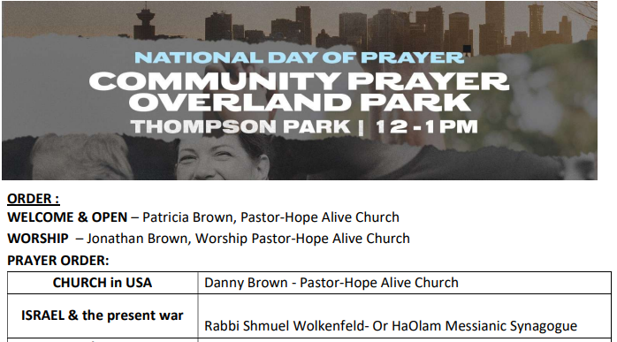
Nov. 7

Slide 69
Laura Terry report

Slide 70
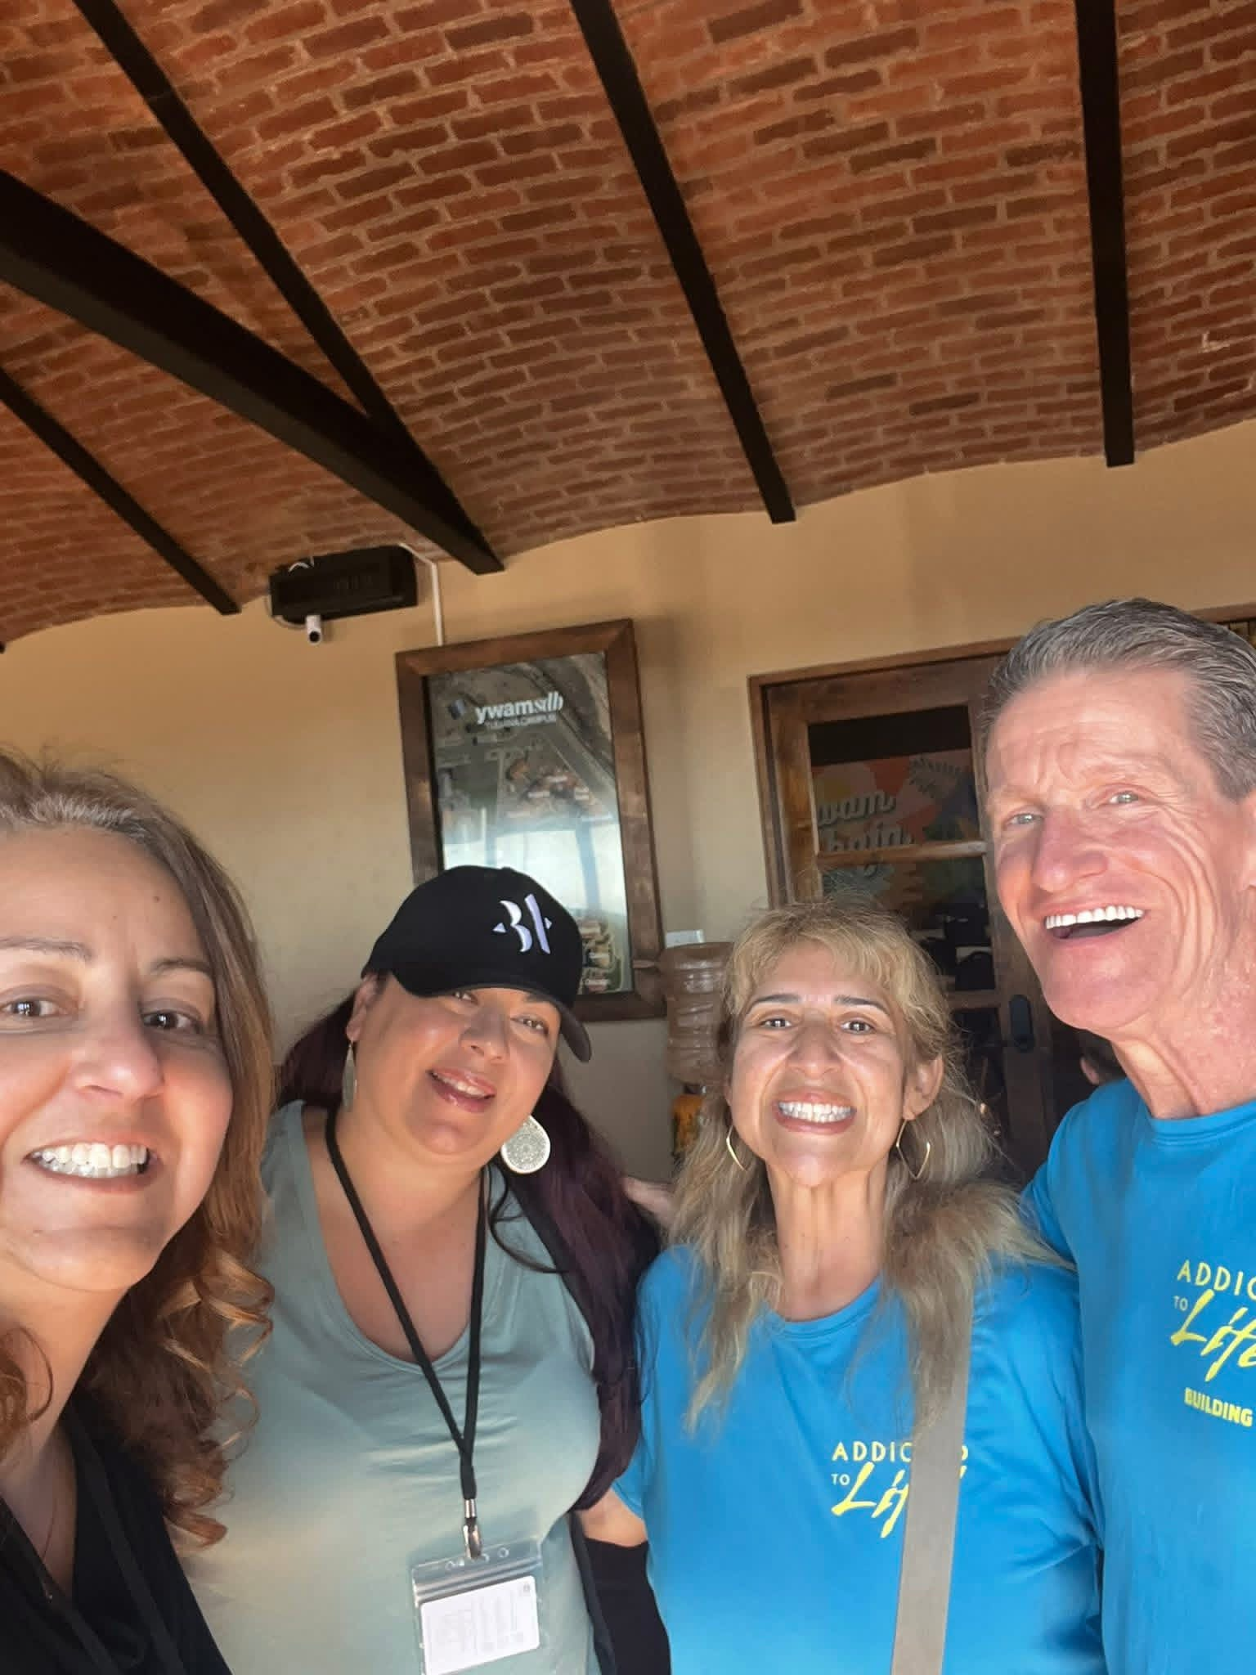

Slide 71
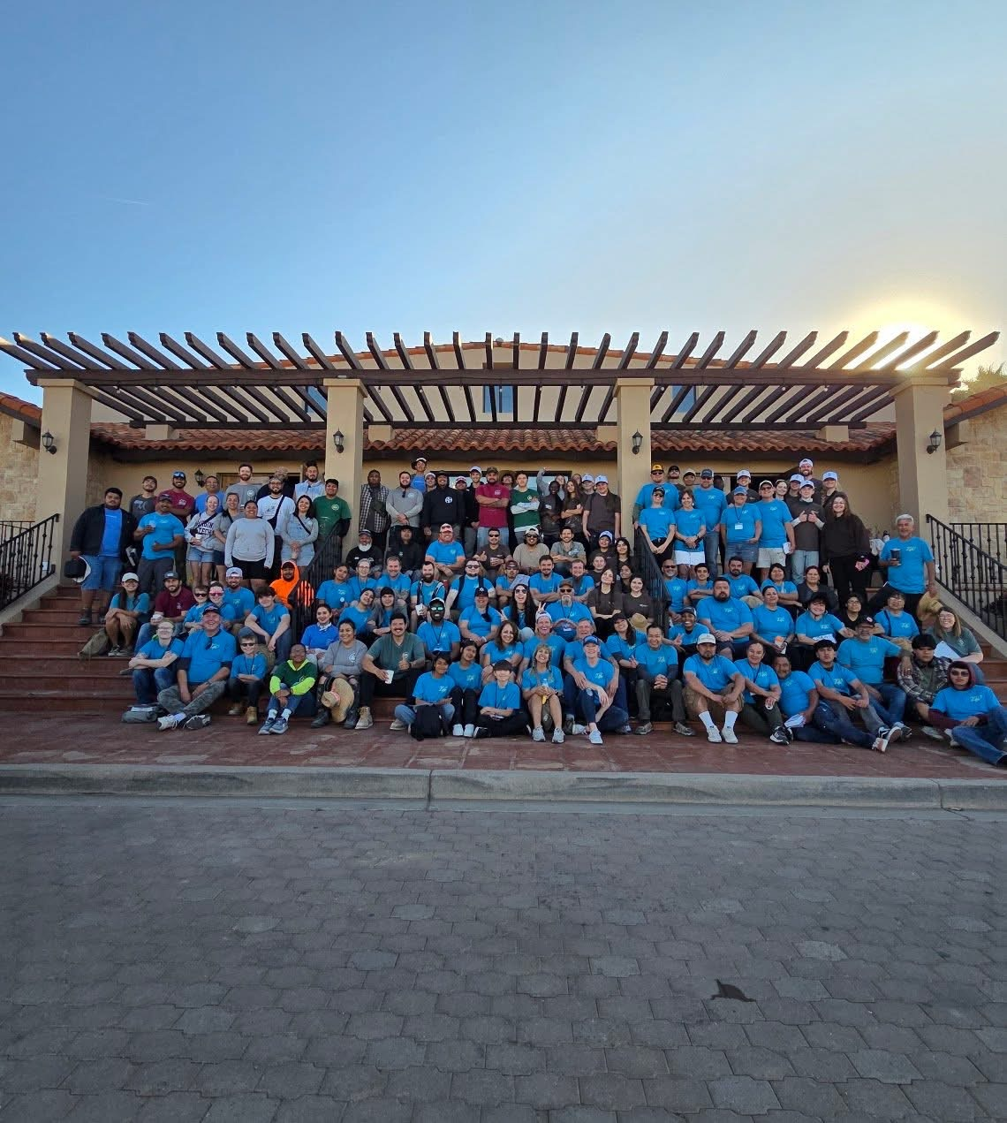

Slide 72
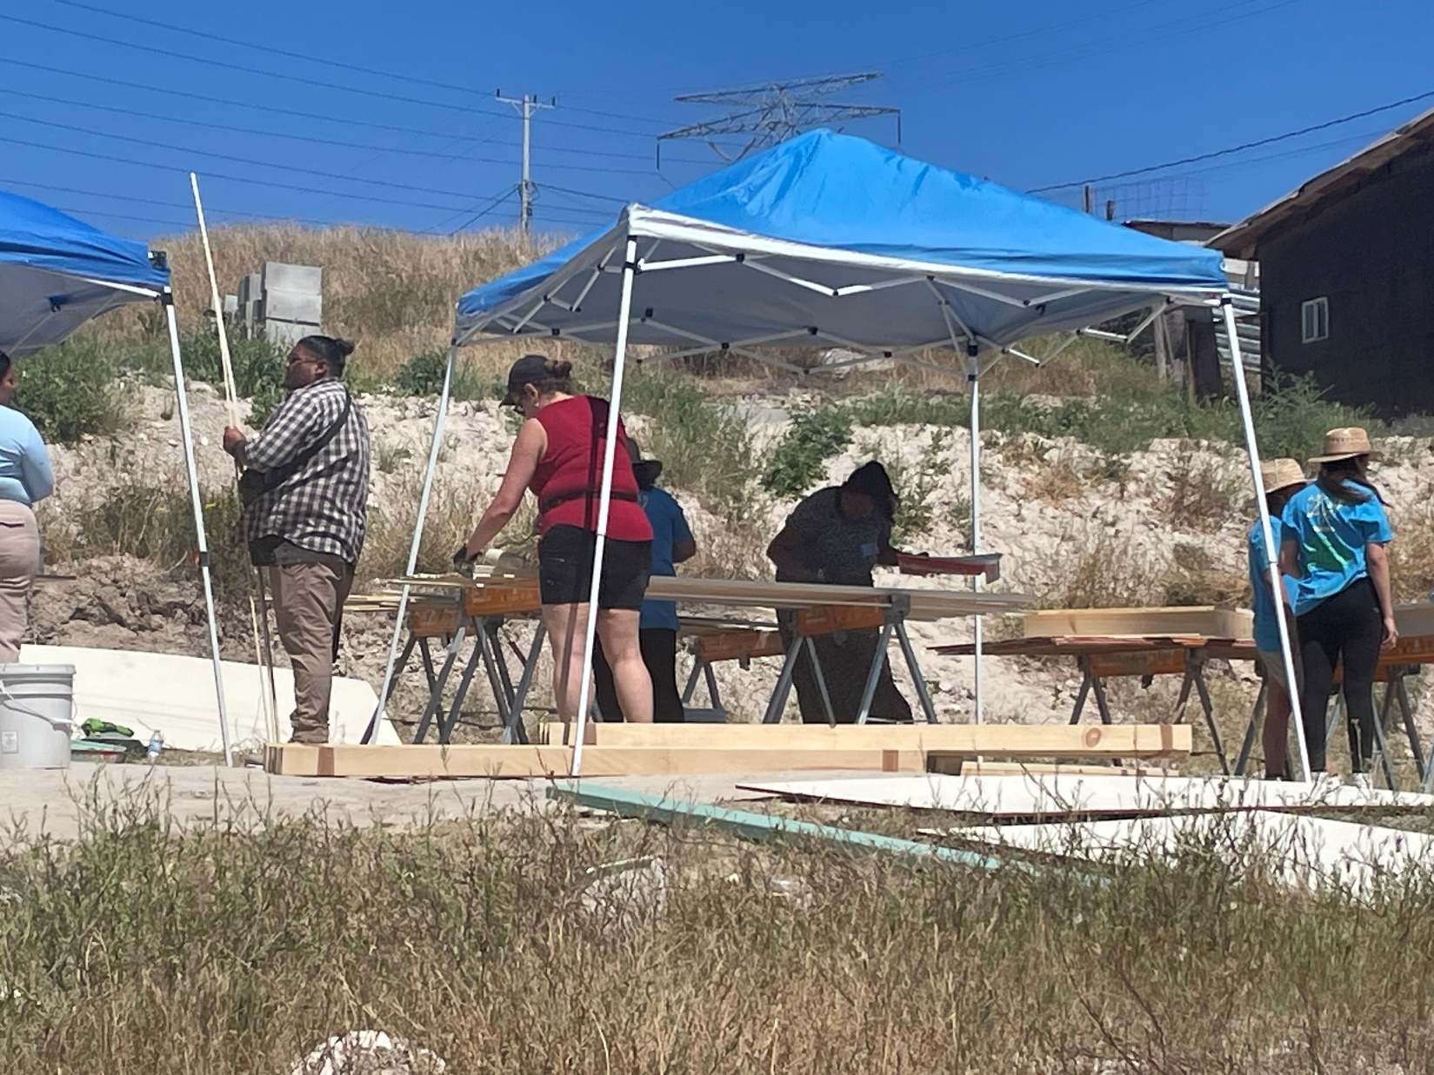

Slide 73


Slide 74


Slide 75
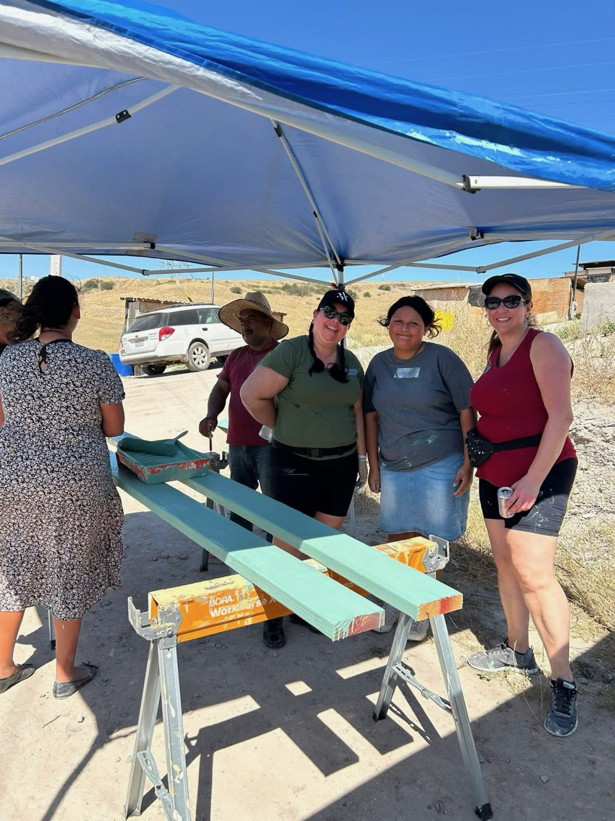

Slide 76
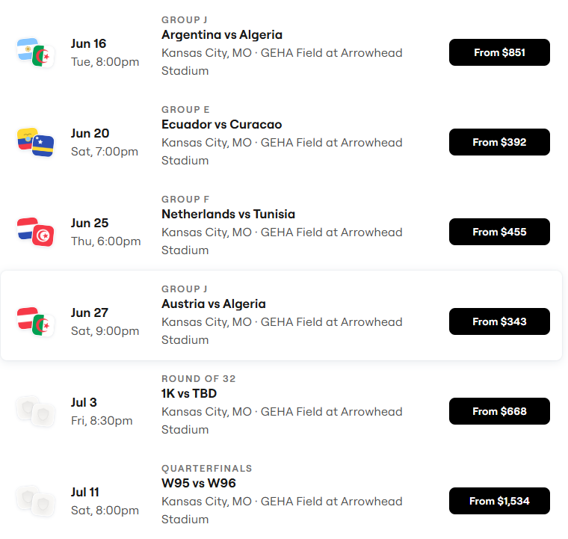
World Cup Schedule
~700,000 visitors to KC!

Slide 77
