Slide 1
Some cheesy Shavuot jokes
that will split your sides.
Notes:
https://anglo-list.com/shavuot-jokes/

Slide 2
Q. What kind of man was Boaz before he married?

Slide 3
Q. What kind of man was Boaz before he married?
A. Ruth-less.
Notes:
https://anglo-list.com/shavuot-jokes/

Slide 4
Q. After Shavuot we all need
to go on diet. Why?
Notes:
https://anglo-list.com/shavuot-jokes/

Slide 5
Q. After Shavuot we all need
to go on diet. Why?
A. To cheddar a few pounds.
Notes:
https://anglo-list.com/shavuot-jokes/

Slide 6
Q: What do you call
cheese that is sad?
Notes:
https://anglo-list.com/shavuot-jokes/

Slide 7
Q: What do you call
cheese that is sad?
A: Blue cheese.
Notes:
https://anglo-list.com/shavuot-jokes/

Slide 8
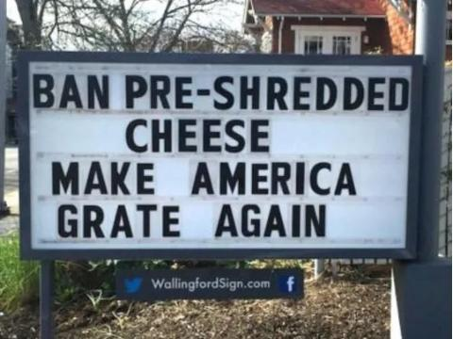

Slide 9
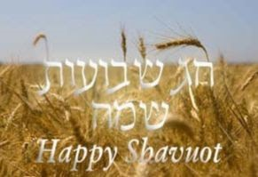

Slide 10
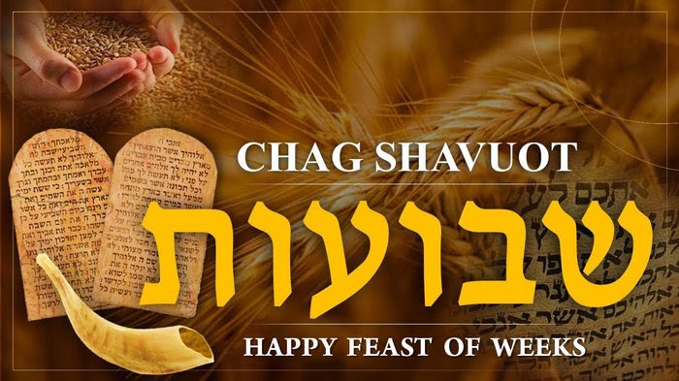

Slide 11
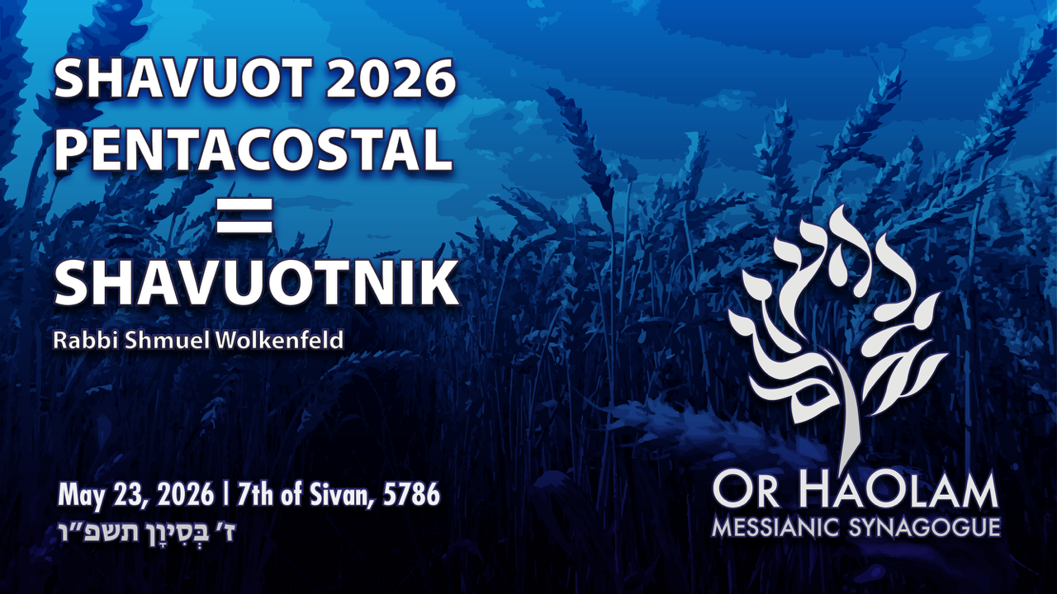

Slide 12

Pentacostal? Rather Shavuotnik
Mysterious & multidimensional

Slide 13
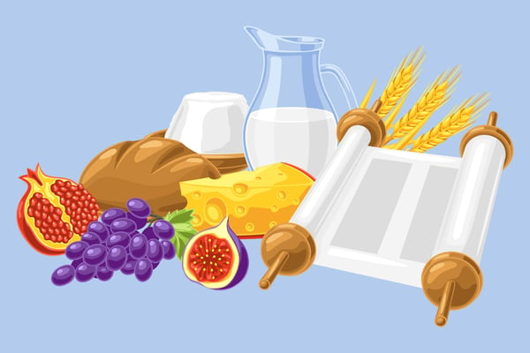
Shavuot: The Holiday With 5 Names!
Notes:
https://unitedwithisrael.org/shavuot-the-holiday-with-5-names/

Slide 14
שבועות Shavuot literally means “weeks” which refers to the nightly, seven-week count
יום הביקורים Yom Habikkurim – The Day of the First Fruits of wheat.
חג הקצירHag Hakatzir—The Harvest Festival.
Notes:
https://unitedwithisrael.org/shavuot-the-holiday-with-5-names/
Shavuot is called the conclusion of Passover.

Slide 15
עצרתatzeret means “to stop,” “refrain” or “hold back.” This is the name for Shavuot most used by the Talmud.
זמן מתן תורתינוZman Matan Torahteinu — “the Time of the Giving of our Torah.”
Notes:
https://unitedwithisrael.org/shavuot-the-holiday-with-5-names/
Talmud represents the term of those who most practice it. “Stop” bc no dramatic symbol: Pesakh unleavened bread and lamb, YK fast, Sukkot lulav++, Hanukkah menorah, just bread here. So, a little mysterious.
Not “day” but “time” bc continuously given.

Slide 16
Shavuot
Messianic terminology innovation

Slide 17
The term “Pentecostal” is derived from Pentecost [50] = Shavuot [weeks] an event that commemorates the descent of the Holy Spirit upon the followers of the Messiah Yeshua, and the speaking in "foreign" tongues.
Notes:
So, we are sort of “Pentecostal” But it’s a very Christian term. Variant…

Slide 18
Pentacost [50] = Shavuot [wks]
Notes:
So, we are sort of “Pentecostal”

Slide 19
Pentacost [50] = Shavuot [wks]
Pentacostal = Shvuotniks
Notes:
So, we are “Shavuotniks”
If someone asks what is Or HaOlam’s theology, tell them we are Shavuotniks.

Slide 20
The English suffix -nik is of Slavic origin. It approximately corresponds to the suffix "-er" and nearly always denotes an agent noun.
Beatnik
Refusenik
Notes:
https://en.wikipedia.org/wiki/-nik

Slide 21
Neatnik: a neat-freak
Nogoodnik: a lazy, incompetent or malicious person
Peacenik: a pacifist; a hippie
Rudenik: a rude person
Wordnik
Notes:
https://en.wikipedia.org/wiki/-nik
Plural neatnikim accent on the last syllable

Slide 22
Jewish adaptation:
Chabadnik follower of Chabad
Jobnik: a non-combat soldier who performs secretarial work
Kibbutznik: member of a Kibbutz
Lamedvavnik ל"ו = 30 + 6
36 righteous
Notes:
R Abaye says: The world has no fewer than thirty-six righteous people in each generation who greet the Divine Presence every day, as it is stated: “Happy are all they that wait for Him [lo]” (Isaiah 30:18)? The numerological value of lo, spelled lamed vav, is thirty-six, alluding to the fact that there are at least thirty-six full-fledged righteous individuals in each generation. Sukkah 45b

Slide 23
Likudnik: supporter of Israeli political party Likud
Moshavnik: member of a Moshav
Mossadnik: Mossad agent
Nudnik: a nagging, boring or awkward person
Hamasnik: a Hamas terrorist

Slide 24
Shvuotnik = someone whose life is centered on the working of the of Shavuot reality: Ruakh / Spirit given to us in abundance on Shavuot, because of the Atonement of the Messiah Yeshua!
So, if someone asks you of your faith, say, Messianic or Shavuotnik.
Notes:
And connected to Jewish covenantal identity!

Slide 26
Pentecostal? Rather Shavuotnik
Mysterious & multidimensional
Primary meaning of Shavuot is
wheat bread

Slide 27
^{Vayikra /Lev 23.15-22} ‘From the day after the day of rest — that is, from the day you bring the sheaf for waving — you are to count seven full weeks, until the day after the seventh week; you are to count fifty days; and then you are to present a new grain [wheat] offering to Adoni.

Slide 28
My sense is that the day after Pesakh is the correct date ofראשית הקציר Resheet HaOmer, beginning of the Omer count.
^{Joshua 5.10-12} The people of Isra’el camped at Gilgal, and they observed Pesakh on the fourteenth day of the month, there on the plains of Yericho. The day after Pesakh they ate what the land produced, matzah and roasted ears of grain that day.

Slide 29
The following day, after they had eaten food produced in the land, the man ended. From then on the people of Isra’el no longer had man; instead, that year, they ate the produce of the land of Kena‘an.

Slide 30
The Sadducees [anciently], Samaritans, Karaites, and Michael Rood followers consider the Sunday after Pesakh as the true day of
Beginning of the Omer
ראשית הקציר Resheet HaOmer
and the Resurrection.

Slide 31
^{Vayikra /Lev 23.15-22} ‘From the day after the day of rest — that is, from the day you bring the sheaf for waving — you are to count seven full weeks, until the day after the seventh week; you are to count fifty days; and then you are to present a new grain [wheat] offering to Adoni.

Slide 32

^{Vayikra /Lev 23.15-22} You must bring bread from your homes for waving — two loaves made with one gallon of fine flour, baked with leaven — as firstfruits for Adoni…

Slide 33
עִשָּׂרוֹן issaron designates one-tenth of an ephah, a dry measure for grain or fine flour. an issaron is approximately 3.3–3.7 quarts, about a gallon = 16 cups.
Notes:
Singular of esronim

Slide 34
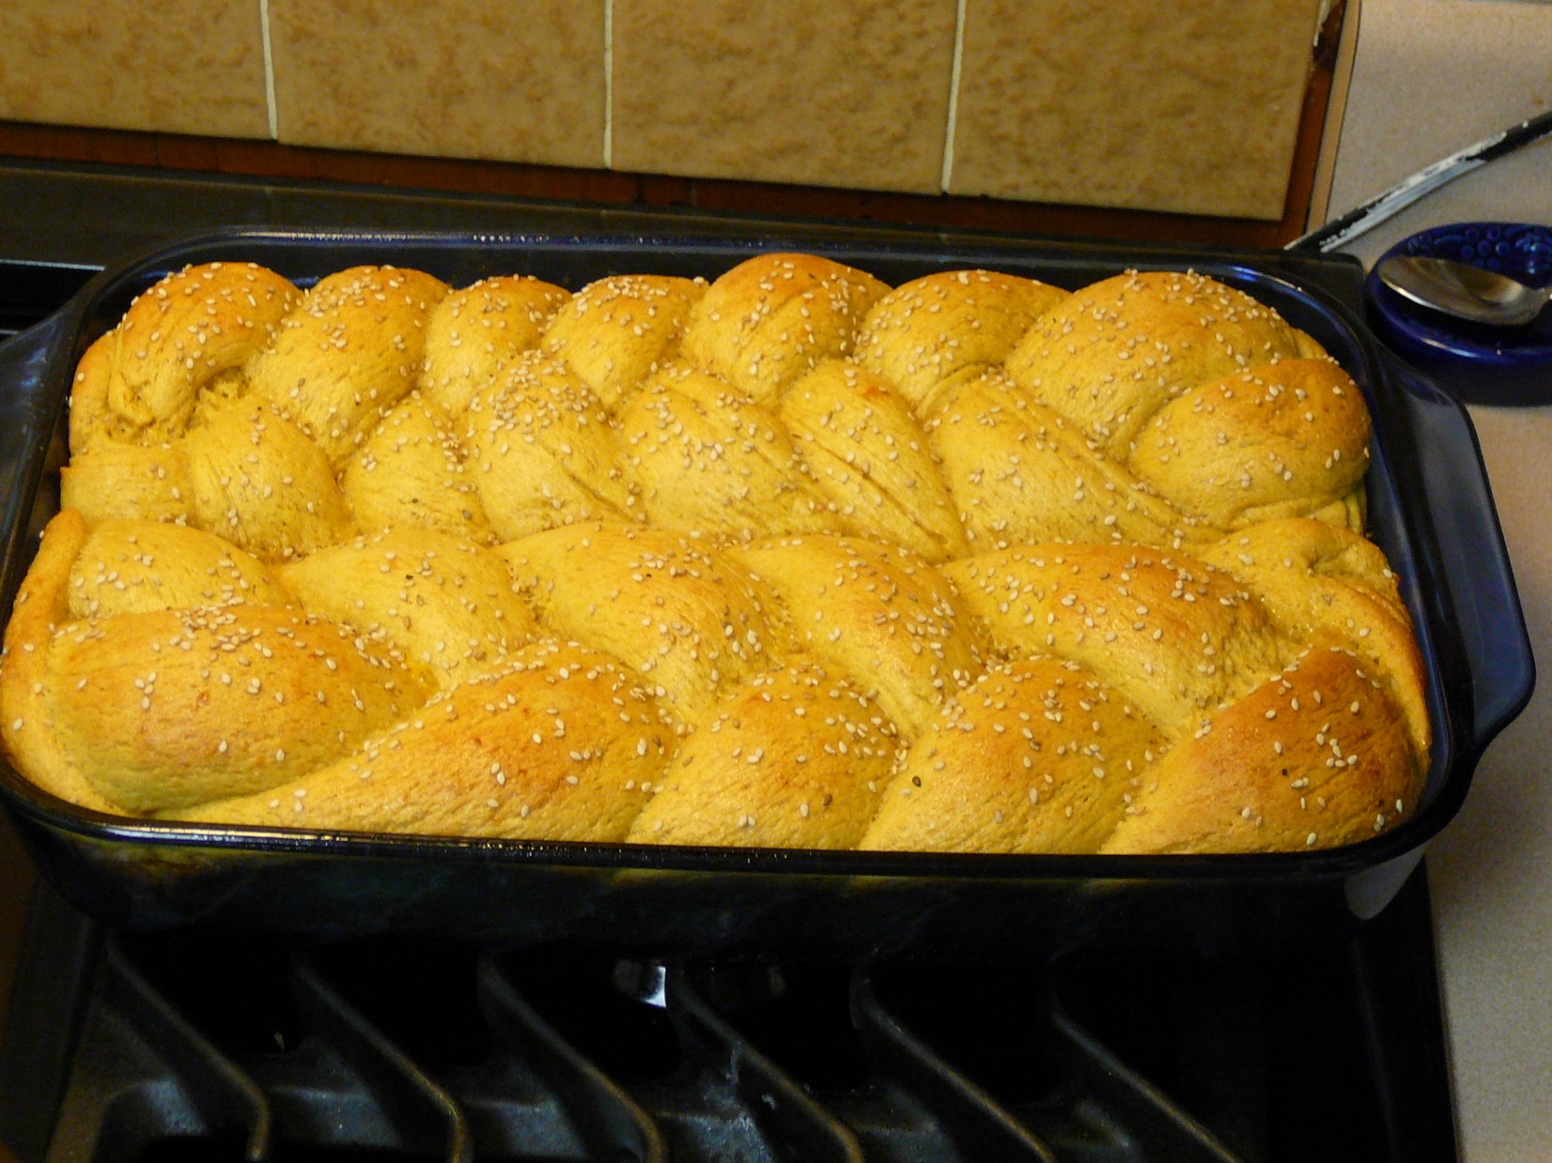
Each loaf 3 cups.
Notes:
Each loaf 3 cups. 6 cups here.
My wife’s hallah is the BEST in the galaxy. Like John Stewart’s chicken salad is the best in the galaxy.

Slide 35
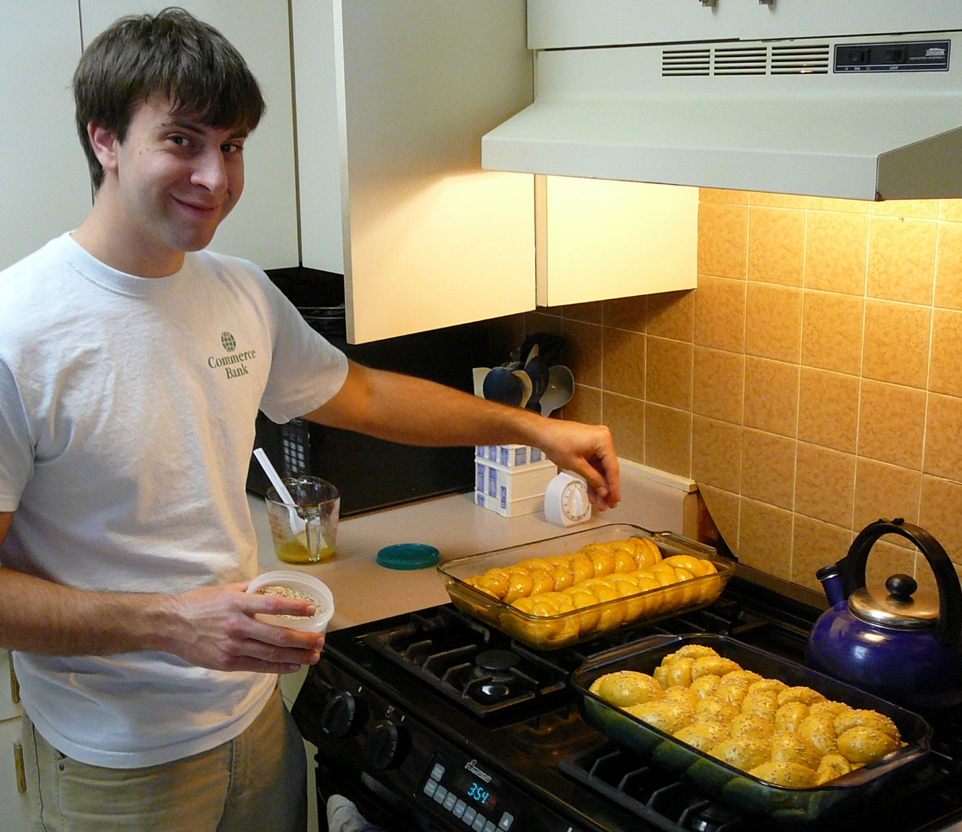
Notes:
Concept:
Shavuot is about a BIG loaf
Leavened loaf
First Bikkurim just after Pesakh is Messiah.
Shavuot is the leavened. Us. Not so perfect in and of ourselves, BUT, we are the fruit.
Or HaOlam. He is the Light, we bear the light, transmit the Light. People deal with us, see the light. Imperfect?

Slide 36
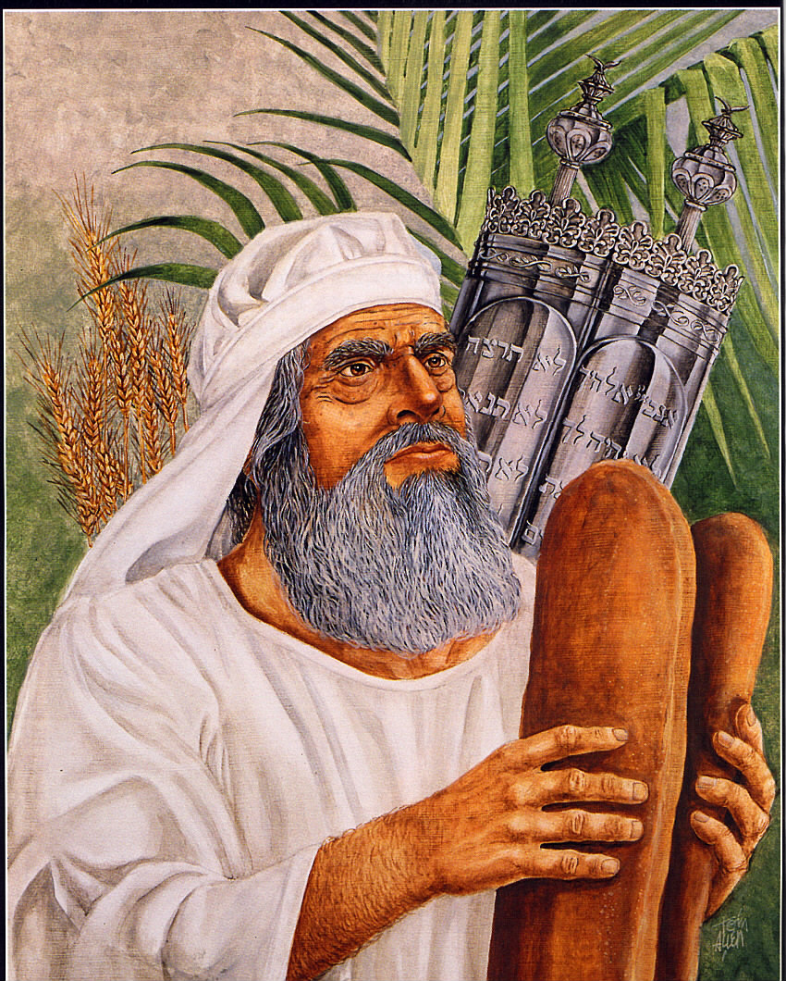
Each loaf a gallon of flour = 16 cups
Five times our hallah at home!
Notes:
Absurdly large loaf
Twice normal wave loaf
Gallon flour = 16 cup loaf

Slide 37
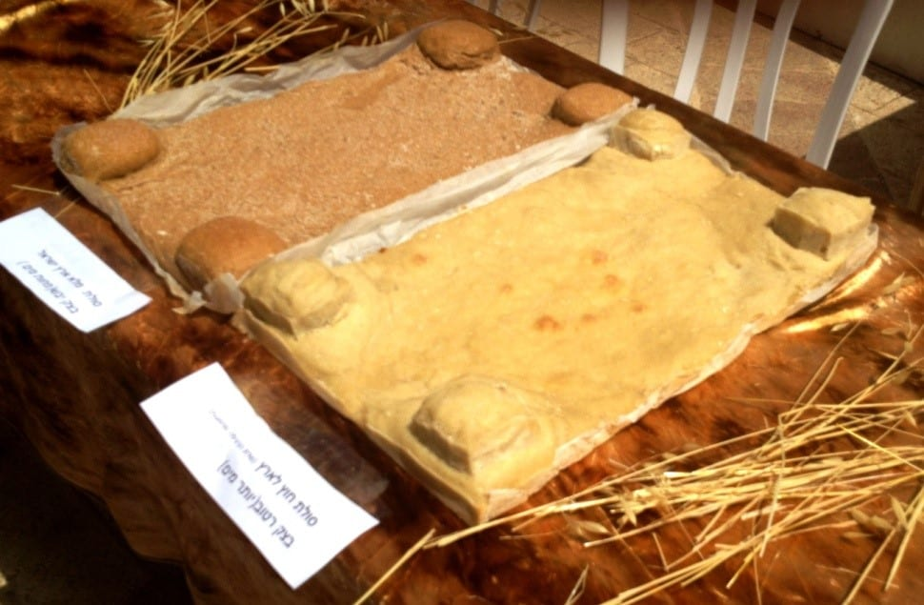
Notes:
https://www.israel365news.com/298508/jewish-priests-perform-pentecost-temple-service-fulfillment-biblical-prophecy-jerusalem/
Taken from the first wheat of the season to ripen, they were large, rectangular in shape with four mini towers at each corner of the loaf.

Slide 38
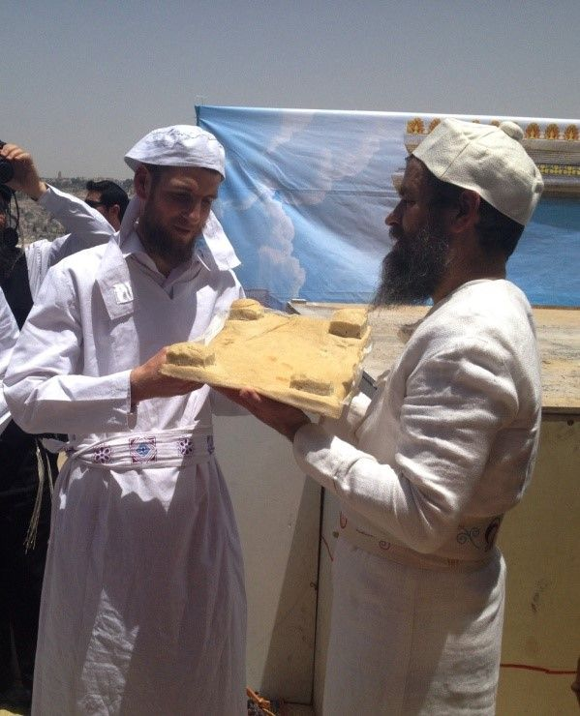
Notes:
https://i.pinimg.com/originals/e1/81/c8/e181c854bd8c3a6228de8c4aaec81d9f.jpg
https://www.israel365news.com/298508/jewish-priests-perform-pentecost-temple-service-fulfillment-biblical-prophecy-jerusalem/

Slide 39
^{Rashi 89b} With regard to the lamb offering that comes with the omer meal offering…the quantity of flour used in its meal offering is doubled.
Notes:
https://www.sefaria.org/Menachot.89b.3?lang=bi&with=all&lang2=en

Slide 40
^{BaMidbar 15.1-4} Adoni said to Moshe, “Tell the people of Isra’el, ‘When you have come into the land where you are going to live, which I am giving to you, and want to make an offering by fire to Adoni — a burnt offering or sacrifice to fulfill a special vow, or to be a voluntary offering, or at your designated times, to make a fragrant aroma for Adoni —
Notes:
Quantity repeated in Bamidbar/ Numbers

Slide 41
^{BaMidbar 15.1-4} then, whether it is comes from the herd or from the flock, the person bringing the offering is to present Adoni with a grain offering consisting of two quarts of fine flour mixed with one quart of olive oil, 5 and one quart of wine for the drink offering. This is what you are to prepare with the burnt offering or for each lamb sacrificed.

Slide 42

Bamidbar/Nu 15.4
עִשָּׂרוֹןissaron) designates one-tenth of an ephah, a dry measure for grain or fine flour. Based on the standard two-thirds bushel ephah, an issaron is approximately 3.5 to 3.9 liters (about 3.3–3.7 quarts).

Slide 43
^{Bamidbar/ Nu 28:26} “‘On the day of the firstfruits, when you bring a new [wheat] grain offering to Adoni in your feast of Shavu‘ot, you are to have a holy convocation; do not do any kind of ordinary work.
Notes:
Again, repeated in Bamidbar/ Nu Shavuot as wheat grain celebration

Slide 44
^{Shmot/} ^{Ex 23:16} Also you are to observe the Feast of Harvest, the firstfruits of your [wheat] labors that you sow in the field,
^{Shmot/} ^{Ex 34:22} “You are to observe the Feast of Shavuot, which is the firstfruits of the wheat harvest.

Slide 45
In ancient times, the grain harvest lasted seven weeks. It began with harvesting the barley during Passover and ended with harvesting the wheat at Shavuot. Shavuot was thus the concluding festival of the grain harvest.

Slide 46
A typical hallah at home is 3 cups.
A loaf for a usual wave offering is 8 cups.
The Shavuot bread loaf offering is 16 cups.
Why?
Notes:
I think I have a Ruakh download on the size of the loaves.
Two tenths deal? = one gallon
waving-two loaves made with one gallon of fine flour, baked with leaven -as firstfruits for ADONI.
Dawn’s hallah 3 cups. Gallon is 16 cups. 5x
each loaf or cake, according to Maimonides F23, was seven hands' breadths long [21”] four hands' breadths broad [12”], and four fingers high: Hilchot Tamidin c. 8. sect. 10.
28” long 16” wide x 4”

Slide 47
^{Vayikra /Lev 23.15-22} The cohen will wave them [the lambs] with the bread of the firstfruits as a wave offering before Adoni, with the two lambs; these will be holy for Adoni for the cohen.

Slide 48
^{Vayikra /Lev 23.15-22} On the same day, you are to call a holy convocation; do not do any kind of ordinary work; this is a permanent regulation through all your generations, no matter where you live.
Notes:
Even if outside of Israel, Shavuot is a holy day. No work. In this case Friday. Extended in the diaspora for no Biblical command, but calendar uncertainty, to two days in the Diaspora.

Slide 49
^{Vayikra /Lev 23.15-22} “‘When you harvest the ripe crops produced in your land, don’t harvest all the way to the corners of your field, and don’t gather the ears of grain left by the harvesters; leave them for the poor and the foreigner; I am Adoni your God.’”
Notes:
In the section about Shavuot grain is the command about gleaning. Hence the book of Ruth at this time. We read in it’s entirety Thursday at the close of the evening.

Slide 50
Conclusion:
Shavuot is about the abundance of wheat bread. LOT of it.
Leavened, so with “flaws.”
G-d LOVES to give in great measure, fullness.

Slide 53
Pentecostal? Rather Shavuotnik
Mysterious & multidimensional
Primary meaning of Shavuot is
wheat bread
3. Secondary meaning of Shavuot
is the milk of Torah, all scripture.

Slide 54
According to the classical timeline, the Israelites arrived at the desert of Har Sinai [mountain] on the new moon.
^{Ex 19:1} In the third month after the people of Isra’el had left the land of Egypt, the same day they came to the Sinai Desert.
Notes:
https://en.wikipedia.org/wiki/Shavuot

Slide 55
The Sinai Revelation, the Ten Words / Commandments, were given following.
15 days Nissan + 29 days Iyyar = 44 + days till Revelation ~50 days.
Notes:
https://en.wikipedia.org/wiki/Shavuot

Slide 56
The Torah is compared to milk and honey, as it says in
^{Song of Songs 4:11} Your lips, my bride, drip honey from the honeycomb. Honey and milk are under your tongue.

Slide 57
^{Shmot / Ex 23:19} You are to bring the best firstfruits of your land into the house of Adoni your God. You are not to boil a young animal in its mother’s milk.
This verse juxtaposes the holiday of Shavuot with the prohibition of mixing milk and meat. On Shavuot, we therefore eat separate meals – one of milk and one of meat.
Notes:
There is a whole Jewish culture of separating dairy and meat. It is an expansion of scripture. We don’t practice it except on Shavuot, to celebrate the giving of the word.
And on Pesakh, to focus on the lamb and the Lamb. Lamb is meat.

Slide 58
^{1 Kefa Pete 2.1-3} Therefore, rid yourselves of all malice, of all deceit, hypocrisy and envy, and of all the ways there are of speaking against people; and be like newborn babies, thirsty for the pure milk of the Word; so that by it, you may grow up into deliverance. For you have tasted that Adoni is good.

Slide 59
Do we drink the milk of the Word deeply, daily?
Privately
As a family unit
Corporately?
Notes:
Some stay for Torah study, some have Torah clubs.

Slide 60
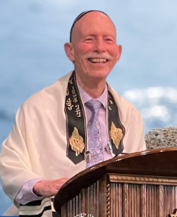
Rabbi Jim Appel
Messianic Synagogue
שמע ישראל
Shema Yisrael
Rochester NY
Notes:
Movie buddy at Rabbi’s Conf. Brooklyn Polytech HS.
I’m urging all of us to take this class, to commit Tuesday nights, forever. Newcomers, old timers, staff.

Slide 61
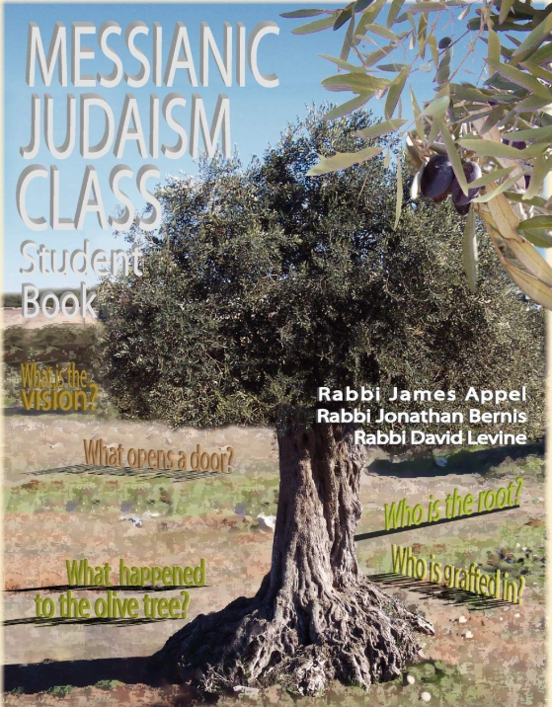
Renewed talimdut / discipleship class
Tuesdays
6:30-7:30 class
7:30 -8:30 Teerosh
Live and Zoom
Notes:
It is written by Rabbi Jim Appel who has been teaching this course in ongoing Tuesday night sessions for more than two decades.
There are many astounding revelations and "Aha!" moments for the students. Your attitude toward your Savior and His Word will never be the same after studying this course! After all, He was born and lived as a Jew and all His disciples and apostles were Jewish.

Slide 62
Conclusion:
Shavuot is about the abundance of the milk of the word. LOT of it.

Slide 64
Pentecostal? Rather Shavuotnik
Mysterious & multidimensional
Primary meaning of Shavuot is
wheat bread
3. Secondary meaning of Shavuot
is the milk of Torah, all scripture.
4. Third: the Ruakh Presence

Slide 65
The tablets were shattered. Israel had sensuously bowed to a golden calf, and Moshe stood at the crossroads of judgment and mercy, interceding for a people who did not know how close they had come to losing everything.
Then God spoke four words that have shaped the Jewish journey ever since:

Slide 66
^{Shmot/ Ex 33.13-18} Now, please, if it is really the case that I have found favor in your sight, show me your ways; so that I will understand you and continue finding favor in your sight. Moreover, keep on seeing this nation as your people.”

Slide 67

^{Shmot/ Ex 33.13-18} He answered, “Set your mind at rest — my presence will go with you, after all.”
פָּנַי יֵלֵכוּ, וַהֲנִחֹתִי לָךְ.
Notes:
His Presence. That is what it is all about. I love apologetics and logic and argument, but THIS is the reality!!

Slide 68
^{Shmot/ Ex 33.13-18} Moshe replied, “If your presence doesn’t go with us, don’t make us go on from here. For how else is it to be known that I have found favor in your sight, I and your people, other than by your going with us? That is what distinguishes us, me and your people, from all the other peoples on earth.”

Slide 69
^{Shmot/ Ex 33.13-18} Adoni said to Moshe, “I will also do what you have asked me to do, because you have found favor in my sight, and I know you by name.” But Moshe said, “I beg you to show me your glory!”

Slide 70
^{Acts 2.2-4} The festival of Shavuot arrived, and the believers all gathered together in one place. Suddenly there came a sound from the sky like the roar of a violent wind, and it filled the whole house where they were sitting.
Notes:
Analogous to Har Sinai, Mt Sinai

Slide 71
^{Acts 2.2-4} Then they saw what looked like tongues of fire, which separated and came to rest on each one of them. They were all filled with the Ruakh HaKodesh.
Notes:
Are we FILLED with Yeshua’s presence.

Slide 72
^{Yn 14.23-26} Yeshua answered him, “If someone loves me, he will keep my word; and my Father will love him, and we will come to him and make our home with him…But the Counselor, the Ruakh HaKodesh, whom the Father will send in my name, will teach you everything; that is, he will remind you of everything I have said to you.
Notes:
All three!

Slide 74
^{2 Cor 3.18} So all of us, with faces unveiled, see as in a mirror the glory of the Lord; and we are being changed into his very image, from one degree of glory to the next, by Adoni the Spirit.

Slide 75
Most Jews have barely heard of Shavuot, the celebration of Matan Torah. In Eretz Yisrael, the contrast between Shavuot and the other sacred days could not be more stark. Shavuot is only about the acceptance of Torah. For those Israeli Jews for whom Torah has long since ceased to be relevant, the holiday offers nothing.
Notes:
Jonathan Rosenblum (May 31, 2006). "Celebrating Shavuos Alone". Mishpacha. Retrieved June 4, 2020.
https://en.wikipedia.org/wiki/Shavuot#cite_note-11

Slide 76
Conclusion:
Shavuot is about the abundance of the Presence, the Ruakh. LOT of it.
Rather than Pentacostal fire,
Shavuotnik Presence!!

Slide 77
^{Col 3.1-5} So, if you were raised along with the Messiah, then seek the things above, where the Messiah is sitting at the right hand of God. Focus your minds on the things above, not on things here on earth. For you have died, and your life is hidden with the Messiah in God.

Slide 78
^{Col 3.1-5} When the Messiah, who is our life, appears, then you too will appear with him in glory! Therefore, put to death the earthly parts of your nature — sexual immorality, impurity, lust, evil desires and greed (which is a form of idolatry);

Slide 79
^{Col 3.12-17} Therefore, as God’s chosen people, holy and dearly loved, clothe yourselves with feelings of compassion and with kindness, humility, gentleness and patience. Bear with one another; if anyone has a complaint against someone else, forgive him.

Slide 80
^{Col 3.12-17} Indeed, just as the Lord has forgiven you, so you must forgive. Above all these, clothe yourselves with love, which binds everything together perfectly; and let the shalom which comes from the Messiah be your heart’s decision-maker, for this is why you were called to be part of a single Body.

Slide 81
^{Col 3.12-17} And be thankful — let the Word of the Messiah, in all its richness, live in you, as you teach and counsel each other in all wisdom, and as you sing psalms, hymns and spiritual songs with gratitude to God in your hearts. That is, everything you do or say, do in the name of the Lord Yeshua, giving thanks through him to God the Father.

Slide 82
Will there be difficulties?

Slide 83
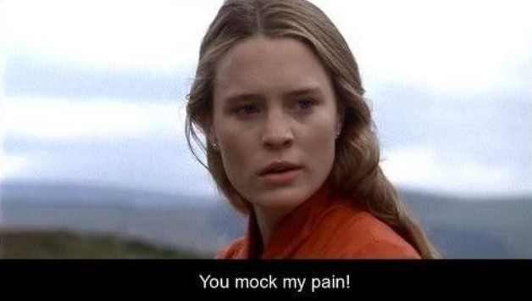
From
The
Princess
Bride
movie
Notes:
https://i.pinimg.com/736x/45/91/79/4591798a2b39a5d7a0cf65005bc7dbd2.jpg

Slide 84
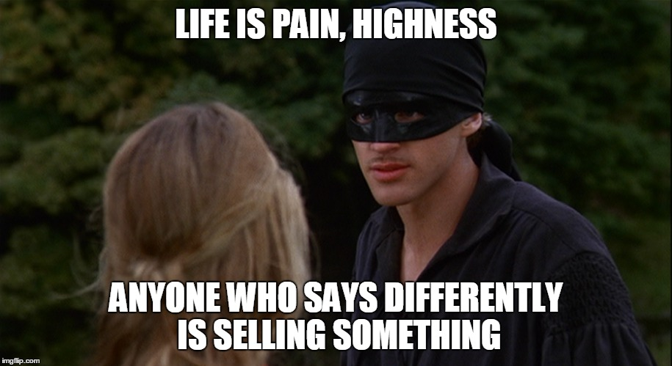
Notes:
“As you wish”

Slide 85
Said one candidate for the US Congress in Texas’s 35th Congressional District

Slide 86
“If you are a Zionist,” then “you are a danger to humanity and belong in prison.” “She’ll turn Karnes ICE Detention Center into a prison for American Zionists and former ICE officers for human trafficking,”
Notes:
https://www.jns.org/news/u-s-news/dems-distance-themselves-from-texas-candidate-calling-for-zionists-to-be-imprisoned-castrated?utm_campaign=Daily%20Syndicate%20Emails&utm_medium=email&_hsenc=p2ANqtz--d_wfrIgu_ElL90n3Jpa4UFvkHXR7Yjl4LkKzQFX-3l-lQ1Hv6iA8_Gu_aEjqr8Wh5PSUJ86FMeCdkqUyix71W2bZXcA&_hsmi=136346184&utm_content=136346184&utm_source=hs_email

Slide 87
a post from a campaign social media page states. “It will also be a castration processing center for pedophiles, which will probably be most of the Zionists,” it adds.
Notes:
https://www.jns.org/news/u-s-news/dems-distance-themselves-from-texas-candidate-calling-for-zionists-to-be-imprisoned-castrated?utm_campaign=Daily%20Syndicate%20Emails&utm_medium=email&_hsenc=p2ANqtz--d_wfrIgu_ElL90n3Jpa4UFvkHXR7Yjl4LkKzQFX-3l-lQ1Hv6iA8_Gu_aEjqr8Wh5PSUJ86FMeCdkqUyix71W2bZXcA&_hsmi=136346184&utm_content=136346184&utm_source=hs_email
How can someone talk like this. Rebuked by many, thankfully.

Slide 88
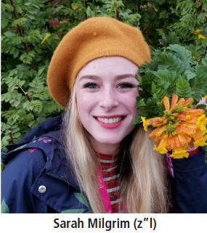
One year after tragedy, Sarah Milgrim’s legacy of peace and bridge-building lives on. Community mourns Sarah Milgrim, killed by gunman at AJC event in Washington
Notes:
https://www.kcjc.com/current-news/top-stories/10846-milgrim-legacy-one-year

Slide 89
^{Mark 10.29-31} In the ‘olam haba, [world to come] eternal life. But many who are first will be last, and many who are last will be first!”

Slide 90
^{1 Cor 13.4} Love suffers long and is kind
Longsuffering is a great and noble concept to honor…until
offense,

Slide 91
^{1 Cor 13.4} Love suffers long and is kind
Longsuffering is a great and noble concept to honor…until
offense,
depression,

Slide 92
^{1 Cor 13.4} Love suffers long and is kind
Longsuffering is a great and noble concept to honor…until
offense,
depression,
fight,

Slide 93
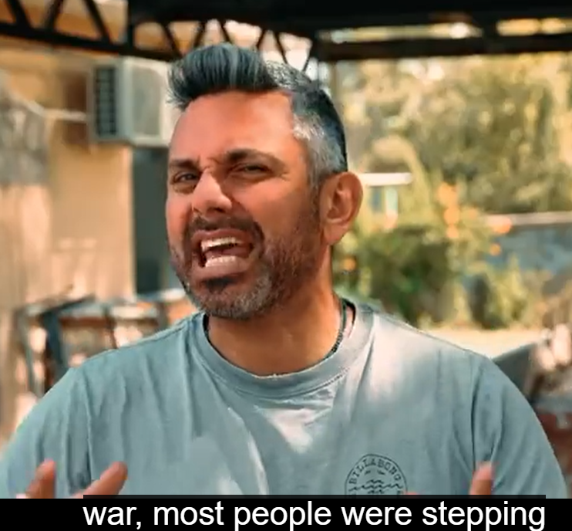

Slide 94
From the Tent of Meeting to the plains of Moab, from the prophets to the upper room, the promise never stopped moving: His face is still going. His rest is still waiting – both at the destination and along the road. And every spring, when the wheat ripens in the fields of Israel,

Slide 95
the church and the synagogue both hear, in their own way, the seven words that started it all: “My Presence will go with you. And I will give you rest.” – Exodus 33:14

Slide 97
Pentecostal? Rather Shavuotnik
Mysterious & multidimensional
Primary meaning of Shavuot is
wheat bread
3. Secondary meaning of Shavuot
is the milk of Torah, all scripture.
4. Third: the Ruakh Presence

