Slide 1
When Louis was younger, he just hated going to bar mitzvahs. All of his uncles and aunts used to come up to him, poke him in the ribs, and say to him, "You're next, Louis."

Slide 2
But they stopped doing that after Louis started doing the same thing to them at funerals.

Slide 3
One day, two bees are buzzing around what's left of a rose bush. "How's your summer been?" asks bee number one. "Not too good," says bee two. "Lotta rain, lotta cold. There aren't enough flowers, therefore not enough pollen."
Notes:
source: http://www.jokebuddha.com/Mitzvah#ixzz3CV2cuktD

Slide 4
The first bee has an idea. "Hey, why don't you go down to the corner and hang a left? There's a bar mitzvah going on. Plenty of flowers and fruit." Bee two buzzes, "Thanks!" and takes off.
Notes:
source: http://www.jokebuddha.com/Mitzvah#ixzz3CV2cuktD

Slide 5
An hour later, the bees bump into each other again. "How was the bar mitzvah?" asks the first bee. "Great!" replies the second.
Notes:
source: http://www.jokebuddha.com/Mitzvah#ixzz3CV2cuktD

Slide 6
The first bee, however, notices a small circle on his friend's head, and inquires, "What's that on your head?" "A yarmulke," is the answer.
"I didn't want them to think I was a Wasp."
Notes:
source: http://www.jokebuddha.com/Mitzvah#ixzz3CV2cuktD

Slide 7
TORAHFIED n.
Notes:
source: http://www.jokebuddha.com/Mitzvah#ixzz3CV2cuktD

Slide 8
TORAHFIED n.
Inability to remember one's lines at one's Bar Mitzvah.
Notes:
source: http://www.jokebuddha.com/Mitzvah#ixzz3CV2cuktD

Slide 9


Slide 10

Bar Mitzvah = Parental Release
Purpose of Bar Mitzvah
Bar Mitzvah and Mother’s Day
Motherhood is under attack
Honoring Moms
Some motherly advice
Parental Blessing and Release

Slide 11
Bar Mitzvah = Parental Release
Purpose of Bar Mitzvah
Bar Mitzvah and Mother’s Day
Motherhood is under attack
Honoring Moms
Some motherly advice
Parental Blessing and Release

Slide 12

לוּקַס בֶּן יְהוֹָתָן וְטַבְתָה
Lukas ben
Y'honatan v'Tavtah
Luke Dotson
Notes:
In a few minutes, Luke’s parents, Tabitha and Jonathan will be called to the bima to recite a blessing over their son:

Slide 13
בָּרוּךְ שֶׁפְּטָרַנִי מֵעָנְשׁוֹ שֶׁלָזֶה.
Ba-rukh shep-ta-ra-nee
may-on-sho sheh-lah-zeh.
Blessed is He Who has released me from [literally: the punishment]
the full responsibility for the character and deeds of my son.
Notes:
The expression goes back to the 4th C, 300’s, in a book called the Midrash Rabbah, where Rabbi Shimon bar Tzadok stated: A person must care for his son until 13 years. After that, he should say, “Blessed are you L‑rd our G‑d, King of the universe, who has released me from the punishment of this [boy].”
https://www.chabad.org/library/article_cdo/aid/4007906/jewish/Baruch-Shepetarani-The-Bar-Mitzvah-Boys-Fathers-Blessing.htm
Supposed that by age 13 the difference between Yaakov and Esav were apparent. Ber Gen 25.27
It is a form of “letting go,” in which children are becoming their own persons and must make their own moral judgments.

Slide 14
Why do we do Bar Mitzvah? How did it start? Origins of Bar Mitzvah
The Great Synagogue in Rome records the custom of a young woman [!]
Notes:
Continued as practice in the Roman synagogue.
http://en.wikipedia.org/wiki/Bar_and_Bat_Mitzvah#History

Slide 15
being called up in synagogue before the entire community dates back to the early years of the Roman Jewish community approximately 2,300 years ago. 200 BCE
Notes:
Continued as practice in the Roman synagogue.
http://en.wikipedia.org/wiki/Bar_and_Bat_Mitzvah#History

Slide 16
Pirkei Avot/Ethics of the Fathers 5.21.1 [~200 CE]
Five years is the age for the study of Scripture.
Ten, for
the study of Mishnah.
Thirteen, for the obligation to observe the mitzvot.
Notes:
https://www.sefaria.org/English_Explanation_of_Pirkei_Avot.5.21.1?lang=bi
Old enough to fast on YK.

Slide 17
Fifteen, for the study of Talmud.
Eighteen, for marriage.
Twenty, to pursue [a livelihood].
Thirty, for strength,
Notes:
https://www.sefaria.org/English_Explanation_of_Pirkei_Avot.5.21.1?lang=bi
Old enough to fast on YK.

Slide 18
Forty, for understanding.
Fifty, for counsel.
Sixty, for sagacity.
Seventy, for elderliness.
Notes:
https://www.sefaria.org/English_Explanation_of_Pirkei_Avot.5.21.1?lang=bi

Slide 19
Eighty, for power.
Ninety, to stoop.
A hundred-year-old is as one who has died and passed away and has been negated from the world.
Notes:
https://www.sefaria.org/English_Explanation_of_Pirkei_Avot.5.21.1?lang=bi

Slide 20
What is a Bar Mitzvah?
בַּר מִצְוָה
בַּר son
מִצְוָה שֵם נfemale noun
(religion) commandment, precept; decree, edict; good deed, act of kindness
Notes:
Son and commandment seem opposite.
Son is the epitome of beloved and precious.
Commandment sound legal, military.
It’s being engaged, involved, enamored with the TRUTH of the Word. Yeshua IS the Word. The sonship dimension is because the Word is a love letter of family identity. Covenantal family identity. Covenant in Messiah is the key word.

Slide 21
בָּרוּךְ אַתָּה, בְּבֹאֶךָ; וּבָרוּךְ אַתָּה, בְּצֵאתֶךָ
^{Dt. 28.6} “A blessing on you when you go out, and a blessing on you when you come in.”
God meets us at transition points
Birth: Brit Milah/circumcision
Puberty
Marriage
Death
Notes:
Celebrate transitions. Honor the budding manhood of Luke Dotson!
Verses that connect love/sonship and the Word.

Slide 22
^{Luke 2. 41-47} Every year Yeshua's parents went to Yerushalayim for the festival of Pesach. When he was twelve years old, they went up for the festival, as custom required.
Notes:
Seems this was His first trip with them for the Regalim, the Pilgrim Holidays. Sort of a proto Bar Mitzvah. Then He got engaged with the teachers…

Slide 23
^{Luke 2. 41-47} But after the festival was over, when his parents returned, Yeshua remained in Yerushalayim...they spent a whole day on the road before they began searching…

Slide 24
^{Luke 2. 41-47} They returned to Yerushalayim to look for him. On the third day they found him -- he was sitting in the Temple court among the rabbis, not only listening to them but questioning what they said; and everyone who heard him was astonished at his insight and his responses…
Notes:
Yeshua appeared to be enamored with the learning, and responded. Some theologians said He didn’t fully understand His Divine identity and destiny until His mikveh/immersion.

Slide 25
^{Luke 2. 41-47} So he went with them to Natzeret and was obedient to them. And Yeshua grew both in wisdom and in stature, gaining favor both with other people and with God.
Yeshua ישוע grew
intellectually,
physically,
socially, and
spiritually.
Notes:
For all that, he returned to the authority of his parents.
Famous line: You are a Bar Mitzvah. Today you are a man. Monday you return to 8th grade.
But He grew. In His love for scripture learning, and social skills, and submission to His parents, He grew. You are already a mighty man, but there is more to come! You come from generations of engineers and learned people. May you further that in Yeshua ישוע

Slide 27
Bar Mitzvah = Parental Release
Purpose of Bar Mitzvah
Bar Mitzvah and Mother’s Day
Motherhood is under attack
Honoring Moms
Some motherly advice
Parental Blessing and Release

Slide 28
So, how does this relate to Mother’s Day?

Slide 29
There is rarely a Bar Mitzvah without the input of the Jewish mother.

Slide 30
She often plays a key role in planning and organizing the event.
The mother typically helps prepare the child spiritually and emotionally for the ceremony.
She may be involved in selecting the Torah portion and other religious aspects.

Slide 31
The Jewish mother often hosts the celebratory meal or reception following the service.
She provides support and encouragement to her child during this significant life transition.
The mother may also share personal reflections or blessings during the ceremony, highlighting family values.

Slide 33
Bar Mitzvah = Parental Release
Purpose of Bar Mitzvah
Bar Mitzvah and Mother’s Day
Motherhood is under attack
Honoring Moms
Some motherly advice
Parental Blessing and Release

Slide 34
There was a CIA memo not too long ago. The memo warned that women were joining a movement it called “white racially and ethnically motivated violent extremist,” or “REMVE.”
Notes:
https://washingtonstand.com/article/biden-cia-memo-tied-motherhood-and-homemaking-to-white-supremacy

Slide 35
From there, the memo proceeded to warn about “the white REMVE view of traditional motherhood” and that one group of concern, whose identity was redacted in the final report, “has lauded motherhood and homemaking as women’s most important responsibility.”
Notes:
https://washingtonstand.com/article/biden-cia-memo-tied-motherhood-and-homemaking-to-white-supremacy

Slide 36

Notes:
https://washingtonstand.com/article/biden-cia-memo-tied-motherhood-and-homemaking-to-white-supremacy

Slide 38
Bar Mitzvah = Parental Release
Purpose of Bar Mitzvah
Bar Mitzvah and Mother’s Day
Motherhood is under attack
Honoring Moms
Some motherly advice
Parental Blessing and Release

Slide 39

Notes:
https://www.drjamesdobson.org/blogs/a-wifes-countenance/?utm_campaign=34268089-MandP%20-%20Weekly%20Content&utm_medium=email&_hsenc=p2ANqtz-8LYWcW0YJfCyyg15kkUABdtTR5soq3z0vq82IHLotz2MJaacgvR1G-4Z8JuLtalxeHGYFxkxiQiaM2mZpGvSCXTalcVA&_hsmi=412622585&utm_content=412622585&utm_source=hs_email

Slide 40
“He is to be free to stay at home and bring happiness to the wife he has married.” – Deuteronomy 24:5
If you really want to know about a man and what kind of character he has, you need only look at the countenance of his wife. Everything he has invested, or withheld, will be there.
Notes:
https://www.drjamesdobson.org/blogs/a-wifes-countenance/?utm_campaign=34268089-MandP%20-%20Weekly%20Content&utm_medium=email&_hsenc=p2ANqtz-8LYWcW0YJfCyyg15kkUABdtTR5soq3z0vq82IHLotz2MJaacgvR1G-4Z8JuLtalxeHGYFxkxiQiaM2mZpGvSCXTalcVA&_hsmi=412622585&utm_content=412622585&utm_source=hs_email

Slide 41
That was the message Bill McCartney, then head coach of the University of Colorado football team, heard in a 1994 sermon. The words cut straight to his heart. McCartney had built the Colorado football program into a powerhouse that won a national championship in 1990. He had also cofounded a national men’s movement, Promise Keepers.
Notes:
https://www.drjamesdobson.org/blogs/a-wifes-countenance/?utm_campaign=34268089-MandP%20-%20Weekly%20Content&utm_medium=email&_hsenc=p2ANqtz-8LYWcW0YJfCyyg15kkUABdtTR5soq3z0vq82IHLotz2MJaacgvR1G-4Z8JuLtalxeHGYFxkxiQiaM2mZpGvSCXTalcVA&_hsmi=412622585&utm_content=412622585&utm_source=hs_email
I heard Coach Mac say that, in Minneapolis

Slide 42
But those achievements came at a price. For years McCartney had withheld his time and energy from his wife, Lyndi, and their four children.
In 1994, Bill McCartney didn’t like what he saw in Lyndi’s countenance—so he resigned from his position at the University of Colorado to devote more time to his wife and family.
Notes:
https://www.drjamesdobson.org/blogs/a-wifes-countenance/?utm_campaign=34268089-MandP%20-%20Weekly%20Content&utm_medium=email&_hsenc=p2ANqtz-8LYWcW0YJfCyyg15kkUABdtTR5soq3z0vq82IHLotz2MJaacgvR1G-4Z8JuLtalxeHGYFxkxiQiaM2mZpGvSCXTalcVA&_hsmi=412622585&utm_content=412622585&utm_source=hs_email

Slide 43
As a husband, you bear the primary responsibility for your wife’s welfare and emotional wellbeing. What do you see in her face tonight?
Do your cheer her?
Notes:
https://www.drjamesdobson.org/blogs/a-wifes-countenance/?utm_campaign=34268089-MandP%20-%20Weekly%20Content&utm_medium=email&_hsenc=p2ANqtz-8LYWcW0YJfCyyg15kkUABdtTR5soq3z0vq82IHLotz2MJaacgvR1G-4Z8JuLtalxeHGYFxkxiQiaM2mZpGvSCXTalcVA&_hsmi=412622585&utm_content=412622585&utm_source=hs_email

Slide 44

Notes:
https://www.drjamesdobson.org/marriage-parenting/why-christian-men-need-to-support-their-wives/?utm_campaign=34268089-MandP%20-%20Weekly%20Content&utm_medium=email&_hsenc=p2ANqtz-_7wQ_vVfdrqf2ZURgRVIVoVZ4GmK5p4IHFOs39syRjzIOrTTRTFvauN592uwvR4YVisbN8pjMgtm5cWrhmoq8t3gN49g&_hsmi=412622585&utm_content=412622585&utm_source=hs_email

Slide 45
^{Mishlei/Prov 31.10} ^{CJB} Who can find a capable wife? Her value is far beyond that of pearls.
^{NIV} A wife of noble character who can find? She is worth far more than rubies.
^{TLV} A wife of noble character who can find? She is worth far more than rubies.

Slide 46

hayil: strength, valor, army, wealth, capability, able, activity, army, band of men soldiers, company, great forces, goods,
Modern Hebrew soldier: חַיָּל חַיֶּלֶת

Slide 47

Notes:
https://cdn.bfldr.com/FK28HSHN/at/t4nfh8tghqxzjpf8gzjp5h4v/ddm-mothers-day-horizontal.mp4

Slide 48
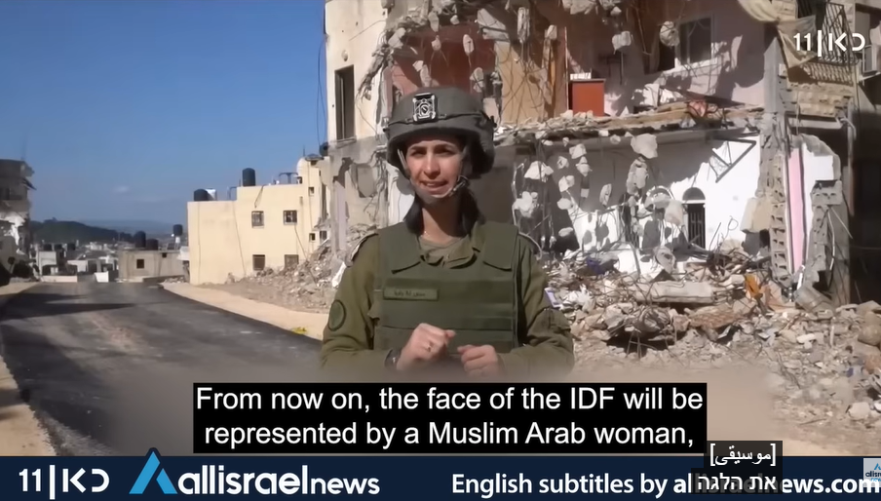
Notes:
https://youtu.be/qRWFSr3Sz84

Slide 49

Help for Stressed-Out Moms
Notes:
https://www.drjamesdobson.org/broadcasts/help-for-stressed-out-moms-2/

Slide 50
I can remember being at a law society dinner with Rob. We were sat around a table similar to this and a young lawyer, woman said to me, "Hi, Di, how are you? Do you work?“
And I just wanted the floor to open up andswallow her.
Notes:
https://cdn.bfldr.com/FK28HSHN/at/87bq94jkmg53k69p8rt64xn5/05042026HELPFORSTRESSEDOUTMOMS.pdf

Slide 51
“Yes, I do work. I'm in a program of social development and at present I’m working with three age groups, first with babies and toddlers. That involves a basic grasp of medicine and child psychology. Next, I'm working with teenagers and I confess the program is not going too well in that area at the moment.
Notes:
https://cdn.bfldr.com/FK28HSHN/at/87bq94jkmg53k69p8rt64xn5/05042026HELPFORSTRESSEDOUTMOMS.pdf

Slide 52
And finally, it's evenings and weekends. I work with a man age 39 who's exhibiting all the classic symptoms of midlife crisis. That's mainly psychiatric work. The whole job involves planning and make it happen attitude and the ability to crisis manage. I used to be an international fashion model, but I got bored.”
Notes:
https://cdn.bfldr.com/FK28HSHN/at/87bq94jkmg53k69p8rt64xn5/05042026HELPFORSTRESSEDOUTMOMS.pdf
And I tell you, the women who are mums at home, when I say that in these seminars, they are so relieved and to just tell them that they are directors of social development. You can see their heads rise and self-esteem just build in them.

Slide 53
Some testimonials

Slide 54
"My mother modeled the idea of celebrating everyday joys. Anything that could be close to construed as a holiday was an occasion for a card from her with a tiny little note in her tiny little handwriting.
Notes:
https://link.join1440.com/view/68ab968ed7432303610d4fafr3bwy.3aqli/de918d7a

Slide 55
Her ability to observe and celebrate the little moments in life brought great joy and was a wonderful model of creating happiness for those around her, which fed her own joy and contentment with life. My memory of her caring and kindness will forever be with me."
— Martha A.B. in Edmore, Michigan
Notes:
https://link.join1440.com/view/68ab968ed7432303610d4fafr3bwy.3aqli/de918d7a

Slide 56
"My mother was heading to GW Hospital to give birth. She had blood dripping down her legs, and yet stopped to braid my hair. She sat on the edge of the tub in her bathroom and patiently did my hair with love and patience. I have never forgotten her act of selflessness."
— Nancy K. in Vero Beach, Florida
Notes:
https://link.join1440.com/view/68ab968ed7432303610d4fafr3bwy.3aqli/de918d7a

Slide 57
"One thing I’ve learned about being a mom is that it’s more about presence than anything else. It’s not about doing things right or better. It’s not about knowing all the answers. It’s not about wishing we could have bought our kids all the cool stuff, or wishing we’d done things differently.
Notes:
https://link.join1440.com/view/68ab968ed7432303610d4fafr3bwy.3aqli/de918d7a

Slide 58
It’s about showing up as we are today, in this moment, and being with our kids fully. It’s not about wanting to change anything; it’s just about being 'here' now."
— Lora P. in Seattle, Washington
Notes:
https://link.join1440.com/view/68ab968ed7432303610d4fafr3bwy.3aqli/de918d7a

Slide 60
Bar Mitzvah = Parental Release
Purpose of Bar Mitzvah
Bar Mitzvah and Mother’s Day
Motherhood is under attack
Honoring Moms
Some motherly advice
Parental Blessing and Release

Slide 61
#1 Stay OUT of DEBT

Slide 62
The United States has crossed a historic financial threshold, as the nation’s debt held by the public has now exceeded the size of its entire economy. New data from the Bureau of Economic Analysis shows that U.S. national debt reached approximately $31.27 trillion as of March 31, while nominal gross domestic product (GDP) stood slightly lower at $31.22 trillion over the previous 12 months.
Notes:
https://www.worthynews.com/114068-u-s-debt-surpasses-entire-economy-raising-alarms-over-fiscal-future

Slide 63

The National Debt is now over $31 trillion, bigger than our entire economy. Here’s what that means: If the federal government were to demand, for an entire year, that all workers hand
Notes:
https://messaging-custom-newsletters.nytimes.com/dynamic/render?abVariantId=0&campaign_id=9&emc=edit_nn_20260508&instance_id=175295&isViewInBrowser=true&nl=the-morning&paid_regi=0&productCode=NN&regi_id=35997600&segment_id=219547&sendId=219547&uri=nyt://newsletter/71c45b7e-1c97-5ede-81ad-ac50e06bc3f3&user_id=0c340ef4a0010f69a562b70ff5e66878

Slide 64
over 100 percent of their wages, that all landlords hand over 100 percent of their rents, that all investors hand over 100 percent of their capital returns and that all corporations hand over 100 percent of their profits, then at the end of that nightmarish year, the government would still be in debt.
Notes:
https://messaging-custom-newsletters.nytimes.com/dynamic/render?abVariantId=0&campaign_id=9&emc=edit_nn_20260508&instance_id=175295&isViewInBrowser=true&nl=the-morning&paid_regi=0&productCode=NN&regi_id=35997600&segment_id=219547&sendId=219547&uri=nyt://newsletter/71c45b7e-1c97-5ede-81ad-ac50e06bc3f3&user_id=0c340ef4a0010f69a562b70ff5e66878

Slide 65
#2 Don’t believe the lies of the media, especially about Israel

Slide 66
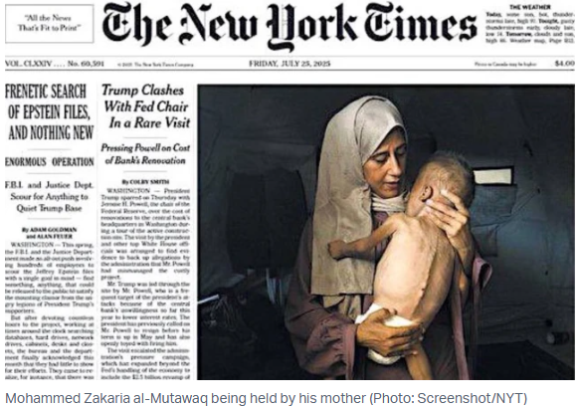
Notes:
https://allisraelnews.com/pulitzer-prize-winning-gaza-photo-award-prompts-scrutiny-over-media-imagery-and-context?utm_source=convertkit&utm_medium=email&utm_campaign=Will%20ending%20US%20military%20aid%20make%20Israel%20stronger%20or%20more%20vulnerable%3F%20-%2021670872

Slide 67
However, later in July 2025, freelance investigative journalist David Collier published a medical report which provided details of the child’s medical condition, including his diagnosis of pre-existing medical conditions, including cerebral palsy and hypoxemia, both of which affect his physical appearance.
Notes:
https://allisraelnews.com/pulitzer-prize-winning-gaza-photo-award-prompts-scrutiny-over-media-imagery-and-context?utm_source=convertkit&utm_medium=email&utm_campaign=Will%20ending%20US%20military%20aid%20make%20Israel%20stronger%20or%20more%20vulnerable%3F%20-%2021670872

Slide 68
The NYT later published an acknowledgement that the child in the image had "pre-existing health problems affecting his brain and his muscle development," while the story and the caption that originally accompanied the picture implied that he was suffering from malnutrition.
Notes:
https://allisraelnews.com/pulitzer-prize-winning-gaza-photo-award-prompts-scrutiny-over-media-imagery-and-context?utm_source=convertkit&utm_medium=email&utm_campaign=Will%20ending%20US%20military%20aid%20make%20Israel%20stronger%20or%20more%20vulnerable%3F%20-%2021670872

Slide 69
#3 Don’t believe the lies of the media, especially about sexuality

Slide 70
The Israeli Foreign Ministry’s social media account posted an announcement of a pride festival to take place at the Dead Sea in June, calling it “the biggest LGBTQ+ festival ever in the Middle East.”

Slide 71

Some conservative Christian accounts on social media noticed the location of the pride event, which will take place in the Dead Sea area,
Notes:
https://allisraelnews.com/jerusalem-gay-pride-parade-will-end-at-knesset-for-1st-time-in-over-a-decade?utm_source=convertkit&utm_medium=email&utm_campaign=Will%20ending%20US%20military%20aid%20make%20Israel%20stronger%20or%20more%20vulnerable%3F%20-%2021670872

Slide 72
the setting for the biblical story of Sodom and Gomorrah, which were judged by God for the perversion of traditional Ancient Near Eastern hospitality and an attempt to engage in homosexual relations with the two angelic visitors, described in Genesis 19.
Notes:
https://allisraelnews.com/jerusalem-gay-pride-parade-will-end-at-knesset-for-1st-time-in-over-a-decade?utm_source=convertkit&utm_medium=email&utm_campaign=Will%20ending%20US%20military%20aid%20make%20Israel%20stronger%20or%20more%20vulnerable%3F%20-%2021670872

Slide 73

Notes:
https://www.ganjingworld.com/article/1i37rfm1r406vPwKhi2HmBpHL1on1c

Slide 74
When Kaytlin O’Neall walked through the chapel doors on a golden October afternoon, her heart swelled with joy and anticipation. Ahead of her stood Drew Brown — the man she had prayed for, laughed with and loved since their school days.

Slide 75
At that moment, every year of friendship, distance and devotion led to this: their wedding day, and their very first kiss.
“This was truly so worth the wait,” Brown told People.

Slide 76
Save your kisses for your missus, then they will be most delicious.
Save your kisses until you are a missus,
then they will be most delicious.
Notes:
https://www.ganjingworld.com/article/1i37rfm1r406vPwKhi2HmBpHL1on1c

Slide 77
#4 Keep Shabbat

Slide 78

Pres. Trump makes a Shabbat proclamation.
Notes:
https://www.jfeed.com/news-world/trump-national-shabbat-proclamation

Slide 79
Trump’s proclamation states that from Friday evening, May 15, until Saturday evening, May 16, Americans are invited to observe the Sabbath in recognition of Jewish customs. This would “recognize the sacred Jewish tradition of setting aside time for rest, reflection, and gratitude to the Almighty…
Notes:
https://allisraelnews.com/trump-proclaims-national-sabbath-to-honor-jewish-american-heritage-month?utm_source=convertkit&utm_medium=email&utm_campaign=Trump%20downplays%20Iranian%20fire%20at%20US%20ships,%20UAE%20as%20Project%20Freedom%20erodes%20Hormuz%20blockade%20-%2021642607

Slide 80
From sundown on May 15 to nightfall on May 16, friends, families, and communities of all backgrounds may come together in gratitude for our great Nation."
Notes:
https://allisraelnews.com/trump-proclaims-national-sabbath-to-honor-jewish-american-heritage-month?utm_source=convertkit&utm_medium=email&utm_campaign=Trump%20downplays%20Iranian%20fire%20at%20US%20ships,%20UAE%20as%20Project%20Freedom%20erodes%20Hormuz%20blockade%20-%2021642607

Slide 81
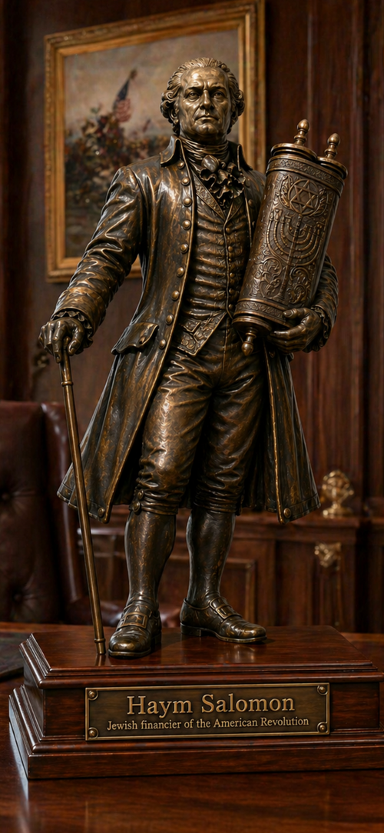
Haym Salomon (1740 – 1785), “the Jew who saved America”
He financed the American Revolution.
1781, Washington’s army was deserting, out of funds, the war was being lost.
Salomon raised the funds, and supported our first four presidents.
Notes:
Story that on YK he called for a collection!!

Slide 82
Without him, the War for Independence would have been lost.
He was imprisoned by the British, lost his health, died young.
But…
The government never paid him back.

Slide 83
He died penniless (at 44 years of age), as did his wife, as did his children.
His grandchildren appealed to Congress, which admitted money was owed, but never paid.
In 1926 (100 years ago), a statue honoring him was proposed for Washington, DC, but never built.

Slide 84
#5 Serve others

Slide 85
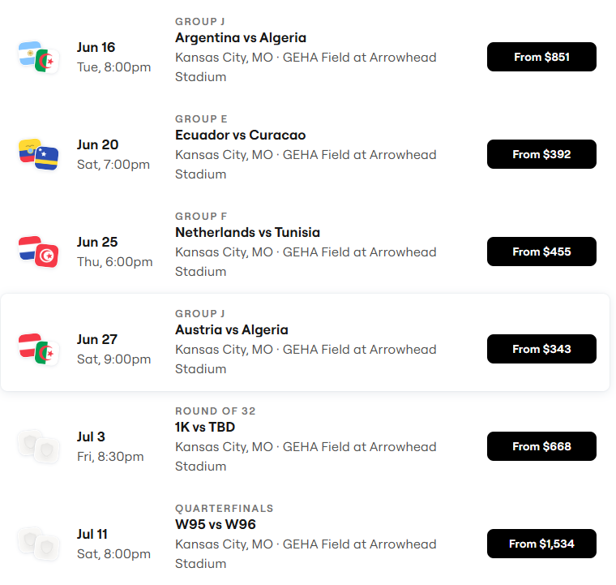
World Cup Schedule
~700,000 visitors to KC!

Slide 86
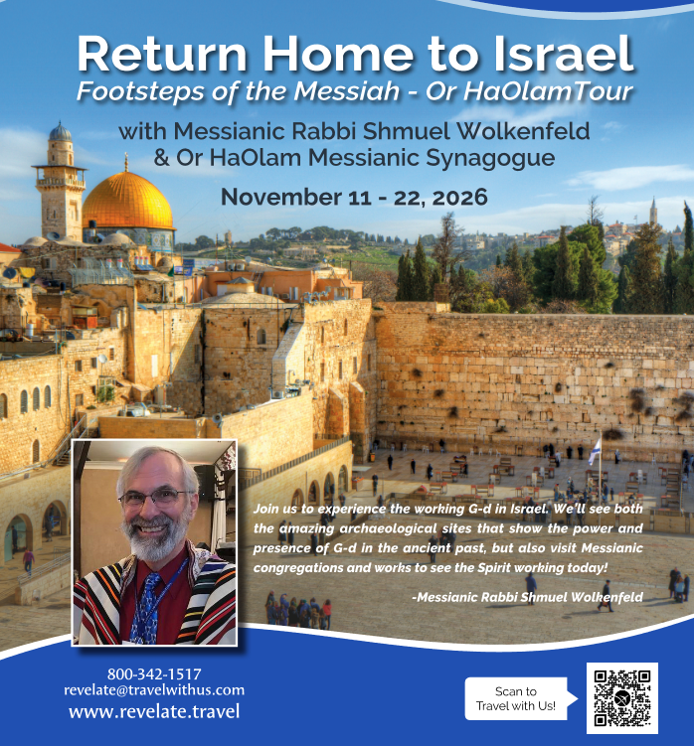

Slide 88
Bar Mitzvah = Parental Release
Purpose of Bar Mitzvah
Bar Mitzvah and Mother’s Day
Motherhood is under attack
Honoring Moms
Some motherly advice
Parental Blessing and Release

Slide 89
בָּרוּךְ שֶׁפְּטָרַנִי מֵעָנְשׁוֹ שֶׁלָזֶה.
Ba-rukh shep-ta-ra-nee
may-on-sho sheh-lah-zeh.
Blessed is He Who has released me from [literally: the punishment]
the full responsibility for the character and deeds of my son.
Notes:
The expression goes back to the 4th C, 300’s, in a book called the Midrash Rabbah, where Rabbi Shimon bar Tzadok stated: A person must care for his son until 13 years. After that, he should say, “Blessed are you L‑rd our G‑d, King of the universe, who has released me from the punishment of this [boy].”
https://www.chabad.org/library/article_cdo/aid/4007906/jewish/Baruch-Shepetarani-The-Bar-Mitzvah-Boys-Fathers-Blessing.htm
Supposed that by age 13 the difference between Yaakov and Esav were apparent. Ber Gen 25.27
It is a form of “letting go,” in which children are becoming their own persons and must make their own moral judgments.

