Slide 1


Slide 2
SpaceX's market value surged to approximately $2.18 trillion following its Nasdaq debut, with shares jumping 23% on its first day of trading.
Here’s why…

Slide 3
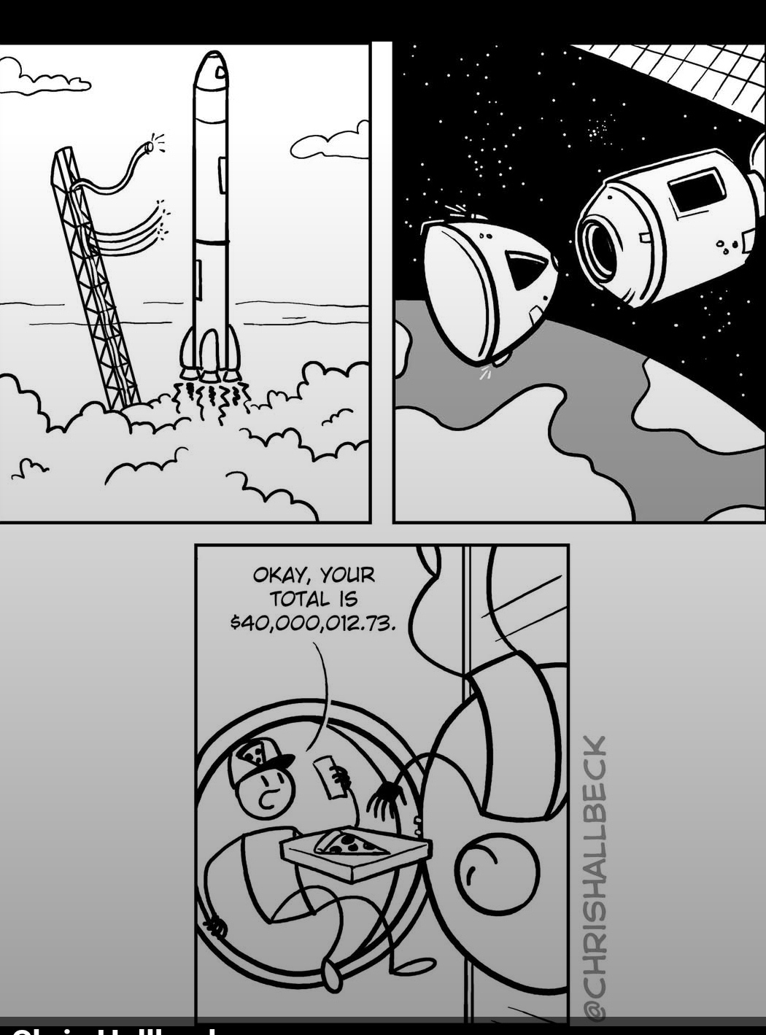

Slide 4
Notes:
Docking with the ISS International Space station

Slide 5
Notes:
Why Elon Musk is now a trillionaire. First in the world.

Slide 6
Rabbi’s Regimen

Slide 7
Research suggests that skeletal muscle does more than support movement—it also functions as an endocrine organ. During exercise, muscles release signaling molecules known as myokines, which communicate with the brain and help support areas involved in memory and learning, including the hippocampus.
Notes:
https://www.theepochtimes.com/health/muscle-loss-may-signal-dementia-risk-experts-recommend-this-brain-healthy-exercise-6038823

Slide 8
As muscle mass declines, these beneficial effects may diminish, potentially increasing the risk of cognitive decline. This is one reason why regular physical activity is considered important not only for maintaining muscle strength, but also for preserving brain health.
Notes:
https://www.theepochtimes.com/health/muscle-loss-may-signal-dementia-risk-experts-recommend-this-brain-healthy-exercise-6038823

Slide 9
Try Dancing: Dancing is a highly recommended brain-boosting exercise. It involves physical activity, as well as practice in memorizing steps, training hand-eye coordination, and increasing social interaction, all of which are beneficial for stimulating brain function.
Notes:
https://www.theepochtimes.com/health/muscle-loss-may-signal-dementia-risk-experts-recommend-this-brain-healthy-exercise-6038823

Slide 10
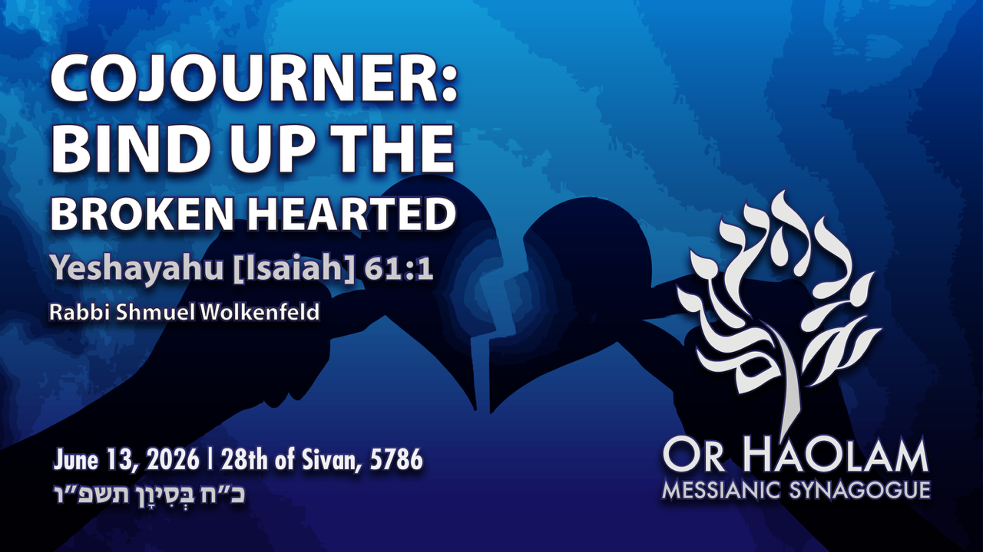

Slide 11

Cojourner: Bind up the
Brokenhearted, Yesh/Is 61.1
Scriptures on sharing Yeshua
Intimidation
Cojourner concept
Talmidut / Discipleship

Slide 12
^{Yeshayahu/Isaiah 61.1-3} The Ruakh of Adoni Elohim is on me, because Adoni has anointed me to proclaim Good News to the poor. He has sent me to bind up the brokenhearted, to proclaim liberty to the captives,

Slide 13
^{Yeshayahu/Isaiah 61.1-3} and the opening of the prison to those who are bound, to proclaim the year of Adoni’s favor | and the day of our God’s vengeance, to comfort all who mourn, to console those who mourn in Zion,

Slide 14
^{Yeshayahu/Isaiah 61.1-3} to give them beauty for ashes, the oil of joy for mourning, the garment of praise for the spirit of heaviness, that they might be called oaks of righteousness, the planting of Adoni, that He may be glorified.
Notes:
Yeshua quoted this in part when He attended His home synagogue in Luke 4.
He came to Natzeret, where He had been raised. As was His custom, He went into the synagogue on Shabbat, and He got up to read. When the scroll of the prophet Isaiah was handed to Him, He unrolled the scroll and found the place where [this] was written,
This was His mission. Up to “Adoni’s favor”

Slide 16
Cojourner: Bind up the
Brokenhearted, Yesh/Is 61.1
Scriptures on sharing Yeshua
Intimidation
Cojourner concept
Talmidut / Discipleship
Notes:
The world may not appear broken hearted, but we are considering the words of the prophet Yermiyahu/ Jeremiah 17.9 “The heart is more deceitful than anything else
and mortally sick. Who can fathom it?
Hearts with unredeemed sin are in the deepest sense broken. Without the joy of the L-rd.

Slide 17
^{Ro 1.16} For I am not ashamed of the Good News, for it is the power of God for salvation to everyone who trusts—to the Jew first and also to the Nations.

Slide 18
^{2 Cor 5.20} Therefore, we are ambassadors of the Messiah; in effect, God is making his appeal through us. What we do is appeal on behalf of the Messiah, “Be reconciled to God!

Slide 19
^{Mark 16.15-16} Then he said to them, “As you go throughout the world, proclaim the Good News to all creation. Whoever trusts and is immersed will be saved; whoever does not trust will be condemned.

Slide 20
^{1 Kefa/Peter 3. 15-16} Treat the Messiah as holy, as Lord in your hearts; while remaining always ready to give a reasoned answer to anyone who asks you to explain the hope you have in you — yet with humility and fear, keeping your conscience clear,

Slide 21
^{1 Kefa/Peter 3. 15-16} so that when you are spoken against, those who abuse the good behavior flowing from your union with the Messiah may be put to shame.

Slide 22
^{T’hillim / Psalm 71:15} All day long my mouth will tell of your righteous deeds and acts of salvation, though their number is past my knowing.

Slide 23
^{Col 4.5-6} Behave wisely toward outsiders, making full use of every opportunity — let your conversation always be gracious and interesting, so that you will know how to respond to any particular individual.

Slide 24
^{Mtt 28.18-20} Yeshua came and talked with them. He said, “All authority in heaven and on earth has been given to me. Therefore, go and make people from all nations into talmidim, immersing them into the reality

Slide 25
^{Mtt 28.18-20} of the Father, the Son and the Ruakh HaKodesh, and teaching them to obey everything that I have commanded you. And remember! I will be with you always, yes, even until the end of the age

Slide 27
Cojourner: Bind up the
Brokenhearted, Yesh/Is 61.1
Scriptures on sharing Yeshua
Intimidation
Cojourner concept
Talmidut / Discipleship

Slide 28
Intimidation
It’s not restful to always have a mission. Obsessive.
It seems invasive to be always telling people to change their life and opinions.
Notes:
Internal disquiet
Relational abrasiveness
Obsessive and oppressive

Slide 29
Intimidation
If we are not living right…
It can only be done right out of abundance of love, joy, peace.
Notes:
3. If have an argument at the restaurant table, it’s inconsistent to be telling others how to live.

Slide 30
^{Acts 4.31} When they had prayed, the place where they were gathered was shaken. And they were all filled with the Ruakh ha-Kodesh and began to speak the word of God with boldness.
^{Acts 8.4} Those who had been scattered preached the word wherever they went.
Notes:
Are we always filled?

Slide 31
^{Acts 5.40-42} After summoning the emissaries and flogging them, they commanded them not to speak in the name of Yeshua, and let them go. The emissaries left the Sanhedrin overjoyed at having been considered worthy of suffering disgrace on account of him.

Slide 32
^{Acts 5.40-42} And not for a single day, either in the Temple court or in private homes, did they stop teaching and proclaiming the Good News that Yeshua is the Messiah.
Notes:
We are always overjoyed??

Slide 34
Cojourner: Bind up the
Brokenhearted, Yesh/Is 61.1
Scriptures on sharing Yeshua
Intimidation
Cojourner concept
Talmidut / Discipleship

Slide 35
Cojourner is a made-up word by an outreach organization.
From:
Sojourner: a temporary resident,
The term sojourner in the Bible refers to a person who is just passing through.
Notes:
https://www.vocabulary.com/dictionary/sojourner
https://www.gotquestions.org/sojourner-in-the-Bible.html
Made up by what was Campus Crusade, now Cru. “Crusade” is an anathema word to Jewish ears. Those who know the least bit of Jewish history know that in the YK Kaddish the city Mayence was brutalized by Crusader warriors, and Godfrey of Bouillon gathered all the Jews in Jerusalem and burned the synagogue while singing worship songs. Billy Graham was told not to use the term Crusade in his NYC outreach.

Slide 37
The Israelites were sojourners in the wilderness; it was not their home. They were merely sojourners there, yearning for the Promised Land God would give them for a permanent home.
Notes:
https://www.gotquestions.org/sojourner-in-the-Bible.html

Slide 38
Cojourner is a made-up word of:
Co-sojourner
That is, sojourning together.

Slide 39
God has created people as spiritual beings. Therefore, everyone’s life is a spiritual journey. Some may be moving toward God, others away. Some may be moving toward other so-called “gods” or stuck in a spiritual quagmire. But everyone is on a spiritual journey. But we don’t always recognize that in others.
Notes:
https://www.cru.org/content/dam/cru/train-and-grow/share-the-gospel/cojourners-training-leaders-guide.pdf

Slide 40


Slide 41

Everyone is on a spiritual journey
G-d is already at work
G-d really wants to use YOU!
Notes:
https://www.cru.org/content/dam/cru/train-and-grow/share-the-gospel/cojourners-training-leaders-guide.pdf

Slide 42
Yeshua listening

Slide 43
^{Luke 24.13-17} That same day, two of them were going toward a village about seven miles from Yerushalayim called Amma’us, and they were talking with each other about all the things that had happened.

Slide 44
^{Luke 24.13-17} As they talked and discussed, Yeshua himself came up and walked along with them, but something kept them from recognizing him. He asked them, “What are you talking about with each other as you walk along?”

Slide 45
Yeshua listening

Slide 46
^{Yn 4.5-7} Yeshua came to a town in Shomron called Sh’khem, near the field Ya‘akov had given to his son Yosef. Ya‘akov’s Well was there; so Yeshua, exhausted from his travel, sat down by the well; it was about noon. A woman from Shomron came to draw some water; and Yeshua said to her, “Give me a drink of water.”
Notes:
Noon? Too hot, plus social outcast. Talking to a woman? Socializing?

Slide 47
^{Yn 4.24-26} God is spirit; and worshippers must worship him spiritually and truly.” The woman replied, “I know that Mashiach is coming” (that is, “the one who has been anointed”). “When he comes, he will tell us everything.” Yeshua said to her, “I, the person speaking to you, am he.”

Slide 48
^{Yn 4.34} Yeshua said to them, “My food is to do what the one who sent me wants and to bring his work to completion.

Slide 49
Yeshua listening

Slide 50
^{Yn 3.1-3} There was a man among the P’rushim, named Nakdimon, who was a ruler of the Judeans. This man came to Yeshua by night and said to him, “Rabbi, we know it is from God that you have come as a teacher;

Slide 51
^{Yn 3.1-3} for no one can do these miracles you perform unless God is with him.” “Yes, indeed,” Yeshua answered him, “I tell you that unless a person is born again from above, he cannot see the Kingdom of God.”

Slide 52
Often, we make assumptions, but we are often surprised by who is really spiritually open. Sometimes those whom we assume are the farthest away, are the most open.

Slide 53
The key principle: Explorers don’t assume, they enter and discover.
Our lives are filled with people who are spiritually unknown to us - we have no idea where they are
spiritually.

Slide 54
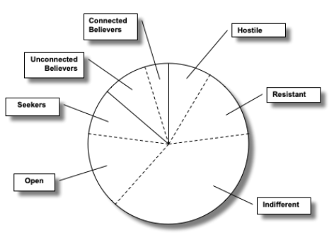

Slide 55
● We’ll discover believers – some who are Connected to a community of believers and growing, some who are Unconnected.
● We’ll discover Seekers – who are searching for God in their spiritual journey.
Notes:
file:///C:/Users/USER/Desktop/UBIF%20DATA%20BACK%20UP/filelib%20-%20Copy%20(3)/WPDOCS/KEHILAH/Outreach%20Ingathering/cojourners-training-leaders-guide.pdf

Slide 56
● There are individuals who are Open –they are not actively seeking God, but they are generally open, if approached appropriately, if in a safe environment.
Notes:
file:///C:/Users/USER/Desktop/UBIF%20DATA%20BACK%20UP/filelib%20-%20Copy%20(3)/WPDOCS/KEHILAH/Outreach%20Ingathering/cojourners-training-leaders-guide.pdf

Slide 57
● The greatest majority may be the Indifferent. For them it is just not on their radar screen; they aren’t thinking much about it, because it seems irrelevant to how they live.
Notes:
file:///C:/Users/USER/Desktop/UBIF%20DATA%20BACK%20UP/filelib%20-%20Copy%20(3)/WPDOCS/KEHILAH/Outreach%20Ingathering/cojourners-training-leaders-guide.pdf

Slide 58
● Another group is the Resistant. Their resistance is rooted in world-views and beliefs that conflict with the gospel.
Notes:
file:///C:/Users/USER/Desktop/UBIF%20DATA%20BACK%20UP/filelib%20-%20Copy%20(3)/WPDOCS/KEHILAH/Outreach%20Ingathering/cojourners-training-leaders-guide.pdf

Slide 59
● Finally, there are the Hostile. Their hostility could flow out of strong beliefs that conflict with the gospel, but often it flows out of emotional issues like bad experiences in their past.
Notes:
file:///C:/Users/USER/Desktop/UBIF%20DATA%20BACK%20UP/filelib%20-%20Copy%20(3)/WPDOCS/KEHILAH/Outreach%20Ingathering/cojourners-training-leaders-guide.pdf

Slide 60
All of them need others to enter into their journeys and help them along. But before we can help show them the way to Yeshua (the Guide) or get beyond their obstacles (the Builder), or encourage them to keep following Messiah (the Mentor), we have to discover where they are.
Notes:
file:///C:/Users/USER/Desktop/UBIF%20DATA%20BACK%20UP/filelib%20-%20Copy%20(3)/WPDOCS/KEHILAH/Outreach%20Ingathering/cojourners-training-leaders-guide.pdf

Slide 61
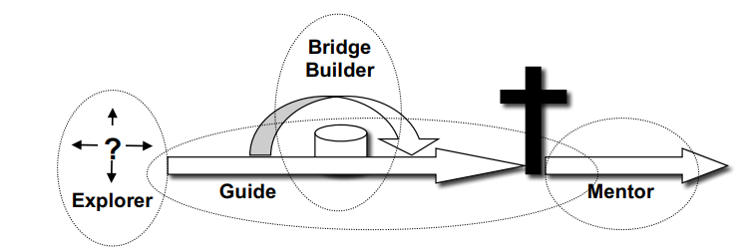
The Four Roles of a CoJourner

Slide 62
Explorer: We need to discover where they are spiritually. We want to understand they’ve been and where they are, so we can help them come to Messiah. That is the role of the Explorer. The two main things an explorer does is ask questions and listen.
Notes:
More on this later

Slide 63
The Guide
A guide is someone who joins with you on a journey, helping show you the way. A good guide will explain things as you go, helping you understand as they lead you.

Slide 64
The Guide
That is the essence of being a witness – showing the way to Yeshua, helping someone understand how they may come to Him. What does a guide use? Their personal experience (often called a testimony or a life story) and the gospel.
Notes:
People can’t refute your experience.

Slide 65
The Builder
When a person is on a journey and comes to an obstacle, say a river, what do they need to continue on? [A bridge.] The same is true spiritually. There are all kinds of issues and obstacles that keep people from coming to Messiah – intellectual issues, emotional baggage, competing desires; etc.

Slide 66
We seek to deal with the issue, that is, we provide a bridge over and beyond the issue so they can continue to move toward Messiah. How? Through prayer and gentle persuasion.

Slide 67
Prayer is important because, no matter what the issue is, the enemy (the devil) seeks to use these obstacles as a way of blinding them and keeping them in spiritual bondage.

Slide 68
Prayer unleashes God’s power. But we also use gentle persuasion—not trying to win an argument, but coming beside them as a friend or CoJourner and helping them get beyond the issue.

Slide 69
The Mentor
When a person comes to Messiah, their spiritual journey is not over – rather it is just beginning. Now they need help and encouragement to continue to follow Yeshua. That is the role of the Mentor. The Mentor encourages new believers in their spiritual journey.

Slide 70
The Mentor
The two primary resources for the mentor are the foundational concepts of the Christian life) and relational connections to other believers. The new believer needs to develop significant connections with other believers – believing friends and a community. He also needs grounded in foundational truths for the Christian life.

Slide 71
The roles are not chronological, that is, always following the same order like a formula. They do always begin with being an Explorer. But the role you play next depends on what you discover about the other person and their spiritual journey.

Slide 72
More on Explorer
When you are at a mall and you look on a big map, what do you look for? The big X that tells you that you are here. That helps you figure out where you’ve been and where you want to go.

Slide 73
Spiritually, we want to help others find the big X in their lives. We want to understand where they’ve been and where they are, so we can help them come to Messiah. That is the role of the Explorer.

Slide 74
Listening: What do you listen for?
1. A window allows you to see what is on the other side. The closer you get to a window, the more you see.
2. The simplest way to see below the surface is to ask, “How are you?” and mean it. When people sense you are genuinely interested, many will openly share.
Notes:
Israeli vernacular answer to “How are you?” “Yes.” That is, most people don’t really want to know, just a courtesy question. Then again, sometime the answer can last for hours!

Slide 75
Listening: What do you listen for?
Unmet Needs
1. Life usually does not work well apart from God’s design. So you can be assured that any one who is not following Messiah usually has significant unmet needs in their lives.
2. In fact, we have plenty of needs of our own as believers – which gives us more common ground.

Slide 76
Listening: What do you listen for?
Unmet Needs
3. The message of Messiah isn’t the “cure-all” for all problems—i.e. “Believe in Yeshua, and your problem will go away”. But the message fundamentally changes our experience and approach to the issues.
Notes:
In a family or a marriage, prayer and devotions don’t solve all problems, but it changes the atmosphere, so that problems can be solved.

Slide 77
Listening: What do you listen for?
Traces of the Spirit
What is most exciting is when you discover how God is already at work in someone’s life –
preparing the way, drawing the person to himself.

Slide 78
Spiritual Mapping
Examples of questions can include:
The Past Experiences: Where you’ve been
What was your religious background as a child?
What have you tried in your spiritual journey since?

Slide 79
Spiritual Mapping
Present Attitudes: Where you are
How has your search left you feeling?
Currently how important is the spiritual area of life to you personally?

Slide 80
Spiritual Mapping
Future Direction: Where you’re going
Do you think you are moving toward God, away from God, or staying about the same?
How would you rate your desire to know God personally?

Slide 81
Our Opportunity this week

Slide 82
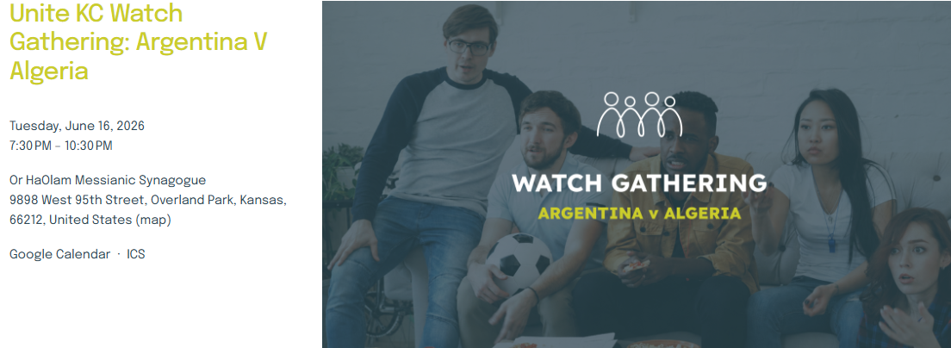

Slide 83
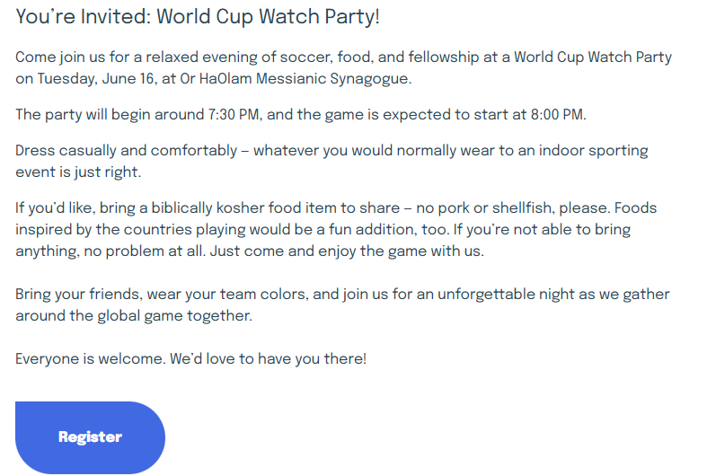

Slide 84
You’re Invited: World Cup Watch Party!
Come join us for a relaxed evening of soccer, food, and fellowship at a World Cup Watch Party on Tuesday, June 16, at Or HaOlam Messianic Synagogue.
The party will begin around 7:30 PM, and the game is expected to start at 8:00 PM.

Slide 85
Dress casually and comfortably — whatever you would normally wear to an indoor sporting event is just right.
If you’d like, bring a biblically kosher food item to share — no pork or shellfish, please. Foods inspired by the countries playing would be a fun addition, too. If you’re not able to bring anything, no problem at all. Just come and enjoy the game with us.

Slide 86
Bring your friends, wear your team colors, and join us for an unforgettable night as we gather around the global game together.
Everyone is welcome. We’d love to have you there!

Slide 87
We don’t know if there will be a flood or a flub. No one from the neighborhood came to our Super Bowl watch parties.
But this may be different.

Slide 88
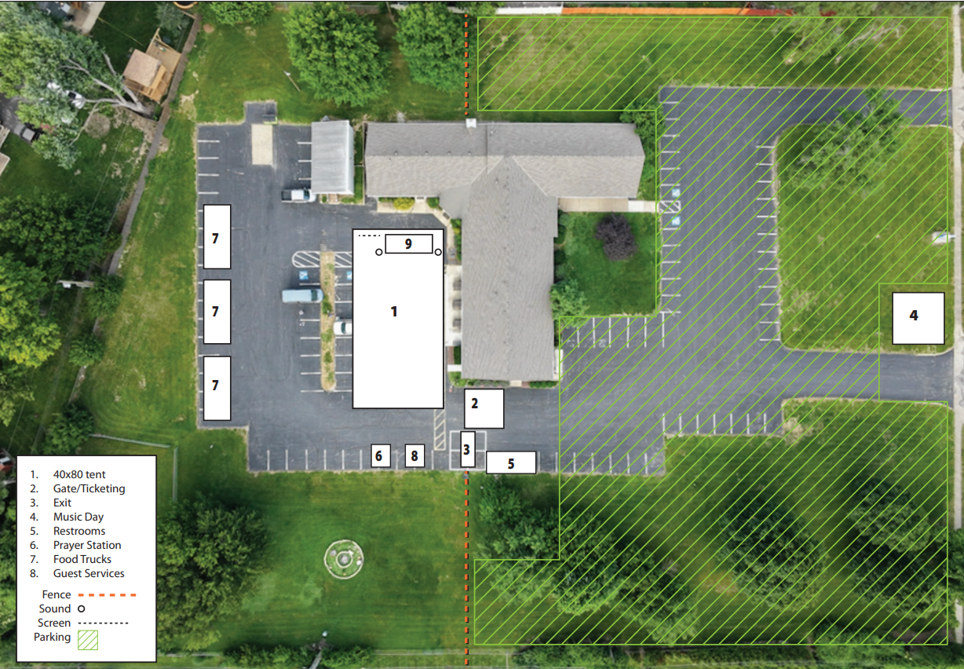
Solu
Site
Map
June 21

Slide 90
Cojourner: Bind up the
Brokenhearted, Yesh/Is 61.1
Scriptures on sharing Yeshua
Intimidation
Cojourner concept
Talmidut / Discipleship

Slide 91
Spiritual openness is growing, but discipleship is not keeping pace.
Two-thirds of U.S. adults say they have made a personal commitment to Messiah that remains important in their lives, a significant rebound from recent lows. Among younger adults, the signal is even stronger: Nearly three in four Gen Z adults say they are seeing peers commit their lives to Yeshua.
Notes:
https://www.barna.com/research/four-trends-ministry-strategy-2026/

Slide 92
Importance of Faith: A Steep Decline
In 2000, nearly three-quarters of Evangelicals (74%) strongly agreed that faith was central to their lives. Today, that number sits closer to half (54%). By comparison, Christian identity dropped 12 points in the same time frame, and monthly congregational attendance dropped 7 points. In short, while many still claim the Believer label or attend service, fewer are orienting their lives around their beliefs.
Notes:
https://www.barna.com/trends/faiths-shrinking-influence/

Slide 93
This decline matters because perceived importance is closely tied to lived discipleship. When belief ceases to carry weight in a person’s worldview, Christian practices, such as church engagement and evangelism, tend to follow suit.
Notes:
https://www.barna.com/trends/faiths-shrinking-influence/

Slide 94
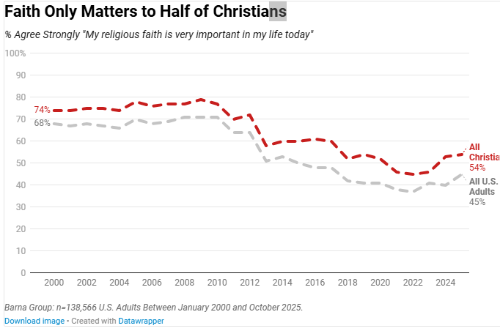
Believers
Notes:
https://www.barna.com/trends/faiths-shrinking-influence/

Slide 96
Cojourner: Bind up the
Brokenhearted, Yesh/Is 61.1
Scriptures on sharing Yeshua
Intimidation
Cojourner concept
Talmidut / Discipleship

