Slide 1
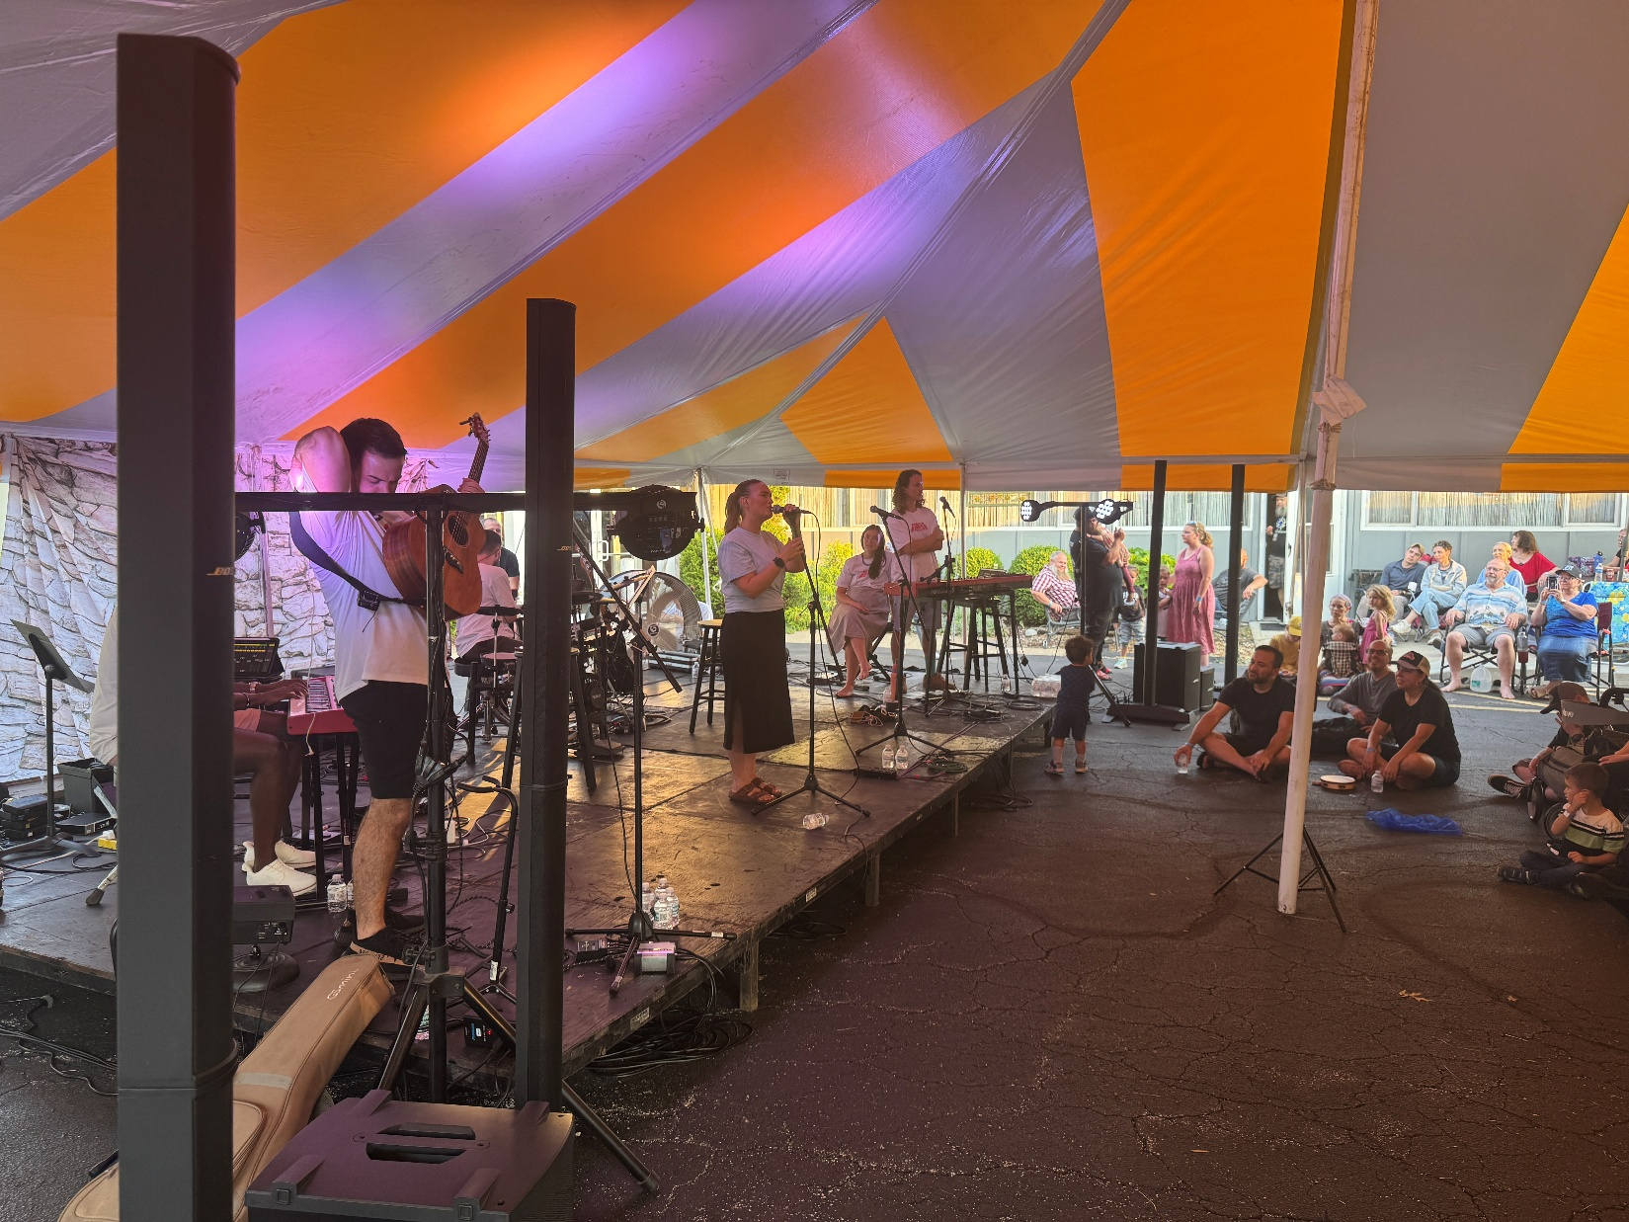

Slide 2
I want to express my profound gratitude to all who worked so hard and skillfully and joyfully to make the worship concert a resounding success in the Ruakh. There was a GREAT expression of Ruakh joy in the Messiah's redemptive love for Israel and all nations. I think there will be a great impact in time now and in eternity.

Slide 3
All the many details were so well organized and executed that we left enriched and NOT exhausted.
Special thanks to Jeremy for heading it up!

Slide 4
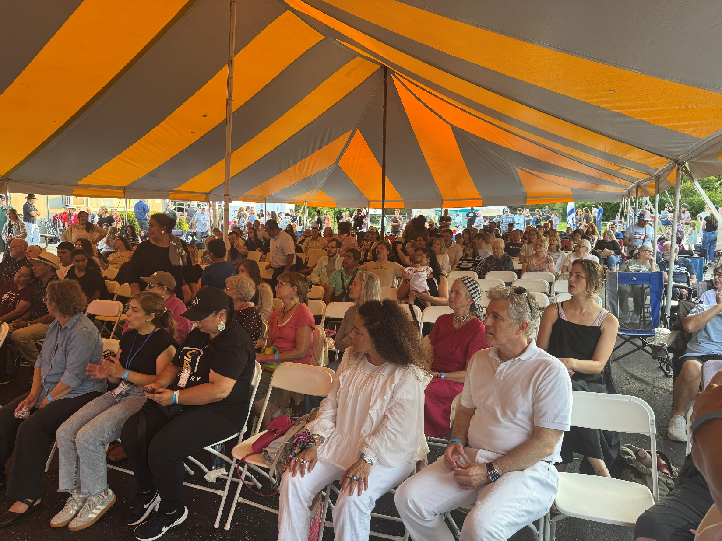
Notes:
After all expenses, we were able to give the SOLU band $5500

Slide 5
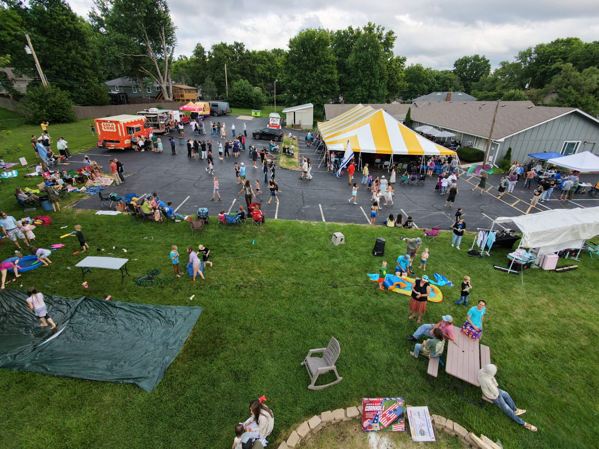
Notes:
Great kids games. “Slip and slide”

Slide 6
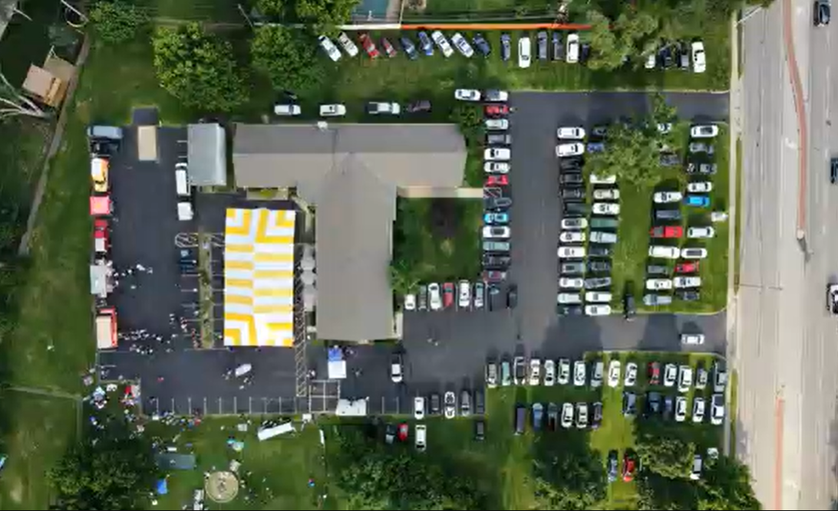
Notes:
Plus kudos to a community member…

Slide 7
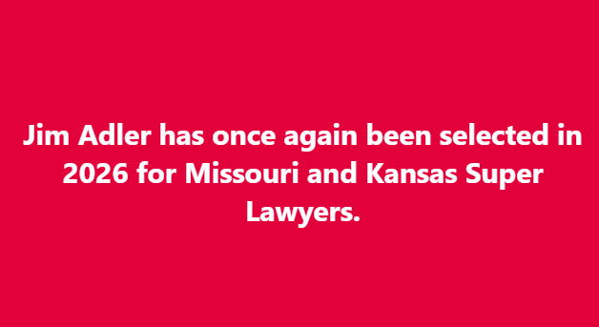
Notes:
https://www.facebook.com/jim.adler.5

Slide 8
Super Lawyers is a rating service that identifies top attorneys in various fields of law. It's based on a peer review process where lawyers are nominated by their peers, then researched and selected through a multi-step process. The rating is considered a mark of excellence in the legal profession.
Notes:
https://www.facebook.com/jim.adler.5

Slide 9
In the context of the post, being selected as a Super Lawyer is an achievement for Jim Adler, highlighting his expertise and reputation among his peers in Missouri and Kansas.
Notes:
https://www.facebook.com/jim.adler.5
In case you don’t know Jim and Cathy…

Slide 10

A hippie version, courtesy of AI, of my wife and me when we were dating about 50 years ago.

Slide 11
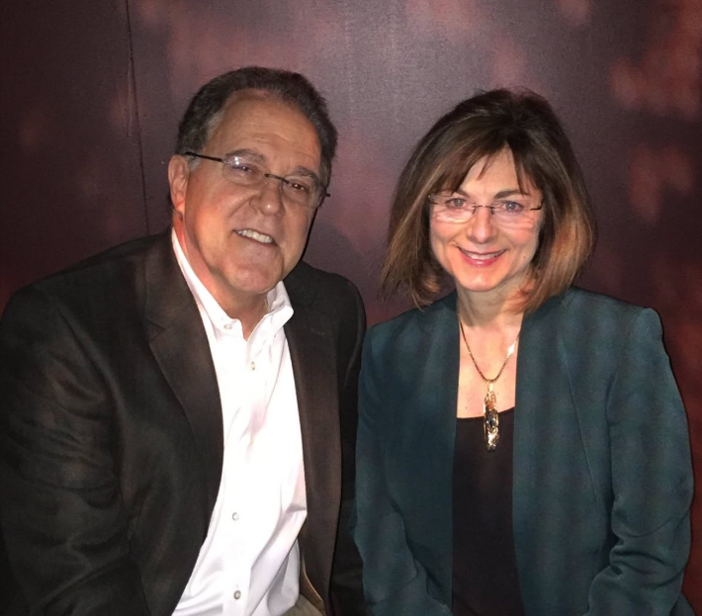

Slide 12
A surprising side adventure
on Thursday
before the SOLU concert.

Slide 13
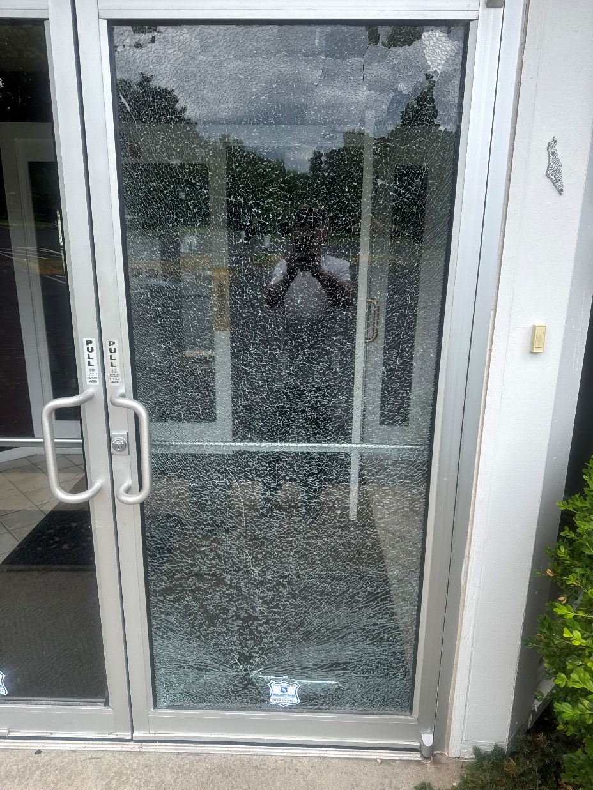

Glass pinhole from stone from a weed eater Thurs.
Notes:
Tempered glass so broke into little pieces, like a car windshield

Slide 14
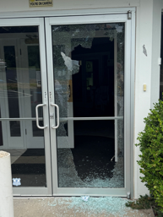
A little nudge and it all collapsed.

Slide 15
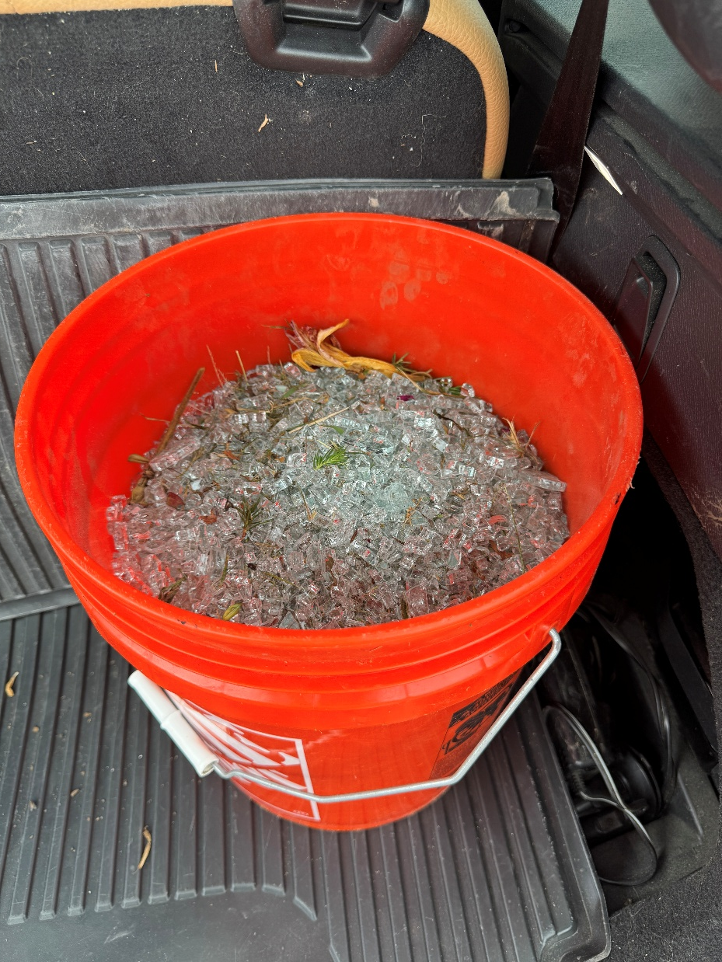
Glass fragments taken to glass recycling

Slide 16
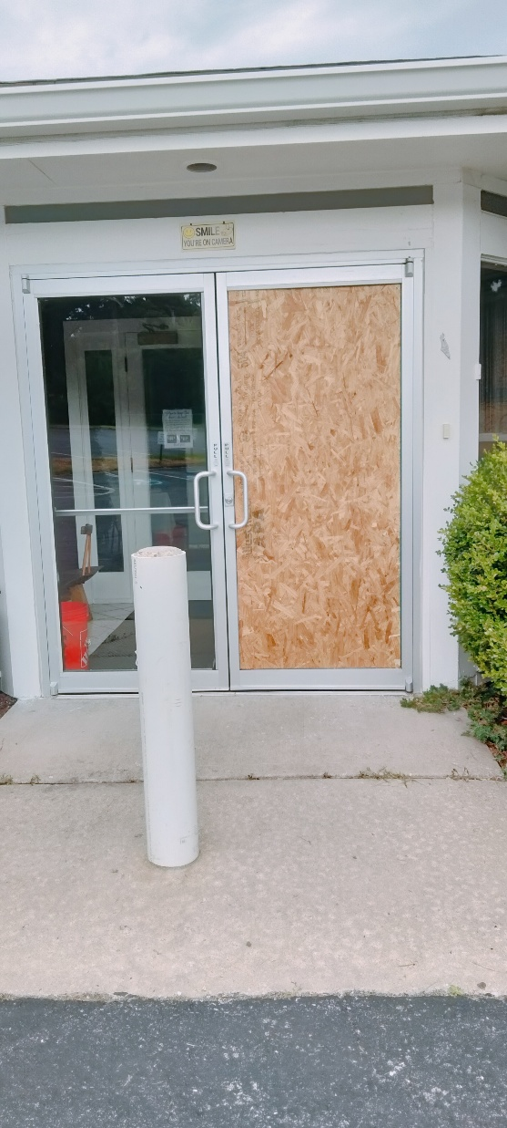
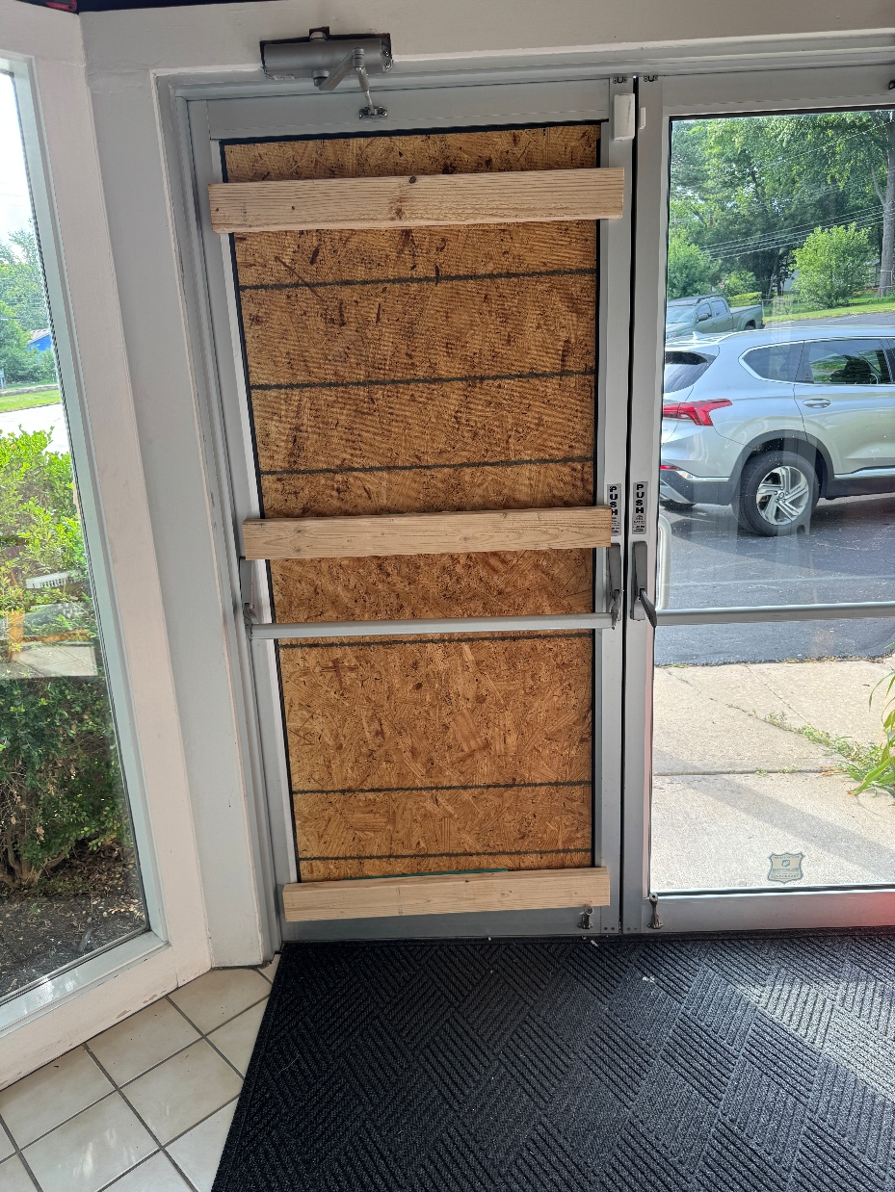
Quick work by Grady to secure the building

Slide 17
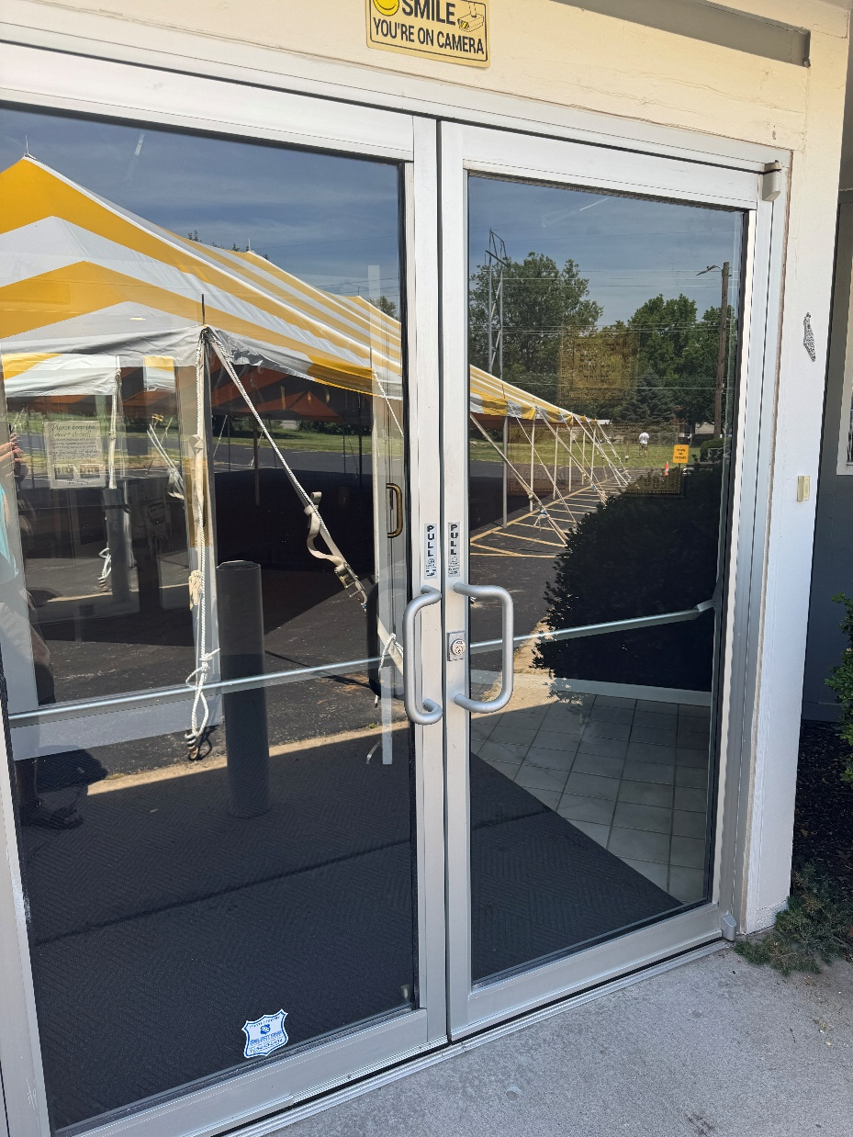
Fixed Friday. Laminated glass. Will not shatter.
Notes:
$700 Glass Doctor

Slide 18
A personal family surprise, mentioned last week…

Slide 19
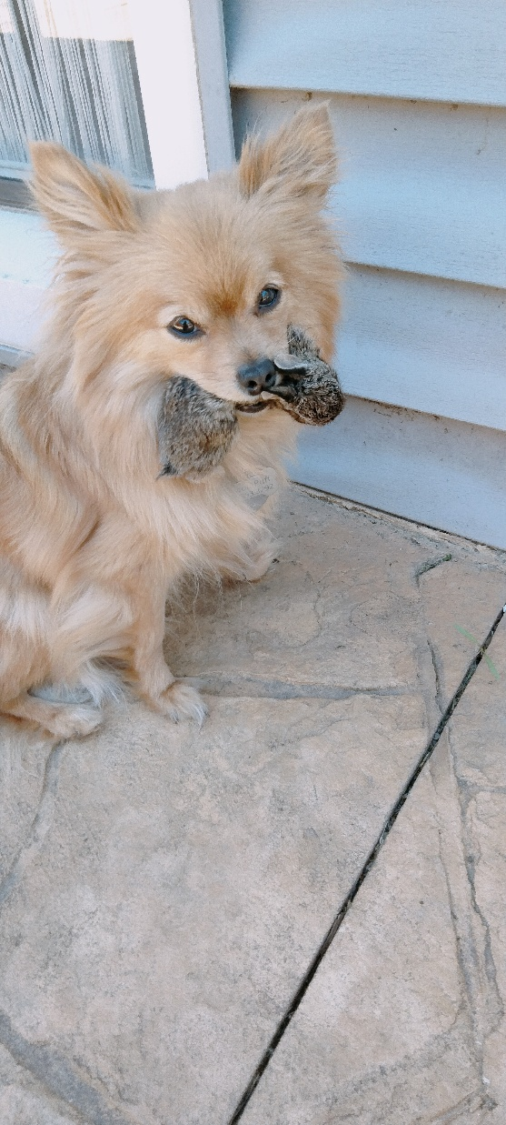
Our Pomeranian, formerly Coco Puff, now
Killer Puff, with a murdered bunny in her mouth.
Actually 13 of them this year!

Slide 21


Slide 22
^{2 Thes 3.16} Now may the Lord of shalom Himself give you shalom always in all ways. The Lord be with all of you.
Notes:
Note two things about this verse…

Slide 23
^{2 Thes 3.16} Now may the Lord of shalom Himself give you shalom always in all ways. The Lord be with all of you.
Shalom from Adoni Yeshua Himself
In ALL ways!
Notes:
The word “Shalom” is more multifarious, manifold, than you might think.
[pray]

Slide 24

Shalom
Meaning of the word
Use of the word in scripture
As a greeting
Shalom and Shabbat
Shalom and Yeshua
Shalom and adversity
Shalom and humility

Slide 25
Shalom
Meaning of the word
Use of the word in scripture
As a greeting
Shalom and Shabbat
Shalom and Yeshua
Shalom and adversity
Shalom and humility

Slide 26
shalam Original Word [verb] : שָׁלַם
To be complete, to be sound, to make amends, to finish, to repay, to reward
Notes:
1973 In Israel as a student, at a falafel stand, the owner looked at me and said something like כסף? Money? But I had paid. So, I mustered up my limited Hebrew skills and said, שילמתי I paid. He understood and believed me, and nodded, and I went on my way.

Slide 27
שָׁלוֹם [noun] Shalom
Hello!, Goodbye!, peace, quiet, safety, health, contentment, tranquility; good condition, success, comfort,;
welfare, wellbeing; -
בשלום
safely; - peacefully, at peace
Notes:
237x This is what you are bidding people when you greet them with “Shalom.”

Slide 28
שָׁלֵם [adjective] Shalem
whole, complete;
in agreement with; entire; intact, complete, integral, unhewn, full perfect, total, safe, uninjured, unharmed, unscathed, healthy, true, faithful, peaceful (mathematics) whole number, integer

Slide 30
Shalom
Meaning of the word
Use of the word in scripture
As a greeting
Shalom and Shabbat
Shalom and Yeshua
Shalom and adversity
Shalom and humility

Slide 31
First use:
^{Ber/ Gen 15.15} As for you, you will join your ancestors in
peace [שָׁלוֹם shalom] and be buried at a good old age.
Tranquility, at ease, unconcerned

Slide 32
^{Ber/ Gen 26.26-29} Then Avimelekh went to him from G’rar with…Pikhol the commander of his army. …They answered, “We saw very clearly that Adoni has been with you; so, we said, ‘Let there be an oath between us: let’s make a pact between ourselves and you

Slide 33
^{Ber/ Gen 26.26-29} that you will not harm us, just as we have not caused you offense but have done you nothing but good and sent you on your way in peace [שָׁלוֹם shalom]. Now you are blessed by Adoni.’”
Unharmed, unhurt

Slide 34
The root word of the noun Shalom is the verb “shalam”. One of the first uses of the word shalam in the Torah is in Exodus 21 and 22. In these 2 chapters, it is used 14 times.
Notes:
https://firmisrael.org/learn/the-meaning-of-shalom/

Slide 35
Moshe is giving instructions to the people about what to do when someone causes material loss or in the case of theft of property. When that loss or injury occurs, the owner is considered lacking or not complete. The one responsible was to make things right.
Notes:
https://firmisrael.org/learn/the-meaning-of-shalom/

Slide 36
In the translation of Exodus 21-22, shalam is translated as “make it good”, “shall surely pay”, “make full restitution” or to “restore”. The ancient Hebrew meaning of shalam was “to make something whole”. Not just regarding practical restoration of things that were lost or stolen. But with an overall sense of fulness and completeness in mind, body and estate. It’s a legal term.
Notes:
https://firmisrael.org/learn/the-meaning-of-shalom/

Slide 37
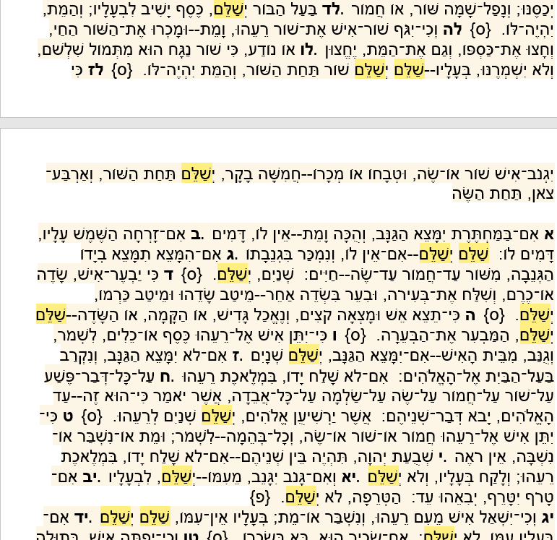
^{21.34} pay
³⁶ surely pay
³⁷ pay [5x]
^{22.2} restitution
³ pay [double]
⁵ restitution
⁶ pay [double]

Slide 39
Shalom
Meaning of the word
Use of the word in scripture
As a greeting
Shalom and Shabbat
Shalom and Yeshua
Shalom and adversity
Shalom and humility

Slide 40

33^{1/3} vinyl disc recording of the Broadway play Milk and Honey
Notes:
https://i.discogs.com/Tb322jkskzmw89A-QGuqeHn2vObpYNqtkfKQtjsLsWQ/rs:fit/g:sm/q:90/h:600/w:588/czM6Ly9kaXNjb2dz/LWRhdGFiYXNlLWlt/YWdlcy9SLTc0MjQy/MzEtMTcyMDY2NDA4/NC0yMTExLmpwZWc.jpeg

Slide 41
Shalom, Shalom,
You'll find Shalom
The nicest greeting you know;
It means bonjour, salud, and skoal
And twice as much as hello.
It means a million lovely things,
Like peace be yours,
Welcome home.
And even when you say goodbye,
You say goodbye with Shalom.
Notes:
https://www.allmusicals.com/lyrics/milkandhoney/shalom.htm

Slide 42
^{Genesis 43:27-28} He asked them how they were לְשָׁלוֹם shalom and inquired, “Is your father well הֲשָׁלוֹם Ha-shalom, the old man of whom you spoke? Is he still alive?” They answered, “Your servant our father is wellשָׁלוֹם Shalom; yes, he is still alive,” as they bowed in respect.
Notes:
Yosef asking his brothers.

Slide 43
Notice what Yeshua said when He first met the talmidim after the resurrection:
While they were telling these things, He Himself stood in their midst and said to them, “Peace be to you.” ^{(Luke 24:36)}. שלום לכם

Slide 44
Remember, Yeshua is a Hebrew-speaking. Jewish Rabbi. He speaks to Jewish disciples in Jerusalem. He probably would have smiled at his stunned friends and said in Hebrew, שלום לכם “shalom lehkhem” (Peace to you).
Notes:
Shalom Alekhem is an expanded, more poetic version that we commonly use.

Slide 45
In modern Hebrew, a common greeting is מה שלומך “ma shlom’kha” which means “how are you?” Yet, notice the word shalom in there. Quite literally you are asking “what is your completeness?” or, “how is your peace?”. It is yet another way to proclaim health and wholeness as you greet those around you.
Notes:
It would do us well to think a bit of all those blessings when we glibly say “Shalom?

Slide 47
Shalom
Meaning of the word
Use of the word in scripture
As a greeting
Shalom and Shabbat
Shalom and Yeshua
Shalom and adversity
Shalom and humility

Slide 48
Shabbat Shalom שבת שלום
The Hebrew word Shabbat comes from the Hebrew word Lishbotלשבות which means “to stop” or
the Hebrew word Lashevet לשבת which means “to sit”.
Notes:
https://firmisrael.org/learn/the-meaning-of-shalom/

Slide 49
Shabbat Shalom שבת שלום
Our lives are on the move, especially today. There are always places to go and things to do. Adoni knew that we would need to stop and to sit, on a weekly basis. Not for His sake but for ours!
Notes:
https://firmisrael.org/learn/the-meaning-of-shalom/

Slide 50
Do we trust that God is able to do for us in 6 days what would take us 7 days to complete? Do we trust Him enough to help us prioritize our lives and live the best life He designed for us?
Notes:
Dawn and me have a sort of hybrid. Shabbat is my big work day. But it’s holy work, a non-commercial day. No buying or selling. But, it’s peaceful, restful as a WORSHIP day.
Monday is our rest day. Nothing stressful, if possible. Or HaOlam policy: no heart attacks, no car wrecks, no deaths in the family on Monday.

Slide 51
What if one day a week, we focused on not just a day of rest but a day of getting our wholeness restored? What if weekly we could completely refill our life tank in our bodies, hearts and minds? That is what true shalom does, if we allow it.
Notes:
One writer calls Shabbat “An Island in Time”

Slide 52

An island in time.
Notes:
https://tse2.mm.bing.net/th/id/OIP.rPe5jvEIW8wPdviIxqwWogHaCb?pid=Api&h=220&P=0

Slide 53
When our peace is full and overflowing, we are able to trust Him to restore what may have been lost last week. We can confidently move forward in hope that we will have all that we need in the week ahead. This is what Shabbat is for. Shabbat is for Shalom. Shabbat Shalom.

Slide 54
Every Friday evening in Israel and Jewish communities around the world, you’ll hear the joyful Shabbat Shalom! Again, this is more than a greeting. Its intent is a hope to encourage others to enter the weekly time of restoration and of “making things whole” that was appointed by God.
Notes:
Guests, family. Can be perfunctory. Hopefully not. This is why we have Saturday services. Friday hospitality

Slide 55
Aharonic blessing
Notes:
Said over family on Shabbat, and other times.

Slide 56
^{BaMidbar / Nu 6.23-27} Adoni said to Moshe, “Speak to Aharon and his sons, and tell them that this is how you are to bless the people of Isra’el: you are to say to them, יְבָרֶכְךָ יְיָ, וְיִשְׁמְרֶךָ
Y’varekh’kha Adoni v’yishmerekha.
[May Adoni bless you and keep you.]

Slide 57
^{BaMidbar / Nu 6.23-27}
יָאֵר יְיָ פָּנָיו אֵלֶיךָ, וִיחֻנֶּךָּ. Ya’er Adoni panav eleikha vikhunekka.
[May Adoni make his face shine on you and show you his favor.]

Slide 58
יִשָּׂא יְיָ פָּנָיו אֵלֶיךָ, וְיָשֵׂם לְךָ שָׁלוֹם.
Yissa Adoni panav eleikha v’yasem l’kha shalom.
[May Adoni lift up his face toward you and give you peace. [שָׁלוֹם shalom] ]’
“In this way they are to put my name on the people of Isra’el, so that I will bless them.”
Notes:
Even as they were travelling through the fierce desert and preparing for war on the Canaanites.

Slide 60
Shalom
Meaning of the word
Use of the word in scripture
As a greeting
Shalom and Shabbat
Shalom and Yeshua
Shalom and adversity
Shalom and humility

Slide 61
^{Yeshayahu/ Isaiah 9. 5-6} For a child is born to us,a son is given to us; dominion will rest on his shoulders, and he will be given the name Pele-Yo‘etz El Gibbor Avi-‘Ad Sar-Shalom [Wonder of a Counselor, Mighty God, Father of Eternity, Prince of Peace],

Slide 62
^{Yeshayahu/ Isaiah 9. 5-6} in order to extend the dominion and perpetuate the peace of the throne and kingdom of David, to secure it and sustain it through justice and righteousness henceforth and forever. The zeal of Adoni-Tzva’ot will accomplish this.

Slide 63
Angels appeared to shepherds in Bethlehem, bringing good news of great joy which shall be to all people (Luke 2:10).
After instructions on how to find the baby,

Slide 64
many more angels appeared proclaiming the following statement:
Glory to God in the highest, and on earth peace [Shalom שלום], good will toward men! (Luke 2:14)

Slide 65
^{Eph 2.13-15} But now, you who were once far off have been brought near through the shedding of the Messiah's blood. For he himself is our shalom - he has made us both one and has broken down the m'chitzah which divided us …He did this in order to create in union with himself from the two groups a single new humanity and thus make shalom,
Notes:
He IS our Shalom

Slide 66
It was their sheer amazement that the One whom they praised, placed Himself in the embodiment of perfect Peace [Shalom שלום] on earth. He did it as a gift. Glory to God in the highest place!
Notes:
https://firmisrael.org/learn/the-meaning-of-shalom/

Slide 67
^{Yn 14. 23-27} Yeshua answered him, “If someone loves me, he will keep my word; and my Father will love him, and we will come to him and make our home with him. Someone who doesn’t love me doesn’t keep my words — and the word you are hearing is not my own but that of the Father who sent me.

Slide 68
^{Yn 14. 23-27} “I have told you these things while I am still with you. But the Counselor, the Ruach HaKodesh, whom the Father will send in my name, will teach you everything; that is, he will remind you of everything I have said to you.

Slide 69
^{Yn 14. 23-27} “What I am leaving with you is shalom — I am giving you my shalom. I don’t give the way the world gives. Don’t let yourselves be upset or frightened.
Notes:
Breathe in and meditate on His Shalom despite all

Slide 70
^{Yn 16.33} “I have said these things to you so that, united with me, you may have shalom. In the world, you have tsuris. But be brave! I have conquered the world!”
Notes:
Really. It doesn’t look like it.

Slide 71
What did Yeshua say about peace?
^{(Mat 5:9)} “Blessed are the peacemakers, for they shall be called sons of God.”

Slide 72
There is a point at which you have so much shalom that it spills out from you, and is repaid or rendered to others. And so, as you make others peaceful and inwardly complete, that makes you a peacemaker.

Slide 73
Yeshua said these peacemakers will be called sons of God. Yeshua was called the Son of God. By sharing God’s uncontainable peace with others, we become just like Yeshua.

Slide 74
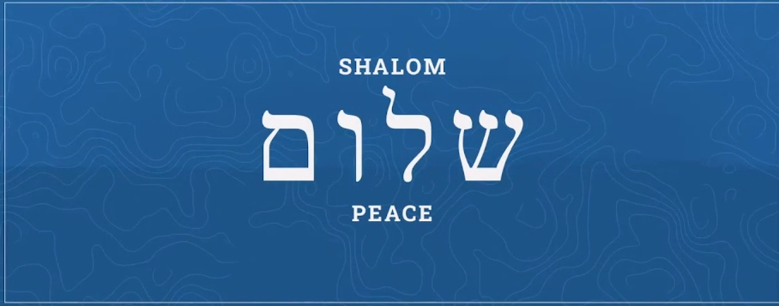
Notes:
https://firmisrael.org/learn/the-meaning-of-shalom/

Slide 76
Shalom
Meaning of the word
Use of the word in scripture
As a greeting
Shalom and Shabbat
Shalom and Yeshua
Shalom and adversity
Shalom and humility

Slide 77
^{T’hillim 120.6-7} I have had to live far too long with those who hate peace [שָׁלוֹם shalom] . I am all for peace [שָׁלוֹם shalom] ; but when I speak, they are for war.

Slide 78
Jerusalem, City of Peace
“Pray for the peace [שָׁלוֹם shalom] of Jerusalem: May they prosper who love you. May peace [שָׁלוֹם shalom] be within your walls, and prosperity within your palaces.” (Psalm 122:6-7)

Slide 79
Jerusalem, City of Peace
Today many are praying for the peace of Jerusalem due to the rising threat from Israel’s enemies. However, this exhortation to pray is not only so Israel can live without conflict.

Slide 80
It is so that Jerusalem can fulfill its destiny as set by the only One who can bring complete restoration to the city, which Jesus referred to as “The city of the great King.”

Slide 81
^{Yeshayahu / Is 2.3-4} For out of Tziyon will go forth Torah [and B’sorah], the word of Adoni from Yerushalayim. He will judge between the nations and arbitrate for many peoples. Then they will hammer their swords into plow-blades and their spears into pruning-knives;
Notes:
This is exactly what the SOLU group was. Coming from Israel with the Word of the King, the Prince of Peace!!

Slide 82
The 48th sura (chapter) of the Quran (Al-Fatḥ), describes in detail something called ‘the Treaty of Hudaybiyyah,’ a ten-year pact established in March 628 AD between Mohammad and the Arabian tribe of Quraysh.
Notes:
https://davidstent.org/making-the-crooked-plain-in-the-middle-east/

Slide 83
Mohammad broke that treaty two years later, in January 630 AD, when his jihadi forces – having re-armed and grown strong during the interim – subjugated the Quraysh tribe, and then moved on to conquer Mecca.
Notes:
https://davidstent.org/making-the-crooked-plain-in-the-middle-east/

Slide 84
PLO leader Yasir Arafat cited this Islamic precedent a number of times when signing the Oslo Accords with the Jewish state. It was his justification for ‘supposedly recognizing’ Israel and ‘supposedly renouncing’ terrorist activities. The following quote from the Arabic-language newspaper al-Quds, published in Jerusalem on May 10, 1998, illustrates Arafat’s strategy:
Notes:
https://davidstent.org/making-the-crooked-plain-in-the-middle-east/

Slide 85
Question: “Do you feel sometimes that you made a mistake in agreeing to Oslo?” Arafat: “No – no! Allah's messenger Mohammad accepted the al-Hudaybiyyah peace treaty and Salah a-Din accepted the peace agreement with Richard the Lion-Hearted”
Notes:
https://davidstent.org/making-the-crooked-plain-in-the-middle-east/

Slide 86
(n.b.: Salah a-Din was the Muslim leader who, after a cease-fire, declared a jihad against the Crusaders and captured Jerusalem).
Notes:
https://davidstent.org/making-the-crooked-plain-in-the-middle-east/

Slide 87
Western leaders who attempt to manipulate jihadi governments into signing and certifying ‘peace agreements’ are ignoring 1400 years of Islamist realpolitik. They are getting dragged into an Islamist desert illusion, a mirage, whose ultimate goal is to destroy the West and Israel.
Notes:
https://davidstent.org/making-the-crooked-plain-in-the-middle-east/

Slide 88
No treaty with the IRGC will work.
No treaty with Hitler or Hirohito of Japan would have worked in WW II.

Slide 89
A final point in the war goals was originally trumpeted by the American President in his February 28, 2026 video, but the current Memo of Understanding between the USA and Iran does not touch it – the savage oppression of the Iranian people.
Notes:
Avner Boskey

Slide 90
“Finally, to the great proud people of Iran, I say tonight that the hour of your freedom is at hand. Stay sheltered. Don’t leave your home. It’s very dangerous outside. Bombs will be dropping everywhere. When we are finished, take over your government. It will be yours to take. This will be probably your only chance for generations.
Notes:
Avner Boskey https://mail.google.com/mail/u/0/?ui=2&ik=9f4a945fb9&view=lg&permmsgid=msg-f:1868235608096672341

Slide 91
For many years, you have asked for America’s help. But you never got it. No president was willing to do what I am willing to do tonight. Now you have a president who is giving you what you want. So let’s see how you respond.
Notes:
Avner Boskey https://mail.google.com/mail/u/0/?ui=2&ik=9f4a945fb9&view=lg&permmsgid=msg-f:1868235608096672341

Slide 92
America is backing you with overwhelming strength and devastating force. Now is the time to seize control of your destiny, and to unleash the prosperous and glorious future that is close within your reach. This is the moment for action. Do not let it pass.”
Notes:
Avner Boskey https://mail.google.com/mail/u/0/?ui=2&ik=9f4a945fb9&view=lg&permmsgid=msg-f:1868235608096672341

Slide 93
How shall we then pray?
Pray that the God of Jacob will break through to America’s leadership and grant them revelation to successfully recognize, confront and block jihadi and Prince of Persia evils.
Notes:
Avner Boskey https://mail.google.com/mail/u/0/?ui=2&ik=9f4a945fb9&view=lg&permmsgid=msg-f:1868235608096672341

Slide 94
Nevertheless,
^{T’hillim/Ps 46.9-10} Come, see the works of Adoni, who brings devastations on the earth. He makes wars cease to the end of the earth.
לְכוּ־ חֲזוּ, מִפְעֲלוֹת יְיָ-- אֲשֶׁר־שָׂם שַׁמּוֹת בָּאָרֶץ. מַשְׁבִּית מִלְחָמוֹת, עַד־קְצֵה הָאָרֶץ:
Brings Shabbat to the end of the earth
Notes:
Trust, and teach TRUTH

Slide 96
Shalom
Meaning of the word
Use of the word in scripture
As a greeting
Shalom and Shabbat
Shalom and Yeshua
Shalom and adversity
Shalom and humility

Slide 97
^{Yaakov 4.1-3} What is causing all the quarrels and fights among you? Isn’t it your desires battling inside you? You desire things and don’t have them. You kill, and you are jealous, and you still can’t get them. So you fight and quarrel.

Slide 98
^{Yaakov 4.1-3} The reason you don’t have is that you don’t pray! Or you pray and don’t receive, because you pray with the wrong motive, that of wanting to indulge your own desires.

Slide 99
The Neuroscience of Hate
The brain’s hate “switch” prioritizes aggressive behavior and negative judgment.
Notes:
https://www.theepochtimes.com/health/what-your-brain-looks-like-when-you-hate-someone-5979990?utm_source=Health_well&utm_medium=email&utm_campaign=well-2026-05-23&src_src=Health_well&src_cmp=well-2026-05-23&est=yaxJqG9ODApOJIliDYYrMEF%2Bjpa821DZww%2FCSV6wz6Z9i50EKfdfPLhQ1Gkdt1Mowg%3D%3D

Slide 100
Hate selectively deactivates the right superior frontal gyrus—the area involved in regulating impulsive responses and understanding others’ feelings.
Notes:
https://www.theepochtimes.com/health/what-your-brain-looks-like-when-you-hate-someone-5979990?utm_source=Health_well&utm_medium=email&utm_campaign=well-2026-05-23&src_src=Health_well&src_cmp=well-2026-05-23&est=yaxJqG9ODApOJIliDYYrMEF%2Bjpa821DZww%2FCSV6wz6Z9i50EKfdfPLhQ1Gkdt1Mowg%3D%3D

Slide 101
This very restricted deactivation in the hater’s brain cuts off the neural “brakes” that keep aggressive impulses in check, turning the hater irrational and making him fixated on the target.
Notes:
https://www.theepochtimes.com/health/what-your-brain-looks-like-when-you-hate-someone-5979990?utm_source=Health_well&utm_medium=email&utm_campaign=well-2026-05-23&src_src=Health_well&src_cmp=well-2026-05-23&est=yaxJqG9ODApOJIliDYYrMEF%2Bjpa821DZww%2FCSV6wz6Z9i50EKfdfPLhQ1Gkdt1Mowg%3D%3D

Slide 102

Notes:
https://www.theepochtimes.com/health/what-your-brain-looks-like-when-you-hate-someone-5979990?utm_source=Health_well&utm_medium=email&utm_campaign=well-2026-05-23&src_src=Health_well&src_cmp=well-2026-05-23&est=yaxJqG9ODApOJIliDYYrMEF%2Bjpa821DZww%2FCSV6wz6Z9i50EKfdfPLhQ1Gkdt1Mowg%3D%3D

Slide 103
Humility is the great way to deep peace with others and G-d. Blaming others is the epitome of non-peace.
In the following movie clip from Ever After, the King and Queen of Spain were blaming each other with full force.

Slide 104
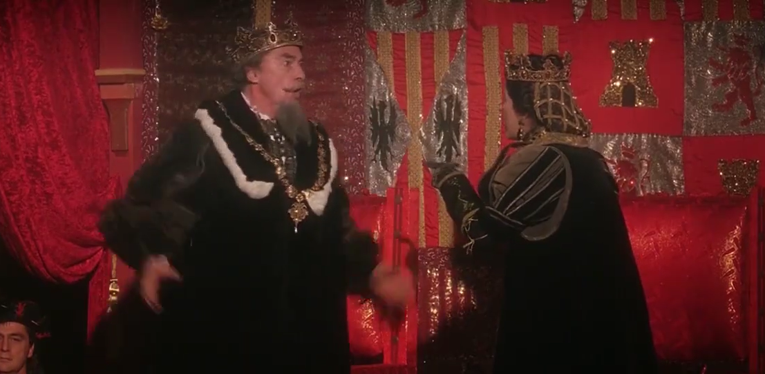
¡La culpa es tuya! It’s YOUR fault!
Notes:
https://youtu.be/NxcVT-UhH60?list=PLGYlzoJJ8siMb0wcz9uh7hRawH7tl5hkF

Slide 106
Shalom
Meaning of the word
Use of the word in scripture
As a greeting
Shalom and Shabbat
Shalom and Yeshua
Shalom and adversity
Shalom and humility

Slide 107
^{Phil 4.4-7} Rejoice in union with the Lord always! I will say it again: rejoice! Let everyone see how reasonable and gentle you are. The Lord is near! Don’t worry about anything; on the contrary, make your requests known to God by prayer and petition, with thanksgiving.

Slide 108
^{Phil 4.4-7} Then God’s shalom, passing all understanding, will keep your hearts and minds safe in union with the Messiah Yeshua.

