Slide 1
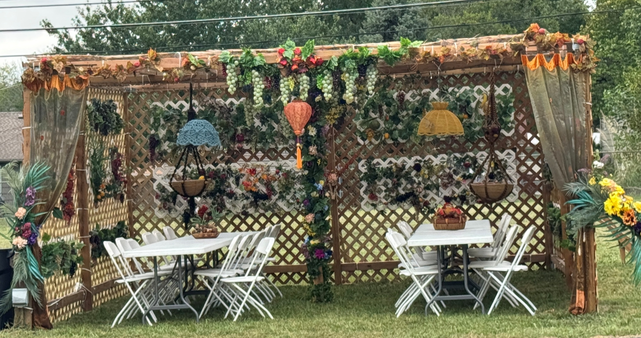
Notes:
Great thanks to all the men who built
and women who decorated
the 2026 5787 Or HaOlam Sukkah.
Note the famous Kassie flowered pillar!

Slide 2
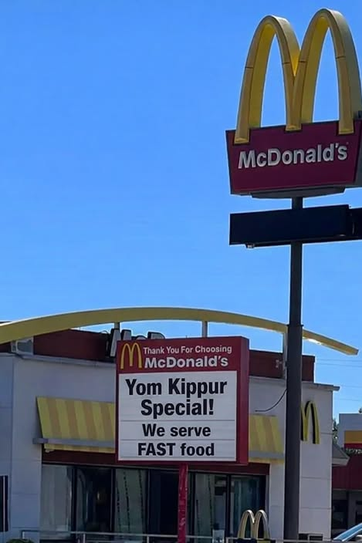
Notes:
From Amy Stewart

Slide 3
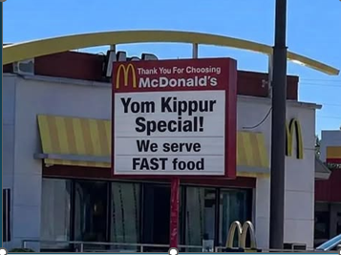

Slide 4
A breathtaking aerial installation titled “2,977 Lights Over New York Harbor” sent 2,977 illuminated drones into the night sky Wednesday, with each light representing one of the lives lost on 9/11.
Notes:
https://worthy.watch/2977-drones-recreate-twin-towers-over-new-york-in-powerful-9-11-tributeD

Slide 5
As seen in video of the tribute, the drones initially moved like a constellation above the harbor before assembling into the unmistakable outlines of the World Trade Center’s Twin Towers at full architectural scale.
Notes:
https://worthy.watch/2977-drones-recreate-twin-towers-over-new-york-in-powerful-9-11-tributeD

Slide 6

Notes:
https://worthy.watch/2977-drones-recreate-twin-towers-over-new-york-in-powerful-9-11-tributeD

Slide 7
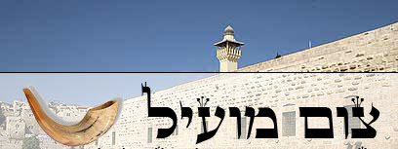
Tsom mo-eel ……..Profitable fast
Tsom Kal צום קל…Easy Fast
Notes:
מוֹעִיל effective, helpful, useful

Slide 8
Every Yom Kippur we chant this hauntingly beautiful Kol Nidre prayer that deeply engages the soul. Why?
Notes:
It’s sort of a cultural icon. Theme of the Kol Nidre prayer was the first talkie movie ever made.

Slide 9
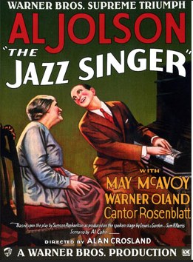

Notes:
1927
1952 remake Danny Thomas
1959 remake Jerry Lewis
Later Neil Diamond remake 1980

Slide 10
Full repentance and
Freedom and
Finality of the day.

Slide 11



Slide 12

Kabseni כַּבְּסֵנִי Wash me Ps 51.4
The goal of Yom Kippur
The content of Yom Kippur
The deliverance of Yom Kippur
Notes:
Jeremy did a great teaching on the HOW of Yom Kippur. How to repent.
This teaching will focus on the WHAT of Yom Kippur, what to repent of.

Slide 13
Kabseni כַּבְּסֵנִי Wash me Ps 51.4
The goal of Yom Kippur
The content of Yom Kippur
The deliverance of Yom Kippur

Slide 14
The goal of the day:

Slide 15
^{Vayikra/Lev.16.21-22} Aharon is to lay both his hands on the head of the live goat and confess over it all the transgressions, crimes and sins of the people of Isra’el; he is to put them on the head of the goat
Notes:
All the sins?? All of it. Huge list, hence our liturgical confessionals.

Slide 16

Notes:
Note three key words:
Avon עוון
Pesha פשע
Khatta חטא

Slide 17
^{Vayikra/Lev.16.21-22} and then send it away into the desert with a man appointed for the purpose. The goat will bear all their transgressions away to some isolated place, and he is to let the goat go in the desert.

Slide 18
פֶּשַׁע pesha crime, transgressions, rebellion, rebellious act, breach of trust, felony
עָווֹן avon
sin, transgression ; (criminal law) misdemeanor, iniquity, trouble, offence

Slide 19
חָטָאתִי khatati
sin, transgress, miss

Slide 20
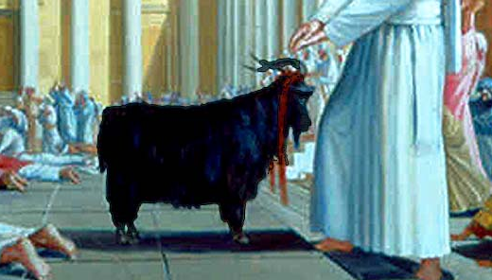
Notes:
THE CONFESSION
"I beseech You, O Lord;
Grant atonement for the sins,
and for the iniquities and transgressions
which the entire house of Israel
has committed against You,
As it is written in the Torah
of Your servant, Moses:
'For on this day
atonement shall be made for you,
to purify you from all your sins
- before the Lord you shall be purified'."
As above, the congregation responds with the words "Blessed be the Name of His glorious kingdom, for ever and ever."

Slide 21
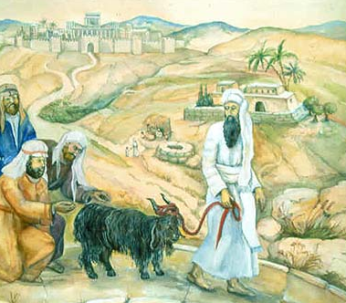
Notes:
ACROSS THE BRIDGE
After confessing for Israel, the High Priest gives the scapegoat into hands of the individual who had been designated to lead it into the desert. This, too, was considered a great privilege. Even though it is not an intrinsic part of the service and therefore could even be done by an Israelite, it was customarily safeguarded within the priestly ranks.

Slide 22
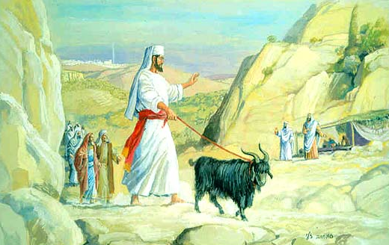
Notes:
The Mishna records that the distance between Jerusalem and the desert cliff was 12 miles.

Slide 23
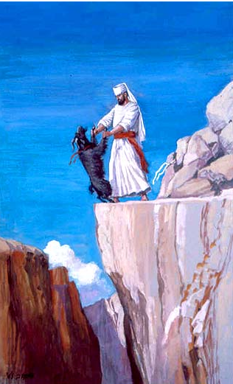
Notes:
THE SCAPEGOAT DIES
Arriving at the cliff, the priest removes the crimson wool that the High Priest had tied to the scapegoat's horns. He divides it into two pieces; one piece he reties once again to the animal's horns, and the second, to a rock. This is so that he will also be able to see when the crimson color has turned white, and know that atonement has been made for Israel's sins. Then he pushes the goat backward with his two hands.

Slide 24
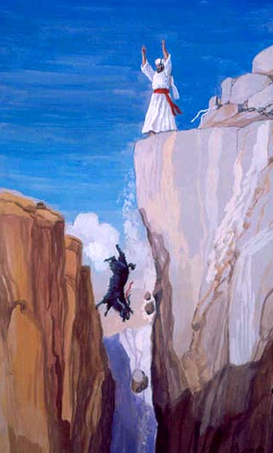
Notes:
Great celebration if cord red → white

Slide 25
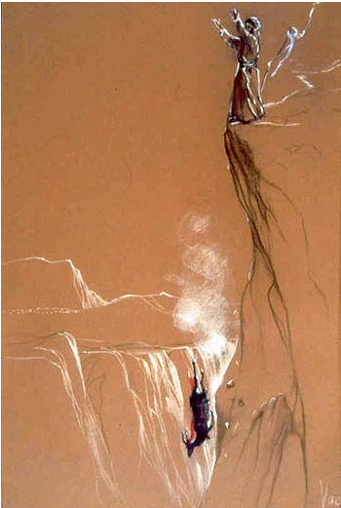
Notes:
THE SCOUTS' SIGNALS
Back inside the Holy Temple, after having delivered the scapegoat into the hands of his colleague, the High Priest must wait to receive word that the scapegoat has reached the desert, for he is not permitted to begin the next stage of the day's service until then. In addition to the miracle of the crimson wool on the Sanctuary turning white, this information reached the Temple another way as well: scouts were positioned at high points all along the route to the cliff.
All the sins gone!!

Slide 27
Kabseni כַּבְּסֵנִי Wash me Ps 51.4
The goal of Yom Kippur
The content of Yom Kippur
The deliverance of Yom Kippur

Slide 28
Full repentance
and Freedom

Slide 29

^{T’hillim / Ps 139.23-24} Examine me, God, and know my heart; test me, and know my thoughts. See if there is in me any hurtful way, and lead me along the eternal way.
Notes:
Whom have we hurt!?!?

Slide 30
עֹצֶב otsev evokes inward ache that arises from wounding, toil, or grief and may surface as a “hurtful way” (Psalm 139:24) or the physical and societal misery imposed by oppressive powers (Isaiah 14:3).

Slide 31
עֹצֶב otsev Though rooted in personal experience, the term readily broadens to corporate suffering and ultimately to the universal burden of sin’s consequences.

Slide 32
^{T’hillim / Ps 90.8} You have set our iniquities before You, our secret sins in the light of Your presence.

Slide 33
Yeshua: ^{Mtt 6.11-12} Give us the food we need today. Forgive us what we have done wrong, as we too have forgiven those who have wronged us.
Notes:
Yeshua is anticipating, urging us to pray and repent and forgive DAILY for our sins.

Slide 34
David’s confession: when Natan the prophet came to him after his affair with Bat-Sheva:
Notes:
Not on Yom Kippur, but at a time of failure.
To Yeshua’s standard, every day has some greater or lesser failure!

Slide 35
^{T’hillim / Ps 51} Be gracious to me, O God, according to Your mercy. According to Your great compassion blot out my transgressions. Wash me thoroughly from my iniquity and cleanse me from my sin. For I know my transgressions and my sin is ever before me.

Slide 36
^{T’hillim / Ps 51.7-14} Behold, I was born in iniquity and in sin when my mother conceived me. Surely You desire truth in the inner being. Make me know wisdom inwardly. Cleanse me with hyssop and I will be clean. Wash me, and I will be whiter than snow.

Slide 37
^{T’hillim / Ps 51.7-14} Let me hear joy and gladness, so the bones You crushed may rejoice. Hide Your face from my sins, and blot out all my iniquities. Create in me a clean heart, O God, and renew a steadfast spirit within me.

Slide 38
^{T’hillim / Ps 51.7-14} Do not cast me from Your presence— take not Your Ruach ha-Kodesh from me. Restore to me the joy of Your salvation and sustain me with a willing spirit.

Slide 39
Solu version:
Notes:
And often happens to me, a worship song opened up a message first to myself, then to present to you.

Slide 40
Be gracious to me God according to Your steadfast love.
According to Your great compassion blot out my transgressions.
For I acknowledge my transgressions and my sin is always before me.

Slide 41
With a broken spirit I cry out.
Wash me Kabseni כַּבְּסֵנִי clean from my iniquity, from my sin purify me
A clean heart create in me Oh God A right spirit renew within me.

Slide 42
This sin is so overwhelming my soul is tiring out
Draining my strength to the point of giving up
So, if you don’t intervene, I will be broken.
Help me Oh Lord, I’m crying out.
Notes:
Note the desperation of the wording!!

Slide 43
A clean heart create in me God.
A right spirit Renew within me,
Father

Slide 44
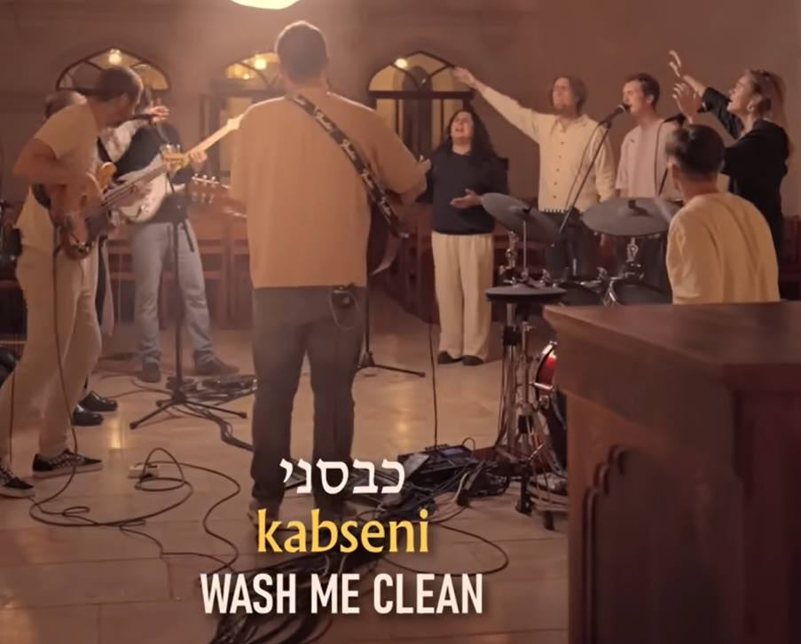

Slide 45
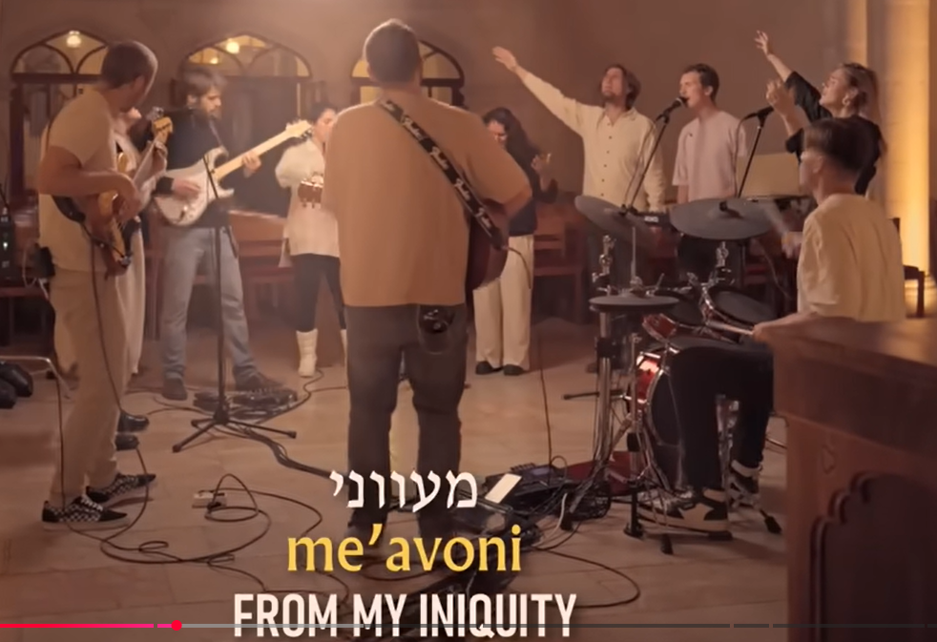

Slide 46
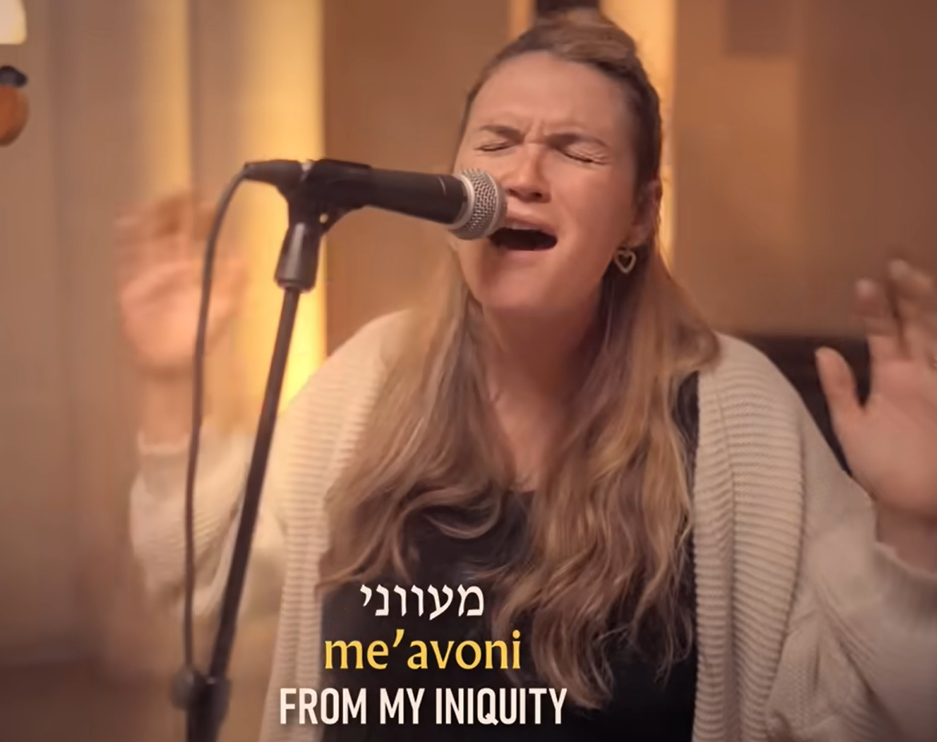
Notes:
Play clip

Slide 47
Why these young people?
Why such dramatic, desperate prayer?
Notes:
We all personally know these kids, to a greater or lesser extent. They were here on our property. We’ve talked, visited, eaten with them. They are upright, worshipful, spouses, fathers, mothers, IDF soldiers.

Slide 48
From the Ruakh as well as I can tell anything, for this evening:
We tend to be superficial, perfunctory, with our confessions.
There is a prototype here, a pattern for real desperate inner repentance.

Slide 49
With a broken spirit I cry out.
Wash me Kabseni כַּבְּסֵנִי clean from my iniquity, from my sin purify me
A clean heart create in me Oh God A right spirit renew within me.

Slide 50
This sin is so overwhelming my soul is tiring out
Draining my strength to the point of giving up
So, if you don’t intervene, I will be broken.
Help me Oh Lord, I’m crying out.
Notes:
Note the desperation of the wording!!

Slide 51
A clean heart create in me God.
A right spirit Renew within me,
Father
Notes:
Consider several topics with desperation. This is more than a bit personal, transparent.

Slide 52
Long suffering
^{1 Cor 13.4 NKJV} Love suffers long and is kind.
It’s so easy to enter a victim mentality.
Focus on pain received
Minimize pain given
Notes:
Sorry for self, discouraged, depressed [not minimizing real clinical depression]
Think of the wounds we GIVE, “Hurt people hurt people.

Slide 53
^{T’hillim / Ps 139.23-24} Examine me, God, and know my heart; test me, and know my thoughts. See if there is in me any hurtful way, and lead me along the eternal way.
Notes:
Dawn and me, lots of issues to work out, many differences in life approach, many counselors over 53 years. Many issues solved. Some are just fundamental differences. Some issues we just don’t resolve!!
We have come to a GREAT conflict diffuser for issues we cannot resolve. A phrase that I HIGHLY recommend to all couples. This may seem trivial, but it’s really deep and powerful.
Take your beloved by the hand, look into her / his eyes, and say:
“Oh, the things you make me suffer.”
Saying it doesn’t resolve the issue. After that, all the friction just seems funny. We laugh and love.

Slide 54
^{1 Kefa 5.8-11} Stay alert! Watch out! Your adversary the devil prowls around like a roaring lion, searching for someone to devour. Stand up against him, firm in your faith, knowing that the same kinds of suffering are being laid upon your brothers and sisters throughout the world.

Slide 55
^{1 Kefa 5.8-11} After you have suffered a little while, the God of all grace—who has called you into His eternal glory in Messiah—will Himself restore, support, strengthen, and establish you. All power to Him forever! Amen.

Slide 56
Notes:
Think about the things you get offended and mad and depressed about rather than suffer.
Suffering is for our good and growth.

Slide 57
Notes:
Play clip

Slide 58
Ingratitude, feelings of rejection, of calamity.
^{1 Thes 5.16-18} Always be joyful. Pray regularly. In everything give thanks, for this is what God wants from you who are united with the Messiah Yeshua.

Slide 59
^{Phil 4 4-6} Rejoice in union with the Lord always! I will say it again: rejoice! Let everyone see how reasonable and gentle you are. The Lord is near! Don’t worry about anything; on the contrary, make your requests known to God by prayer and petition, with thanksgiving.

Slide 60
Mark 12.31 Yeshua quoting Lev 19.18 You are to love your neighbor as yourself.
וְאָהַבְתָּ לְרֵעֲךָ כָּמוֹךָ:
Notes:
One of my kids said to me that I was a needy guy. I’ve spent much time and prayer trying to understand what he meant,
I am a people pleaser. I HATE rejection. Love to give and receive comfort. That is why, early in the history of Or HaOlam, my leaders recommended a Benevolence Committee. When someone comes to me with a need, my sympathy engages, but NOT necessarily analytic intervention. Ask the hard questions. Say, “No.” Benev committee analyzes, and I am the nice guy.
Confrontation: not avoider, but delayer.
Recently, this word כָּמוֹךָ as yourself, has really hit me.

Slide 61
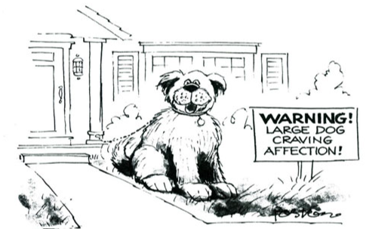
Notes:
Me, and Coco Puff
Saving this cartoon since 2007 to use.

Slide 62
Do you walk in this sense from Yeshua, not pride, of walking in love and acceptance
“as yourself כָּמוֹךָ" ??

Slide 63
Otherwise, it’s easy to have
^{Eph 4.31-32} Bitterness, rage, anger, violent assertiveness and slander, along with all spitefulness. Instead, be kind to each other, tenderhearted; and forgive each other, just as in the Messiah God has also forgiven you.
Notes:
This is NOT my problem but one of the causes of porn use is emotional distraction or suppression – using pornography to avoid negative relational emotions such as sadness, anxiety, or stress.
https://truthaboutporn.org/study/why-do-people-watch-pornography-the-motivational-basis-of-pornography-use/
That is, the models on screen don’t reject you.

Slide 64
Notes:
Think about the things you DON’T feel thankful for. Things that make you feel belittled, rejected.

Slide 65
Notes:
Play clip

Slide 66
Arrogance
^{Yaakov 1.19} Therefore, my dear brothers, let every person be quick to listen but slow to speak.
Notes:
NYC quick to talk, to interrupt. HEAR.

Slide 67
^{Iyov/Job 2.11-13} Now when Iyov’s three friends heard of all the calamities that had overwhelmed him, they all came…They had agreed to meet together in order to come and offer him sympathy and comfort…

Slide 68
^{Iyov/Job 2.11-13} They wept aloud, tore their coats and threw dust over their heads toward heaven. Then they sat down with him on the ground. For seven days and seven nights, no one spoke a word to him; because they saw how much he was suffering.

Slide 69
^{Iyov/Job 8.1-4} Bildad the Shuchi spoke next: “How long will you go on talking like this? What you are saying is raging wind! Does God distort judgment? Does Shaddai pervert justice? If your children sinned against him, he left them to be victims of their own offense.
Notes:
Do you give quick advice w/o hearing??

Slide 70
Notes:
Think about the things you DON’T feel thankful for. Things that make you feel belittled, rejected.

Slide 71
Notes:
Play clip

Slide 72
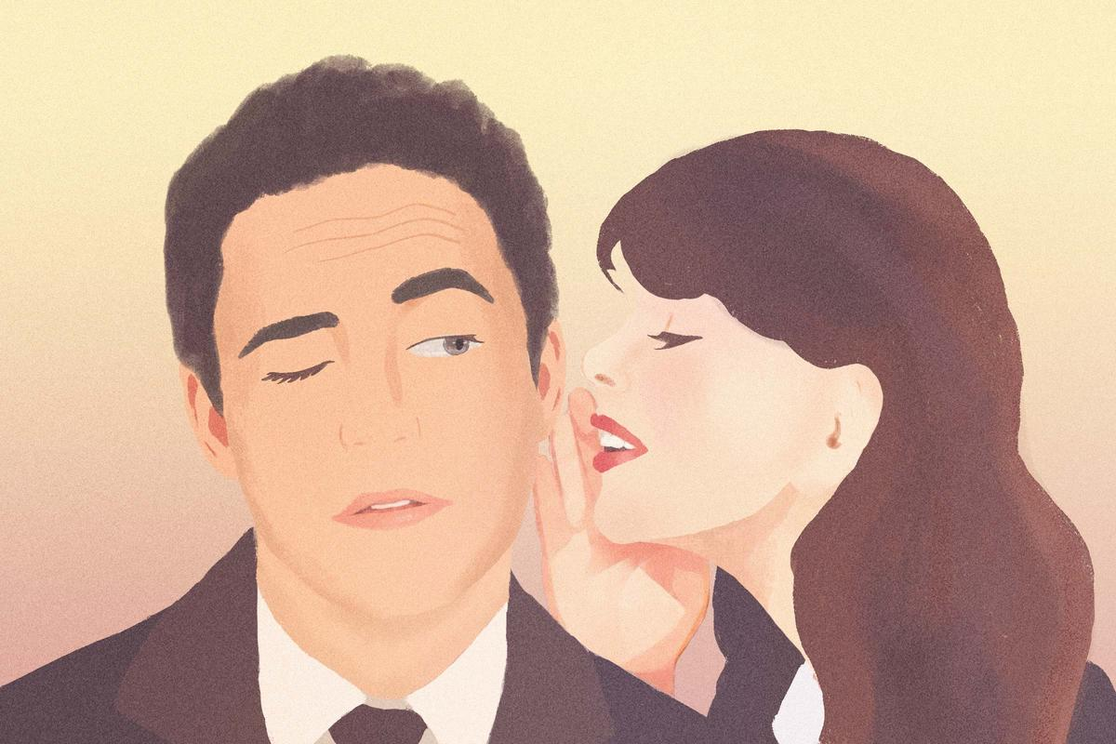
The Poisonous Power of Gossip
Notes:
I’ve been accused of absurd things, and because I am a people pleaser, I responded as if the accusation had substance and I needed to substantiate my innocence. What I should have said was, Why do you say that? Who have you listened to?
https://www.theepochtimes.com/opinion/the-poisonous-power-of-gossip-6085179?utm_source=Bright&src_src=Bright&utm_campaign=bright-2026-09-19&src_cmp=bright-2026-09-19&utm_medium=email&est=kbj%2BnMw0fOBaTjyOJjEKjc4NUQDnefSTlqIGlxk23ccy9Oref%2F%2BteOSZEcCflM4urQ%3D%3D

Slide 73
What makes gossip so dangerous is that it does not have to be true to be effective. A lie repeated often enough can begin to feel like common knowledge. A suspicion whispered by one person can become a verdict pronounced by many.
Notes:
https://www.theepochtimes.com/opinion/the-poisonous-power-of-gossip-6085179?utm_source=Bright&src_src=Bright&utm_campaign=bright-2026-09-19&src_cmp=bright-2026-09-19&utm_medium=email&est=kbj%2BnMw0fOBaTjyOJjEKjc4NUQDnefSTlqIGlxk23ccy9Oref%2F%2BteOSZEcCflM4urQ%3D%3D

Slide 74
By the time the truth finally appears, the damage may already be permanent: a reputation destroyed, a friendship broken, a family divided, or a career derailed.
Notes:
https://www.theepochtimes.com/opinion/the-poisonous-power-of-gossip-6085179?utm_source=Bright&src_src=Bright&utm_campaign=bright-2026-09-19&src_cmp=bright-2026-09-19&utm_medium=email&est=kbj%2BnMw0fOBaTjyOJjEKjc4NUQDnefSTlqIGlxk23ccy9Oref%2F%2BteOSZEcCflM4urQ%3D%3D

Slide 75
Notes:
Think about the things you DON’T feel thankful for. Things that make you feel belittled, rejected.

Slide 76
Notes:
Play clip

Slide 78
Kabseni כַּבְּסֵנִי Wash me Ps 51.4
The goal of Yom Kippur
The content of Yom Kippur
The deliverance of Yom Kippur
Notes:
Longsuffering: if can’t fix, discouraged, angry
Ingratitude and seeking approval instead of giving
Arrogance: all the answers instead of listening
Gossip

Slide 79
^{Ro 2.4} The goodness of God leads you to repentance.

Slide 80
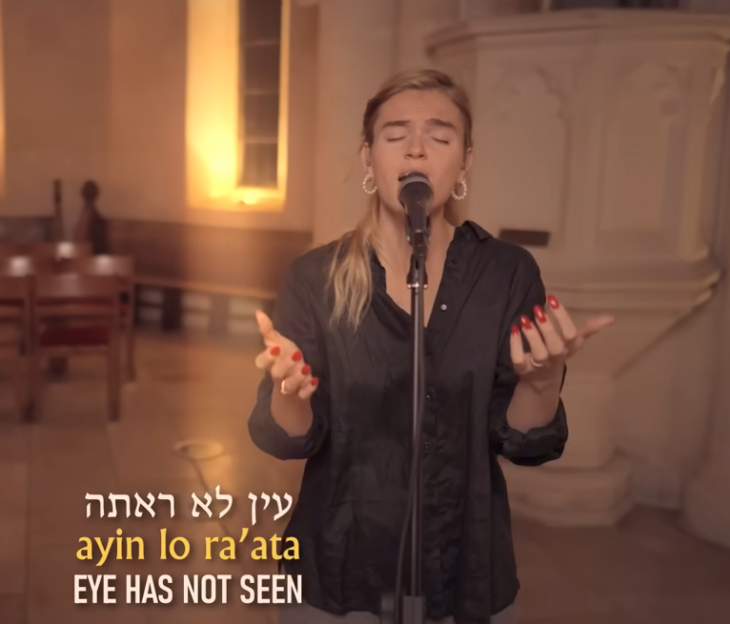

Slide 81
Eye has not seen ear has not yet heard
Beauty for ashes who would have believed?
A father like this who turns the world upside down
A son who is ready to lay down His life
The Holy Spirit dwelling within us

Slide 83
Kabseni כַּבְּסֵנִי Wash me Ps 51.4
The goal of Yom Kippur
The content of Yom Kippur
The deliverance of Yom Kippur

